Slide 1
Who has the power??

Slide 2
CHAMPs
C- Level 1
H-Ask 3 before me, then raise your hand
A-Working with your partner on the Who has the power activity
M-None without permission
P-working quietly with your partner, staying on task and in your seat
S-Success!

Slide 3
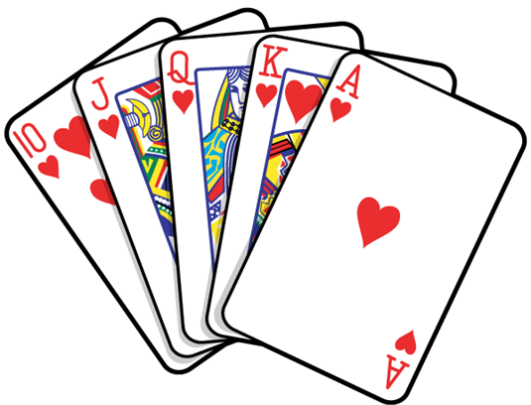
Cards
Each pair will have a deck of 10 cards, which are worth 2 points each. You start with 20 points.
If I have to remove a card, your group loses 2 points (18, 16, 14…).
Reasons I may need to remove a card include:
Talking above a level 1 (whisper) Remember, they shouldn’t heard you next door.
Talking off topic (I want to hear about your Who has the power activity only).
Working on another assignment/being off-task.
Being out of your seat
Touching the cards (unless they fall).

Slide 4
1. Who is going to keep people safe from speeding cars (speed limits)?
Government Level
Power
Local
Local

Slide 5
2. Who is going to protect us from foreign invasion or threats?
Government level
power
Federal
Enumerated

Slide 6
3. There is a pothole in the street outside my house. Who should I talk to?
Government Level
Power
Local
Local

Slide 7
4. A group of people want to establish a new city. Who should they talk to?
Government Level
Power
State
Reserved

Slide 8
5. Who decides who might get married legally?
Government Level
Power
State
Reserved

Slide 9
6. Who resolves conflicts between states?
Government Level
Power
Federal
Enumerated/Delegated

Slide 10
7. My garbage hasn’t been picked up in two weeks, who do I talk to about this issue?
Government Level
Power
local
local

Slide 11
8. Who makes sure that the country’s economy is safe and stable?
Government Level
power
federal
Enumerated/delegated

Slide 12
9. My taxes keep going up! Who can I talk to about this?
Government Level
Power
Federal, state, local
Concurrent

Slide 13
10. Who is in charge of passing laws around here?
Government level
power
Federal, state, local
concurrent

