Slide 1
The Road to the revolution

Slide 2
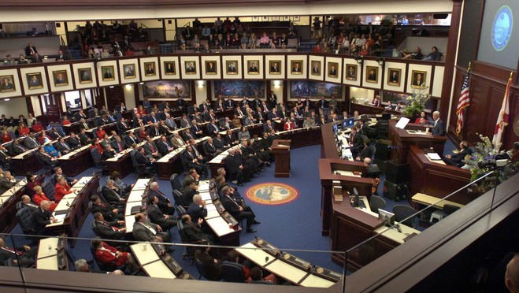
I can define:
Boycott
refusal to buy or use goods or services
Repeal
To cancel a law
Goods
merchandise or objects for sale or trade
Legislature
governing body responsible for making laws

Slide 3
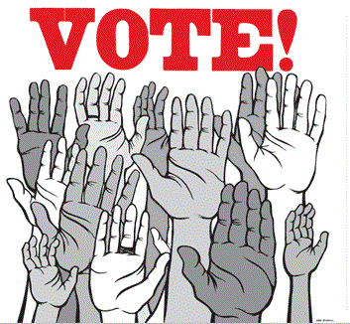
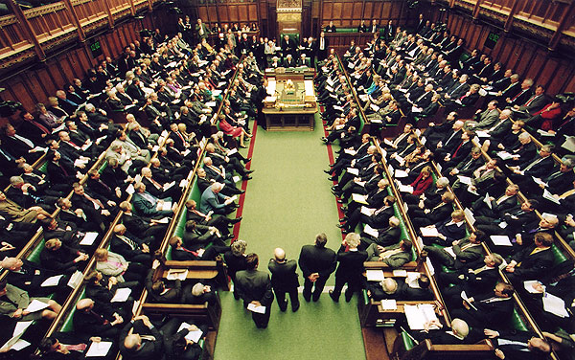
Parliament
the name of the English legislature
Representation
a person or group acting on behalf of another person or group
Grievances
complaint about a concern
Taxation
Money government collects from citizens to pay for public services (roads, schools, debts)

Slide 4
= Anything that supports limited government.

Slide 5
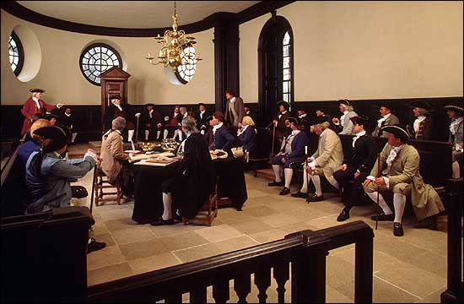
= Anything that explains how the colonies were governed.
What form of government did the Virginia Colony have?
What form of government did the Plymouth Colony have?

Slide 6
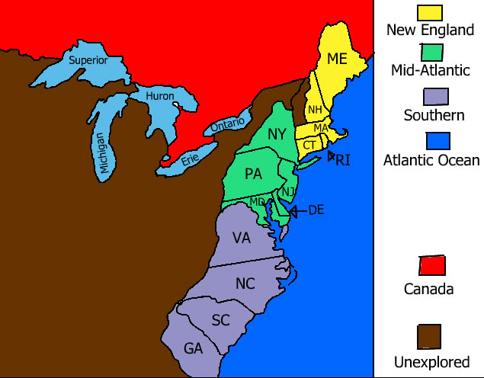
= Examples of how the colonists were independent and didn’t need the king or parliament.

Slide 7
_______ = Any unfair practices by the English government.
Think back to your response from yesterday’s FOCUS work. Can you see any connections yet?

Slide 8
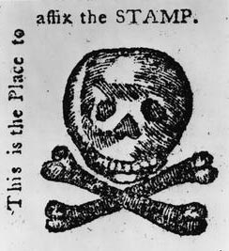
The colonists created their own version of the stamp as an act of rebellion. They refused to pay for the stamp and instead used this one as an act of opposition.
Anything that explains why the British needed money.
________ = How the British decided to find the money to pay off their debts.
= The colonists’ reaction to the British decision.
Next to the British response

Slide 9
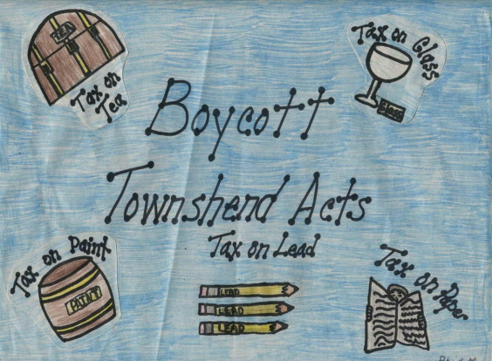
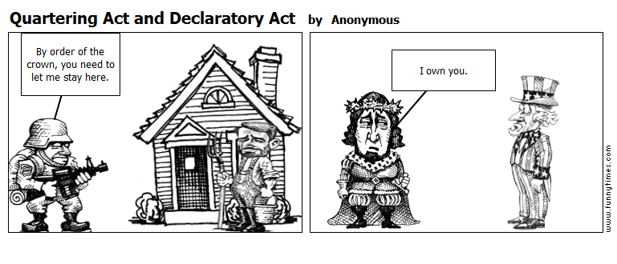
Which Act took the power of self-government away
Which Act limited the right to due process
______ Which Act was an invasion of privacy in their home

Slide 10
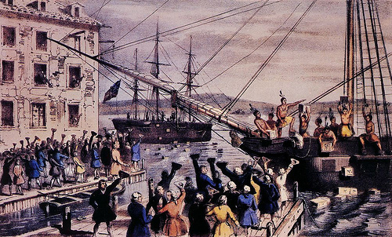
______ = An Enlightenment Principle
= What we had to do in order to make the freedom real

Slide 11
Write-Pair-Share:
Explain how the relationship between England and the colonies became strained.

Slide 12
The colonists’ reasons for declaring independence can be summarized into three main themes: individual rights, taxation and representation. Individual rights are rights guaranteed to a person. Colonists believed that King George III and the Parliament limited the colonists’ individual rights by the laws that they passed and their reactions to colonial grievances (complaints). Colonists believed that their rights were limited by being taxed on different goods and services while these taxes did not benefit the colonies. They also believed that their rights were limited because their interests were not represented in the Parliament and because their ability to govern themselves in the colonies was taken away.

Slide 13
The English taxed goods and services used by the colonists as a way to pay off the debt that resulted from the French and Indian War. Colonists believed this taxing was unfair because the tax money went directly to England, instead of the money returning to the colonies. The colonists also believed the taxes were unfair because the colonies were not represented in Parliament. Colonists believed that taxation without representation was wrong.

Slide 14
A lack of representation was another main concern, specifically colonists’ views and opinions being represented in Parliament and the colonists’ ability to represent themselves in colonial governments. Colonists were not represented in Parliament and therefore their interests or opinions were not considered when laws were passed and other decisions made. Over time, the colonists’ right to govern themselves was taken away when Parliament declared that the English had the highest authority to govern the colonies and when Parliament ended some colonial governments and put members of Parliament in charge.

Slide 15
According to the reading, in what ways did the colonists believe their rights were being limited?
The colonists believed their rights were being limited because of the laws that were being passed and the reaction the King and Parliament had to colonial grievances. They also felt that their rights were being limited because they were being taxed and the money didn’t benefit the colonies. Their right to be represented was also taken away.

Slide 16
According to the reading, why was taxation a major problem for the colonists?
According to the second paragraph, taxation was a major problem for the colonists because the money was not used to benefit the colonies and they were not represented in Parliament.

Slide 17
What effect did not having representation in Parliament have on the colonists?
The colonists didn’t have anyone to represent their needs in Parliament, so when a law was passed, their interests or opinions were not considered.

Slide 18
How were the colonists’ right to self-government taken away by Parliament?
According to the third paragraph, the colonists’ right to self-government was taken away when the Parliament decided that the English government was the highest authority over the colonies and even ended colonial governments.

Slide 19
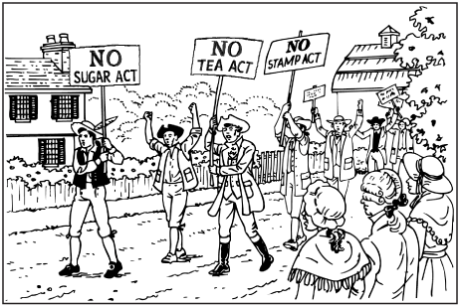
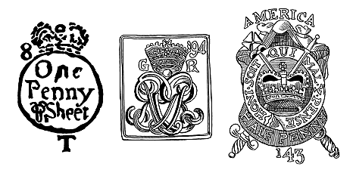
I can explain the connection between boycotting and parliament’s repeal of an act.
Colonists would boycott British goods to show their disapproval to try and make parliament repeal acts that were created. Parliament would then create a new act that caused more colonial concerns.

Slide 20
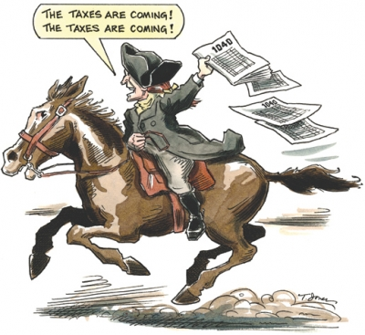
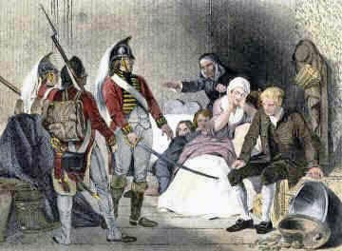
I can explain the colonists’ 3 main concerns about British policies:
Taxation – British began taxing colonists on sugar, paper products and tea. The colonists felt the taxes were unfair.
Examples: Stamp Act, Townshend Act
Representation – Colonists felt if they had no representation in parliament, their interests or opinions were not being considered.
Individual rights – Rights were violated by restricting activities of the colonist, ending trade, taxing them unfairly, eliminating jury trials, and quartering soldiers.
Examples: Quartering act, Intolerable(Coercive) Acts

Slide 21
I can explain the meaning of the following colonial concerns:
“No Taxation without representation” :
The colonists felt they were being unfairly taxed because they had no one to represent their interests in parliament.

Slide 22
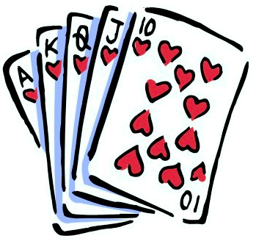
CHAMPs
C-Level 1
H-Raise your hand
A- Working with your partner in order to summarize and connect the events to the three themes of colonial concern.
M- Only with permission
P- Working quietly at a level 1 with only your partner on this assignment only. Working on only the assignment given.
S-Success!

Slide 23
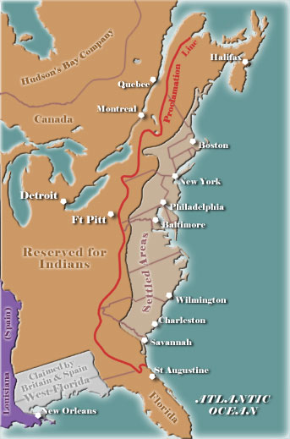
Event | Summary | Connection to Colonial Concerns: rights, taxation, representation
Proclamation of 1763 | The French and Indian War left England in debt, so they looked to the colonies for money. England banned the colonists from moving past the Appalachian Mountains, which angered them because they helped to win the land. | Right Representation

Slide 24
Event | Summary | Connection to Colonial Concerns: rights, taxation, representation
Writs of Assistance
Writs of Assistance were search warrants that allowed British officials to search the property of colonists. James Otis believed that the Writs of Assistance violated their rights.
Rights

Slide 25
Event | Summary | Connection to Colonial Concerns: rights, taxation, representation
Sugar Act
In order to pay off their war debts, the British Parliament passed the Sugar Act which added a tax to items such as sugar, wine, and coffee. The colonists were unhappy and boycotted the tax and the Parliament repealed it.
Rights
Representation
Taxations

Slide 26
Event | Summary | Connection to Colonial Concerns: rights, taxation, representation
Stamp Act
Parliament passed the Stamp Act which taxed all printed material. The colonists were mad that the money went straight to England and some colonists formed the Sons of Liberty group which boycotted English goods and sometimes used violence against the tax collectors. The colonists petitioned the King and Parliament asking that the tax be repealed because it violated their rights.
Rights
Representation
Taxation

Slide 27
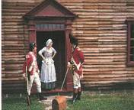
Event | Summary | Connection to Colonial Concerns: rights, taxation, representation
Quartering Act
The Quartering Act required colonists to house British soldiers in their homes. The colonists were suspicious and unhappy about the act because their approval was not asked.
Rights
Representation

Slide 28
Event | Summary | Connection to Colonial Concerns: rights, taxation, representation
Townshend Acts
The Townshend Acts put a tax on many goods the colonists bought from England. These taxes would increase the price of the goods the colonists had to buy. Sam Adams wrote a letter voicing the colonists’ concerns about unfair taxation without representation.
Rights
Representation
Taxation

Slide 29
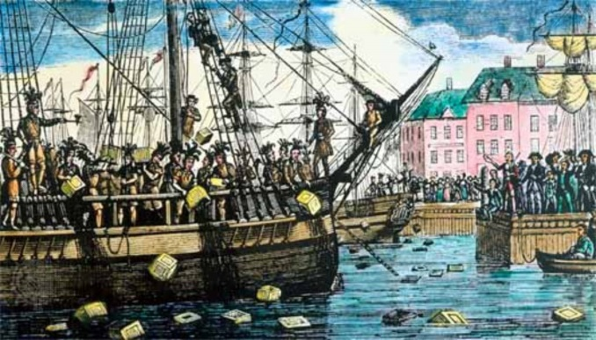
Event | Summary | Connection to Colonial Concerns: rights, taxation, representation
Tea Act
Parliament only allowed the British East India Company to import tea into the colonies. This meant the colonists could only buy tea from this company. In response, the colonists dumped hundreds of chests of tea into Boston Harbor in what’s known as the Boston Tea Party.
Rights
Representation

Slide 30
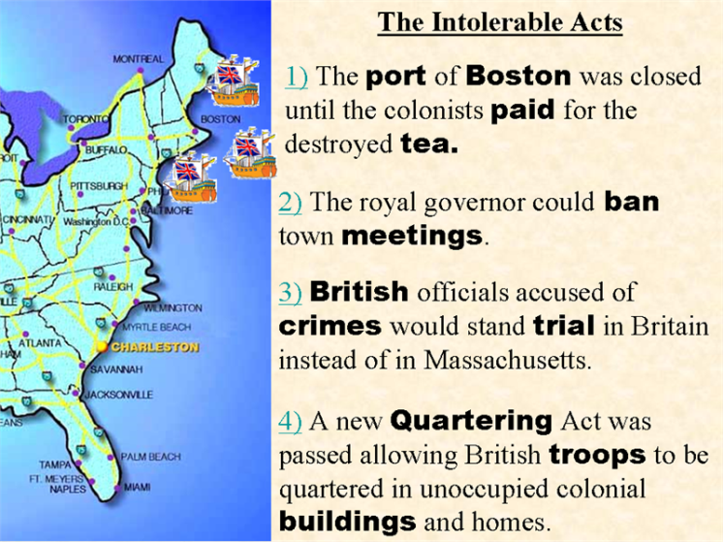
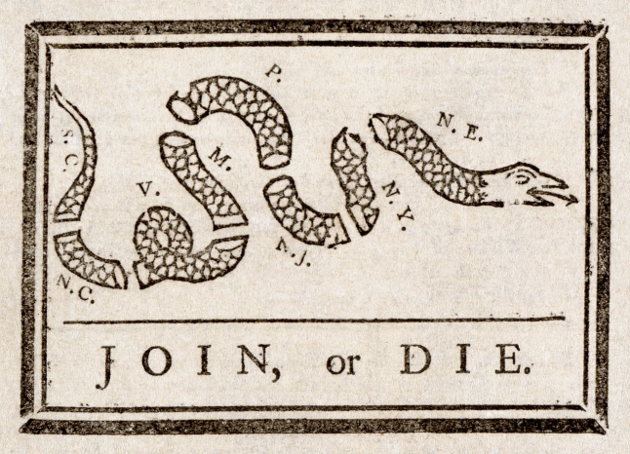
Event | Summary | Connection to Colonial Concerns: rights, taxation, representation
Intolerable Act
The British passed a series of laws in response to the Tea Party which the colonists called the Intolerable Acts. These laws shut down the port of Boston until the tea was paid for, put Massachusetts under military rule, allowed royal officials to go to trial in England, ended the colonial governments, and reinstated the Quartering Act. It also gave colonial land to Canada. In response, the colonists met at the First Continental Congress where they agreed to boycott England and began to form militias.
Rights
Representation

Slide 31
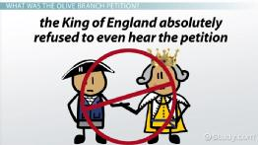
Event | Summary | Connection to Colonial Concerns: rights, taxation, representation
Lexington and Concord
Lexington and Concord became the first battles of the Revolutionary War. After the battles, the colonists met again in the Second Continental Congress and sent the King the Olive Branch Petition where they asked him to reach an agreement with the colonists in order to stop the fighting. The king refused to even read the petition and instead sent troops to end the rebellion.
Rights

Slide 32
Cause and Effect
Because…
Effects…
A. They were angry about the Stamp Act taxes.
B. The British government was too far away to deal with daily problems.
C. They were tired of the way the British were treating them.
D. He shared power with Parliament.
E. The colonists won the Revolutionary War.
F. They knew the colonists could not make those products themselves.
G. In England, the Parliament represented people in government.
H. It was in debt after fighting expensive wars.
____ 14. In the 1600s, the king could not just do what he wanted.
____ 15. The first colonists started their own governments.
____ 16. Colonists were used to having a say in government.
____ 17. Britain needed a way to make money.
____ 18. The colonists boycotted British goods.
____ 19. The British taxed paint, glass, and lead.
____ 20. The colonists declared independence.
____ 21. Britain lost control of the colonies.
D
B
G
H
A
F
C
E

