Slide 1
The Enlightenment
Colonial Influences

Slide 2
Mark the Text
Circle= Important People
Box= Important Ideas
Underline= Anything that explains those important ideas

Slide 3
A Time of New Ideas
In the 1700’s a movement developed in Europe called the Enlightenment. The Enlightenment was a period of time when people developed new ideas about peoples’ basic rights and how much control they should have over their government and their futures.
What ideas was the Enlightenment about?
  The Enlightenment was about people’s basic rights and how much control they should have over their government.

Slide 4
The Social Contract
If there was no government at all, people would live in a state of nature with no rules and complete freedom—but without any protection from each other, which means we could do whatever we wanted. One Enlightenment idea supported by John Locke, Montesquieu, Rousseau and Thomas Hobbes was the social contract. In a social contract, citizens agree to give up some freedom they would have in a state of nature (like the freedom to rob and kill people), and in exchange the government protects citizens’ right to life, liberty, and property. To Enlightenment thinkers, the relationship between a government and its citizens was like an agreement, or a contract. Citizens agree to obey a set of rules, and the government agrees to protect citizens’ rights.

Slide 5
How is the relationship between government and the people (“the social contract”) like an agreement? | Which Enlightenment Thinkers agreed with the Social Contract?
The people agree to give up some of their rights and the government agrees to protect their other rights.
Locke, Montesquieu, Rousseau, Hobbes

Slide 6
Natural Rights
Enlightenment thinkers like John Locke believed that human beings are born with fundamental, basic rights that no person can take away from you. These natural rights included the right to life, liberty, and property. Life refers to the fact that people want to live and will fight to survive. Liberty means that people want to be as free as possible to make their own decisions. Property represents the fact that people want to own things that help them survive, such as land, food, and tools. Locke believed these rights aren’t given to people—people are born with them. In order for people to enjoy these natural rights, other rights needed to be protected. Enlightenment thinkers believed people should have the right to express themselves, to move around freely, and to petition the government.

Slide 7
Explain Natural Rights In Your Own Words: | Which Enlightenment Thinker believed in Natural Rights? | List an example of a Natural Right:
Natural Rights are rights that you are born with and that can’t be taken away from you.
John Locke
Life, Liberty, Property-
Freedom of expression, freedom to petition/protest the government.

Slide 8
Consent of the Governed
Enlightenment thinkers like John Locke believed that governments had a responsibility to hold up their end of the social contract. If a government failed, then citizens would no longer agree to be governed and they would have the right to revolt. This idea is known as consent of the governed. Traditionally, a government protected citizens from foreign invaders, but the government also had absolute authority over the people. A king ruled his citizens whether they consented or not. To Enlightenment thinkers, this was unacceptable. Nowadays, citizens show approval or disapproval of their government by voting, petitioning the government, or peacefully protesting.

Slide 9
Explain Consent of the Governed in Your Own Words: | Which Enlightenment Thinker believed in Consent of the Governed? | List an example of how citizens show their consent (approval) or disapproval:
If the government doesn’t protect our rights like it agrees to under the social contract, then the people can rebel against the government.
Voting, protesting, petitioning the government
John Locke

Slide 10
Separate...
Montesquieu studied the laws, customs, and governments of European countries to see how they created and enforced laws. He admired the government of England. The English government had three parts: a king to enforce laws, Parliament to create laws, and courts to interpret laws. The government was divided into parts, or branches and each part had its own purpose and unique responsibilities. Today, our government is divided into three branches, the legislative (law-making), executive (law enforcer), and judicial (law interpreter). Montesquieu called this the separation of powers.

Slide 11
Explain the Separation of Powers in Your Own Words: | Which Enlightenment Thinker believed in Separation of Powers? | Explain how our government’s powers are separated:
The government is divided into parts and each part has its own job or purpose.
The three branches: Legislative, Executive, Judicial
Montesquieu

Slide 12
…but Equal
Dividing the powers of government was just the first step. Each part of the government needed to be balanced with the other parts. Montesquieu thought that each of the parts, or branches, of government should be equal. He worried that if one branch had more power than the others, people would suffer and lose their freedoms. To avoid this, he suggested that each branch have the ability to limit the power of the other two branches. For example, in the U.S, if Congress tried to pass a bill that the President didn’t like, he could veto, or refuse to sign the bill into law, but if Congress had enough votes, they could override the President’s veto, passing the law anyway. Today, we call this the system of checks and balances.

Slide 13
Explain Checks and Balances in Your Own Words: | Which Enlightenment Thinker believed in Checks and Balances? | List an example of how one branch of government can check the power of another:
A system our government has for limiting the power of the branches.
Montesquieu
The president can veto a bill passed by Congress so that it doesn’t become a law.

Slide 14
Influence on America
The brightest Enlightenment thinkers, with names like Rousseau, Montesquieu, and Locke, became very famous. They influenced leaders in Europe, and became popular with Americans who wanted independence. John Locke’s ideas of natural rights and consent of the governed helped to inspire Americans to break ties with England and had a large influence the Declaration of Independence.
When our Founding Fathers created a government for the new United States, they embraced many Enlightenment ideas. James Madison, the “Father of the Constitution,” liked Montesquieu’s idea that each branch of government should have a clear responsibility and that each branch should be able to limit the power of another so much that he included them in the U.S. Constitution. As a result, the U.S. Constitution clearly explains what each branch is supposed to do: Congress makes laws, the President enforces laws, and the Courts interpret laws. Each branch has the power to check, or limit, the other branches. This keeps all branches of government balanced and equal.

Slide 15
Enlightenment Thinker: | Which American Document Did he Influence?
John Locke
Montesquieu
Declaration of Independence
U.S. Constitution

Slide 16
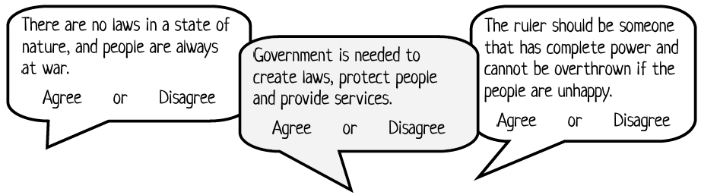
Think-Pair-Share
Agree or Disagree: Read each statement and determine if Locke would agree or disagree.

Slide 17
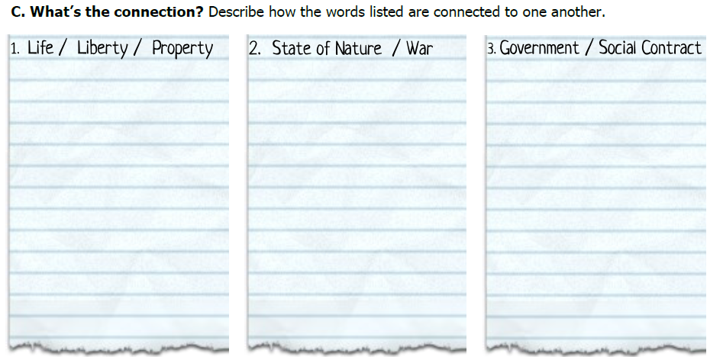
Life, Liberty, and Property are all examples of natural rights.
In a state of nature, or anarchy, people are constantly in a warlike situation where survival is key.
The social contract happens when people agree to give up some freedoms in order to have protection offered by laws and a government.

Slide 18
What was the Enlightenment?
The Enlightenment was a period of time when people developed new ideas about human existence, including peoples’ basic rights and the level of control they should have over their government and their futures.
Before this time, most countries were ruled under an absolute monarchy who had complete control over the government and citizens’ lives. It was pretty revolutionary (new) for people to demand rights and protection from their government.

Slide 19
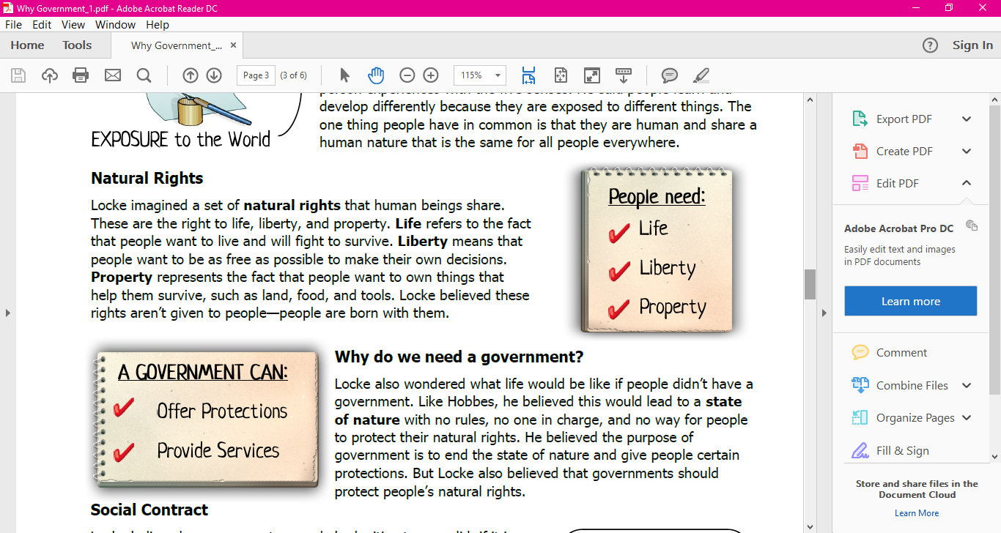
Social contract
An agreement between people and their government where citizens agree to give up some freedoms and in return, the government will protect them.
This idea was shared by Thomas Hobbes, Rousseau, John Locke, and Montesquieu.

Slide 20

John Locke’s Beliefs
Natural Rights: basic freedoms you are born with and shouldn’t be taken away
Synonyms: human rights, basic rights, civil liberties, civil rights, freedoms, individual liberties, equal rights
  Example: 1st amendment rights -freedom of speech, religion
Consent of the Governed: people show approval or disapproval of their government
If the government doesn’t do its job, we can change or get rid of it.
  Example: voting, petitioning the government or peaceful protest

Slide 21
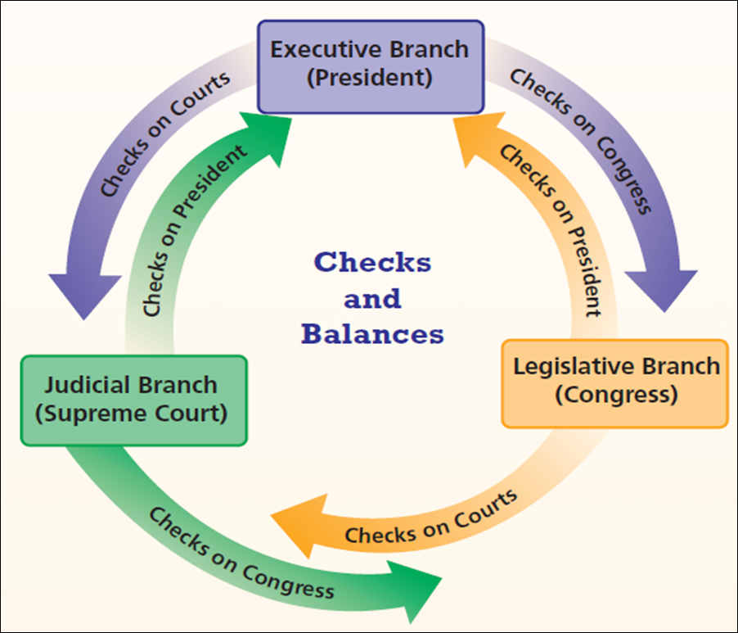
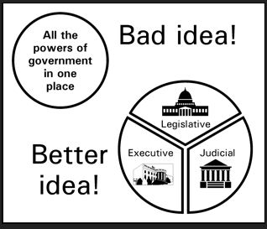
Montesquieu’s Beliefs
Separation of Powers: government power divided by three branches
  Example: legislative, executive, and judicial
Checks & Balances: how the branches limit each other’s power
  Example: president vetoing a bill

Slide 22
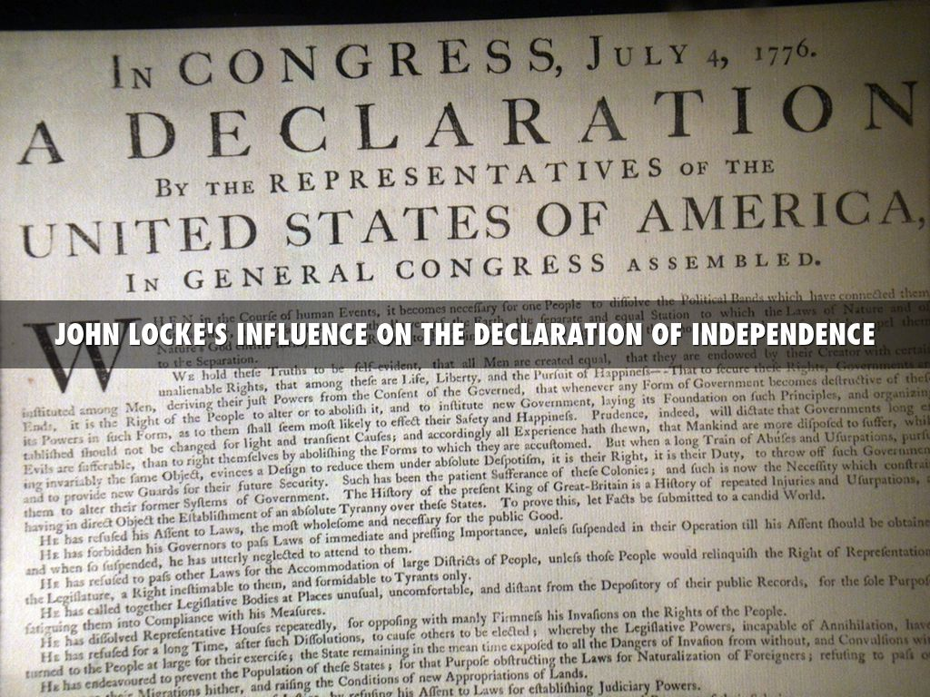
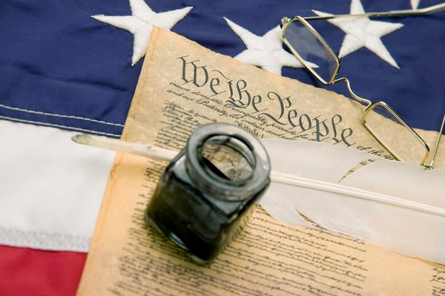
Which important documents did each thinker influence?
Locke:
  Declaration of Independence
Montesquieu:
  U.S. Constitution

Slide 23
“Being all equal and independent, no one ought to harm another in his life, health, liberty, or possessions.”
Locke

Slide 24
“For we cannot abuse power…power checks power.”
Montesquieu

Slide 25
“There is as yet no liberty if the power of judging be not separated from legislative power and the executive power.”
Montesquieu

Slide 26
“Men being, as has been said, by nature, all free, equal and independent, no one can be put out of this estate, and subjected to the political power of another, without his own consent.”
Locke

Slide 27
Would John Locke and Montesquieu agree or disagree with this quote:
“To avoid this state of war … is one great reason of men's putting themselves into society, and quitting the state of nature…”
Circle one: Agree or Disagree
Which Enlightenment idea is being discussed in the quote?
Social Contact

Slide 28
Put the number of the word in the right category.
Social Contact
State of Nature
Both
Natural Rights
Life
Liberty
Property
Government
No laws
Laws
Compromises are made
You are on your own!
Rights are protected
1
2
3
4
5
10
7
6
9
8

Slide 29
Excerpt from the Declaration of Independence | Summary of excerpt in your own words | Connection to the ideas of John Locke
We hold these truths to be self-evident, that all men are created equal, that they are endowed by their Creator with certain unalienable Rights, that among these are Life, Liberty and the pursuit of Happiness.
Governments are instituted among Men, deriving their just powers from the consent of the governed
…whenever any Form of Government becomes destructive of these ends, it is the Right of the People to alter or to abolish it…
A Prince whose character is thus marked by every act which may define a Tyrant, is unfit to be the ruler of a free people.
All men are created equal and all men have the right to life, liberty and the pursuit of happiness.
natural rights
Government gets its power from the approval of the people.
consent of the governed
They get their powers
It is the right of the people to change or end government if it fails them.
consent of the governed and social contract
A tyrant(dictator) is unfit to rule a free people.
natural rights

Slide 30
Enlightenment documents

Slide 31

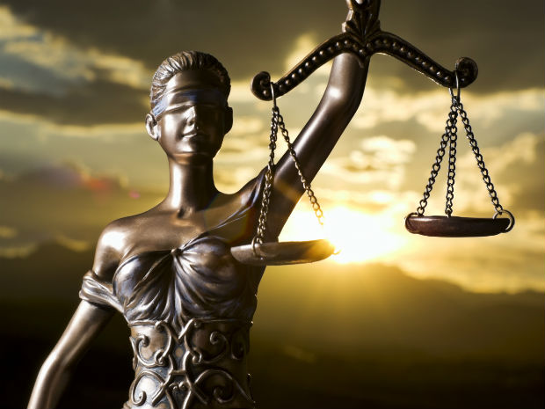
Important principles
Limited Government: A government that has been limited in power by a constitution, or written agreement.
Rule of Law: law applies to everyone equally, no one is above the law - not even government officials

Slide 32


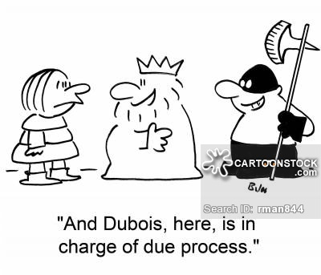
Due Process: People have the right to fair and reasonable laws. Officials have to follow rules when enforcing laws and need to treat all people in the same way.
Self-government: People can make decisions on how their government should work.
Rights: a set of things that people believe they should be free to do (privilege)

Slide 33
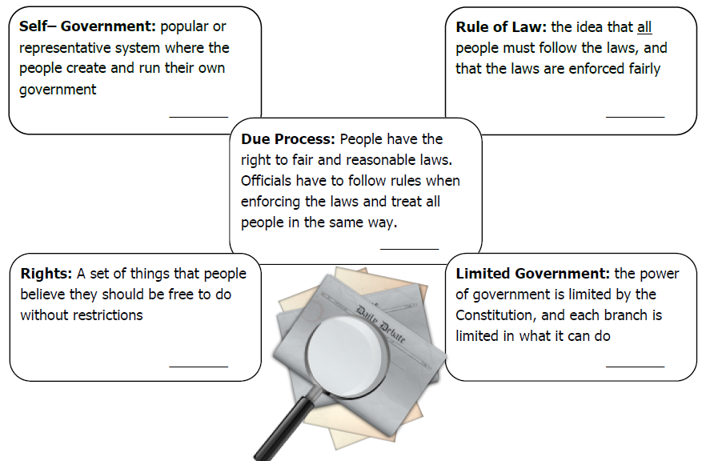
E
A
D
B
C

Slide 34
Marking the Text
= Name of the document
___________ = key words/phrases that might help to identify the purpose of the document
= Big Ideas/Principles of the Document

Slide 35
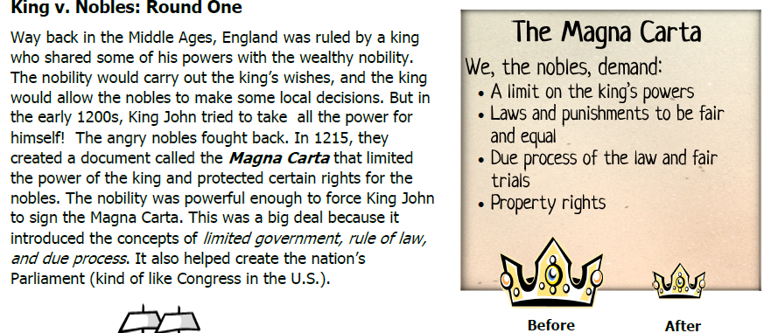

Slide 37
CHAMPs for Big Ideas Chart
C= Level 1
H= Raise your hand
A= Working with only your partner on the Big Ideas Chart using your reading
M= None without permission
P= Quietly working with only your partner on the Big Ideas Chart, remaining in your seat unless given permission to get up
S= Success!!!
Cards:
You have a deck of 10 cards
They are worth 2 points each = 20 total points
Each time I have to remove a card, you AND your partner lose 2 points
  Minus 1 card = 18 points
Ways to keep your cards:
  Stay in your seat
  Working only with your partner
  Staying at a level 1
  Staying on task (working only on this assignment)
  Keeping hands off of the cards

Slide 38
Which principles are found in these documents?
Magna Carta – limited government, rule of law, due process, rights
English Bill of Rights – rule of law, due process, rights, limited government
Mayflower Compact – self government, rule of law
Common Sense – rights, self-government

Slide 39
Which U.S. Document did these enlightenment documents influence?
Magna Carta Constitution
English Bill of Rights Bill of Rights
Mayflower Compact Constitution “We the people”
Common Sense Declaration of Independence

Slide 40
The Magna Carta influenced the colonists’ views on the purpose of government in three main ways. First, it helped to establish limited government in the United States through the three branches outlined in the U.S. Constitution. Each branch has the power to check or limit the power of the other two. The system of checks and balances keeps any one branch from getting too powerful. Second, like the Magna Carta, the U.S. Constitution is the law of the land and no one is above it. This is the idea of rule of law.

