Slide 1
The Declaration of Independence

Slide 2
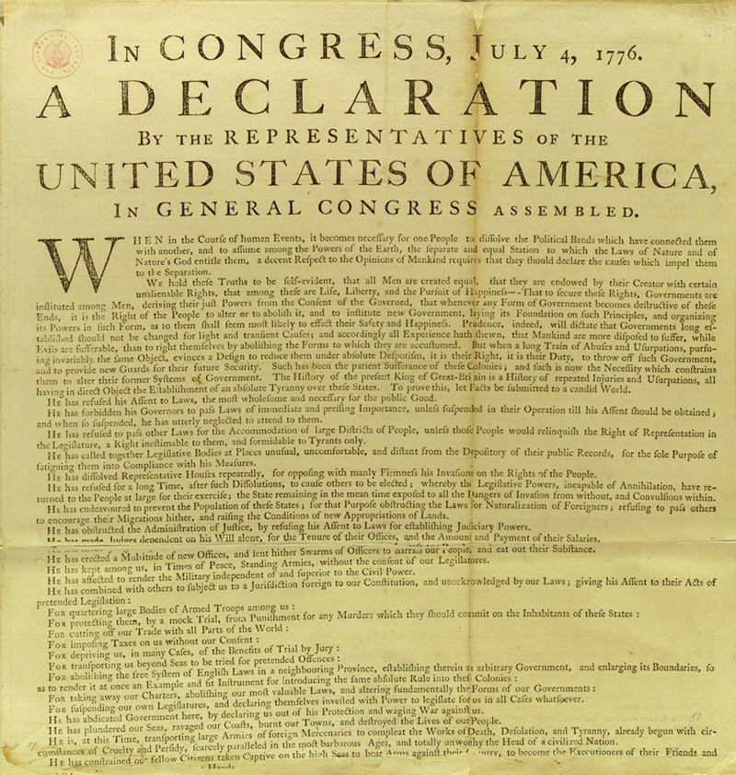
The most famous break-up letter in history

Slide 3
I can identify the five parts of the Declaration of Independence:
Preamble:
The introduction that explains why the DOI is being written
Statement of beliefs:
The colonists explain the rights of the people and the role of government power
“When in the Course of human events, it becomes necessary for one people to dissolve the political bands which have connected them with another, and to assume among the powers of the earth, the separate and equal station to which the Laws of Nature and of Nature's God entitle them, a decent respect to the opinions of mankind requires that they should declare the causes which impel them to the separation.” –Declaration of Independence
We hold these truths to be self-evident, that all men are created equal, that they are endowed by their Creator with certain unalienable Rights, that among these are Life, Liberty and the pursuit of Happiness.--That to secure these rights, Governments are instituted among Men, deriving their just powers from the consent of the governed, --That whenever any Form of Government becomes destructive of these ends, it is the Right of the People to alter or to abolish it, and to institute new Government

Slide 4
Grievances:
A list of all of the colonists’ complaints
Resolution:
Explains how the colonists have tried to alert the King/Parliament to the problem and avoid separation
“…He has kept among us, in times of peace, Standing Armies without the Consent of our legislatures.
…For cutting off our Trade with all parts of the world: …For imposing Taxes on us without our Consent: …For depriving us in many cases, of the benefits of Trial by Jury”- Declaration of Independence
“In every stage of these Oppressions We have Petitioned for Redress in the most humble terms: Our repeated Petitions have been answered only by repeated injury. A Prince whose character is thus marked by every act which may define a Tyrant, is unfit to be the ruler of a free people.”- Declaration of Independence

Slide 5
Declaration of Independence:
The colonists formally declare their independence from Britain
“… solemnly publish and declare, That these United Colonies are, and of Right ought to be Free and Independent States; that they are Absolved from all Allegiance to the British Crown, and that all political connection between them and the State of Great Britain, is and ought to be totally dissolved…” – Declaration of Independence

Slide 6
I can identify the natural rights expressed in the Declaration of Independence
Life
Liberty
The pursuit of happiness (property)
From where/whom did our Founding Fathers get these ideas about rights?
“We hold these truths to be self-evident, that all men are created equal, that they are endowed by their Creator with certain unalienable Rights, that among these are Life, Liberty and the pursuit of Happiness.”
-Declaration of Independence

Slide 7
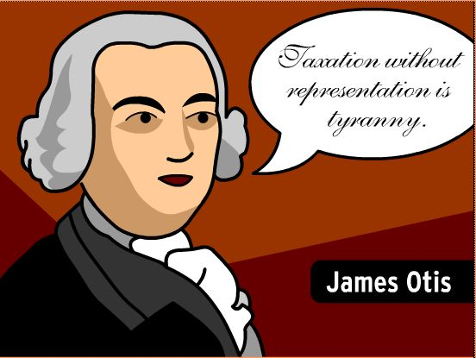
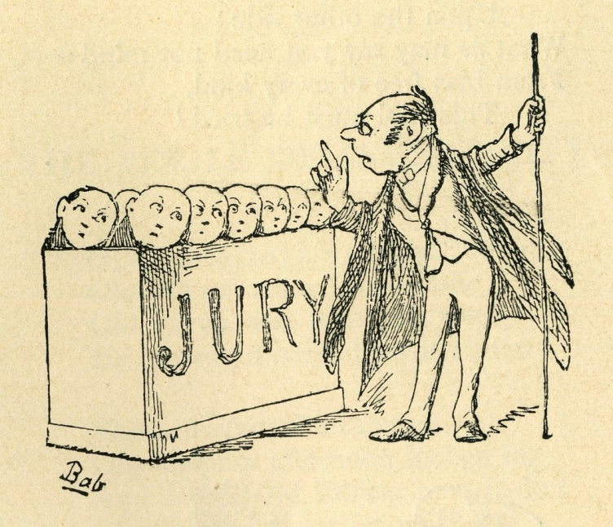
I can identify the complaints in the Declaration of Independence by putting them into my own words:
Imposing taxes without our consent of government
Forcing us to pay taxes without asking for our input
Suspending trial by jury and judicial powers
Eliminating equal and fair treatment in the courts and jury trials

Slide 8
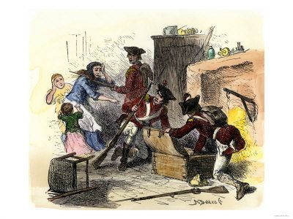
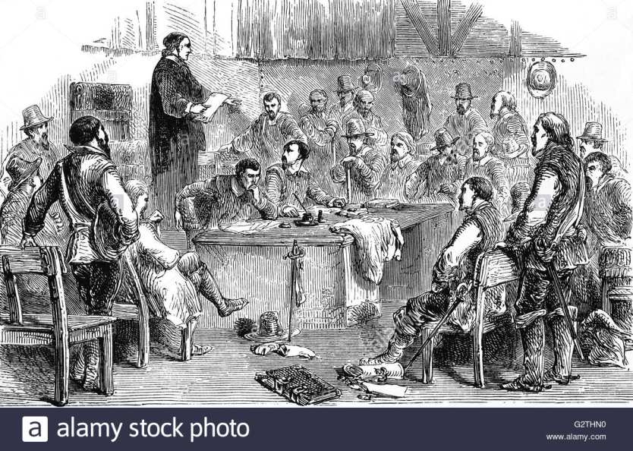
Quartering soldiers
Being forced to house soldiers
Dissolving Legislatures locally
Eliminating the right to govern themselves

Slide 9
I can explain the relationship between natural rights and the role of government
All men are created equal
Everyone should be treated the same under the law (rule of law, due process)
Endowed by our Creator with certain unalienable rights
Born with basic rights that cannot be taken away(natural rights)

Slide 10
Governments instituted among men to secure these rights
People create the government to protect their rights(social contract)
Government gets power from consent of the governed
People show their approval or disapproval of the government through actions (consent of the governed)

Slide 11
When government gets destructive, we can abolish or alter it
When the government does not protect our rights, we can get rid of it or change it (social contract)

Slide 12
CHAMPS
C- Level 1
H- Raise your hand
A- Match each piece of the Declaration with the section it belongs in. Write the evidence that matches with each section.
M- None without permission
P- Quietly working with only your partner to determine where each piece of the Declaration goes while staying in your seat
S- Success!

