Slide 1
State Power
Got a Reservation?

Slide 2
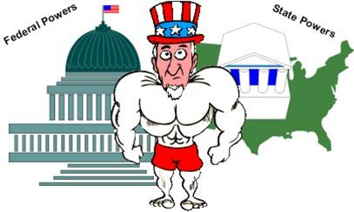
1. Explain how the Constitution treats states both as independent countries and as small units within a big country:
The Constitution lets states have power to do a lot of things, but it gives some powers only to the federal government.

Slide 3
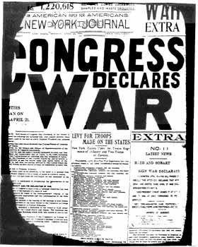
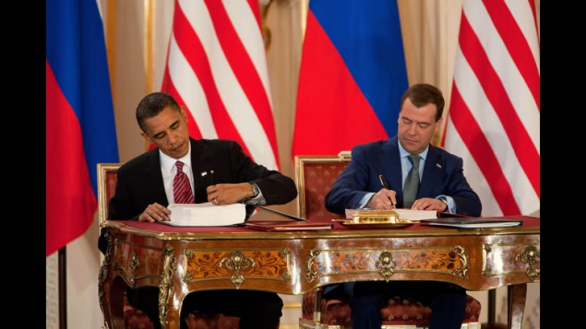
2. The Federal government has powers that are __________, or assigned to it by the Constitution.
Delegated/Enumerated

Slide 4
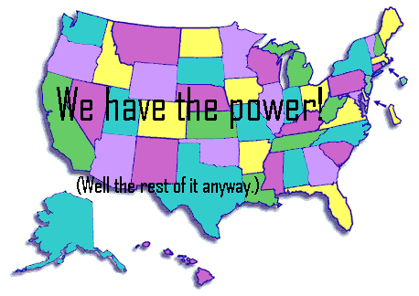
3. Which amendment reserves powers for the states?
10th

Slide 5
4. What is an example of something states can’t do?
Granting titles of nobility
Making treaties with foreign countries
Cause problems for other states

Slide 6
5. What are two examples of power that the states do have?
Education
Health care
Fire protection
Police
Marriage
Driver’s licenses

Slide 7
6. What are concurrent powers?
Powers that are shared

Slide 8
7. What is an example of a concurrent power?
Court system
Enforcing laws
Borrowing money
Collecting taxes

Slide 9
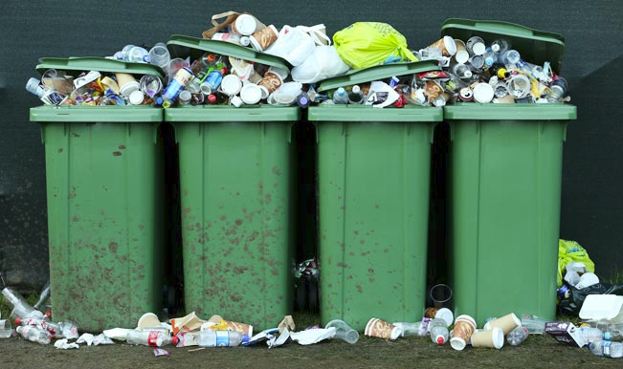
8. Which level of government do you think affects citizens on a daily basis, state or local?
Local government affects us on a daily basis, from our water, electricity, garbage, speed limits…

Slide 10
9. What will happen if a local law says it’s okay to text and drive, but the state law makes it illegal?
Rule of Thumb: Laws at a higher level (state is higher than local) would overrule laws/ordinances at a lower level.

Slide 11
Decide if each statement is True (T) or False (F).
_____ 1. The states in the United States are individual countries.
_____ 2. The Constitution gives a specific list of powers to the federal government.
_____ 3. The Constitution gives a specific list of powers to the states.
_____ 4. “Concurrent” powers are the powers that only states have.
_____ 5. The Constitution lists some specific things states can’t do.
_____ 6. States do not have their own constitutions or laws.
_____ 7. The Constitution doesn’t say anything about local governments.
_____ 8. Local governments have their own power to make decisions about anything.
_____ 9. Laws at a lower level of government are always superior to laws at a higher level.
_____ 10. The federal government can influence states by attaching rules to federal money.
F
T
F
F
T
F
T
F
F
T

