Slide 1
Sources and Types of Law

Slide 2
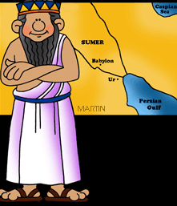
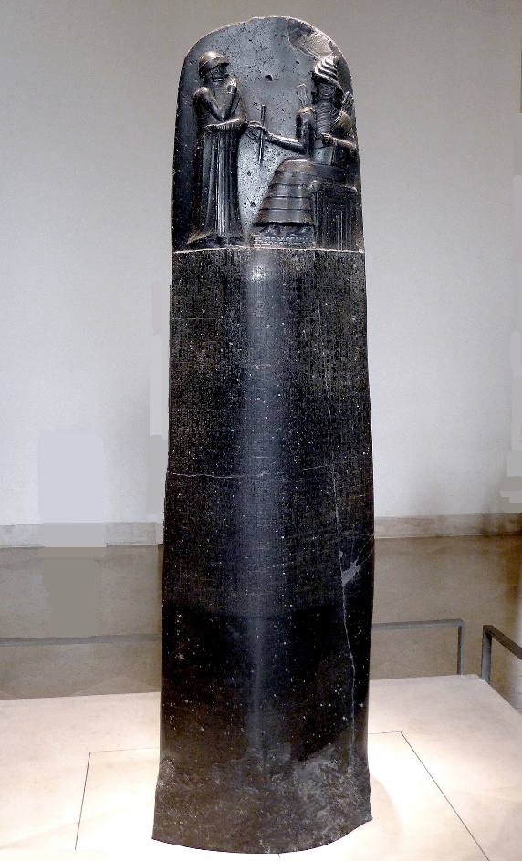
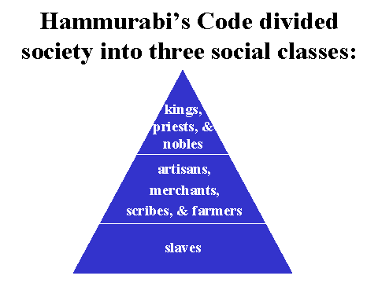
Code of Hammurabi
What it was:
Earliest written code of law/rules- Babylonia 1760 B.C.
What it did:
The Code of Hammurabi guided the society of Babylon.
Related to marriage, slaves, adoption, business practices but depended on social status
“An eye for an eye”
How did it impact the U.S. government?
The U.S. Constitution is also a series of laws written to guide society in the United States.

Slide 3
Sources of Law
Where do laws come from?

Slide 4
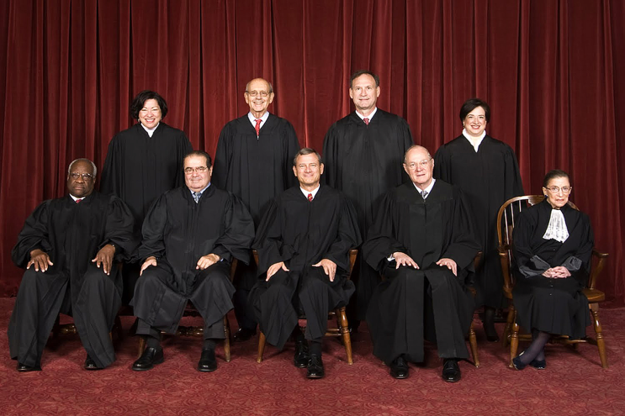
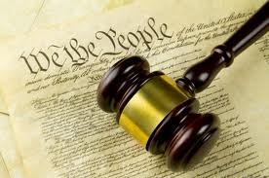
Constitutional Law:
Deals with the structure and meaning of constitutions.
Constitutional Law cases decide the limits of the government’s power and the rights of the individual
Source:
Constitutions (U.S. and State)
Example: Gideon v. Wainwright’s right to an attorney was violated

Slide 5
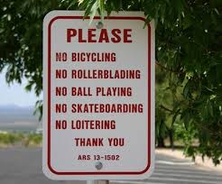
Statutory Law:
Statute: A law written by a legislative branch of government.
Source:
Legislative Branch of government (state or Federal)
Example:
Speed limits, minimum wage
Foundation of many rights and privileges that we have

Slide 6
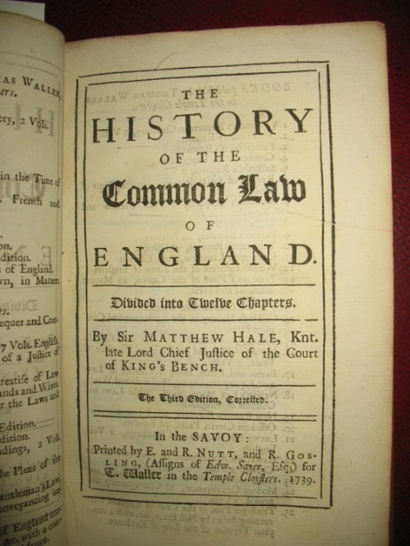
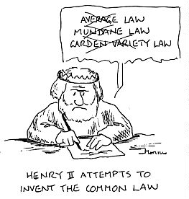
Common/Case Law:
Source:
Judges base their decisions off of precedents (previous case decisions) and customs
Example:
Plessy v. Ferguson set up a precedent that allowed for segregation to continue

Slide 7
Types of Law

Slide 8
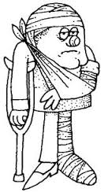
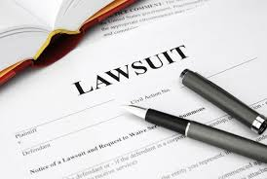
Civil Law:
Cases that involve disputes between people or groups
Example:
Lawsuits (You slipped and broke your arm at Walmart)

Slide 9
Criminal Law:
Deal with laws that make something a crime
Misdemeanor or Felony
Aim to protect public safety
Example:
It is illegal to drink and drive

Slide 10
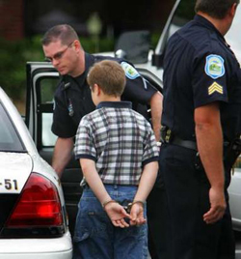
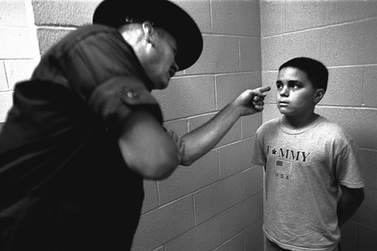
Juvenile Law:
Deals with cases of people 18 and under
Examples:
Adoption/Foster care
Curfew
School Attendance
More flexible than the adult justice system

Slide 11
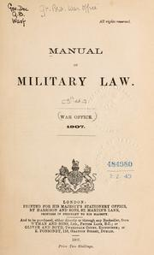
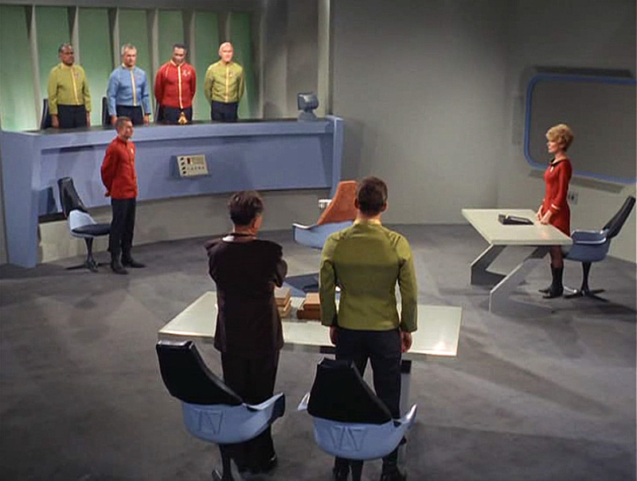
Military Law:
Uniform Code of Military Conduct
Examples:
Deals with disrespect towards superior officers,
leaving the military without permission (AWOL),
failing to obey an order
Court Martial: Court made up of officers who hear military cases

Slide 12
What If? Select the correct type of law based on the scenario.
When a soldier failed to return to base after going on leave, he was charged and brought to trial for being AWOL (Absent Without Official Leave).
a. Military Law
b. Juvenile Law
c. Civil Law
d. Criminal Law
Julie was pulled over by the police at 2:00am and was charged with breaking the curfew law in her town. She was fined and released back to her parents.
a. Military Law
b. Juvenile Law
c. Civil Law
d. Criminal Law

Slide 13
The Smith family has decided to adopt their foster child, Anna. They work with their state adoption agency to complete all of the necessary paperwork.
a. Military Law
b. Juvenile Law
c. Civil Law
d. Criminal Law
A married couple decides to get a divorce. They disagree over who gets what. A judge hears both sides and makes a decision about how their property should be divided.
a. Military Law
b. Juvenile Law
c. Civil Law
d. Criminal Law

Slide 14
A man was caught on tape robbing a gas station. He was arrested, brought to trial, and found guilty of burglary. He was sentenced to 10 years in prison and a fine.
a. Military Law
b. Juvenile Law
c. Civil Law
D. Criminal Law
Karen ordered an iPod off the internet and paid with her credit card, but she never received the order. The seller is refusing to refund her money, so she takes the matter to court.
a. Military Law
b. Juvenile Law
c. Civil Law
d. Criminal Law

Slide 15
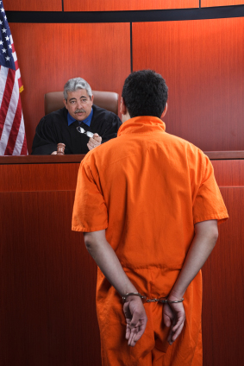
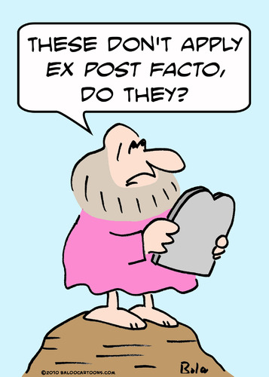
Define Writ of Habeas Corpus:
A court order that requires police to bring a prisoner to court to explain his charges
Define Ex post facto Law:
A law that would allow a person to be punished for an action that was not against the law when it was committed

Slide 16
Amendment | Explain what the amendment protects | Explain its importance in the legal system | Name of the court case and explain why it is important to the amendment
14th Amendment | Requires the states to treat all people fairly under the law Guarantees due process | No matter your race, ethnicity, gender, or socio-economic status, you should be given equal access to the justice system. | Furman v. Georgia Plessy v. Ferguson
4th Amendment | Protects against unreasonable search and seizures –search warrant is required | You should feel protected in your home/property If police find something without a warrant, it can’t be used against you. | Mapp v. Ohio
5th Amendment | Guarantees due process You have the right not to incriminate yourself (the right to remain silent) Protects against double jeopardy (being tried for the same crime twice) Provides for a grand jury in federal cases | You don’t have to answer questions that might implicate you in a crime. If found innocent, you don’t have to worry about being brought back to stand trial for the same crime. | Miranda v. Arizona
6th Amendment | You have the right to an attorney, even if you can’t afford one. You also have the right to know the charges brought against you. You have the right to a speedy trial. You have the right to confront witnesses | Everyone should be offered the opportunity to have a professional handle their case to ensure that the best effort was given. If you’re arrested, you should know what you’re being arrested for and at your trial, you should be able to question witnesses against you. | Gideon v. Wainwright
8th Amendment | Forbids cruel and unusual punishments Forbids excessive bail | The punishment must fit the crime. | Furman v. Georgia

