Slide 1
Prequel to the constitution

Slide 2
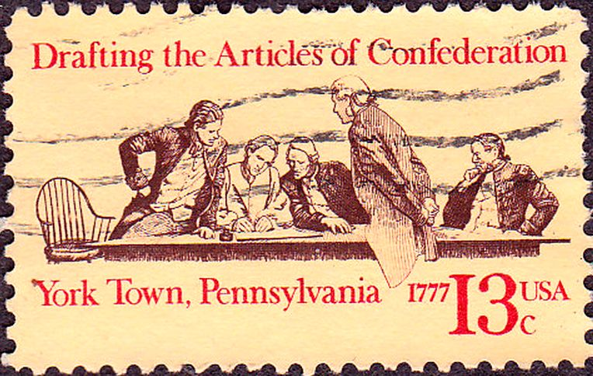
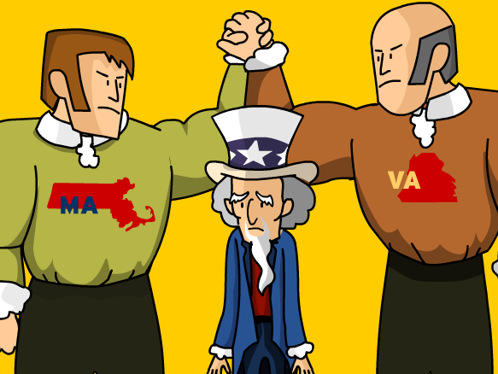
Terms to Know
Articles of Confederation - the first constitution of the United States
Confederation - a system of government where power is given to the independent states and there is little power in the central government
Constitutional Convention - a meeting in Philadelphia where it was decided to throw out the Articles of Confederation and create the Constitution
Debt - something owed; such as money

Slide 3
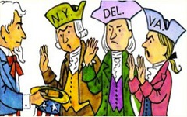
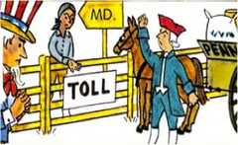
I can identify the weaknesses of the government under the Articles of Confederation
Congress had no power to
tax
Regulate (control) trade (commerce)

Slide 4
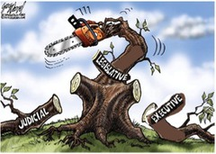
The national government lacked the following:
a national court system [judicial branch]
central leadership [executive branch]
The ability to enforce its laws

Slide 5
Congress was too strict:
changes to the Articles required unanimous consent of the 13 states

Slide 6
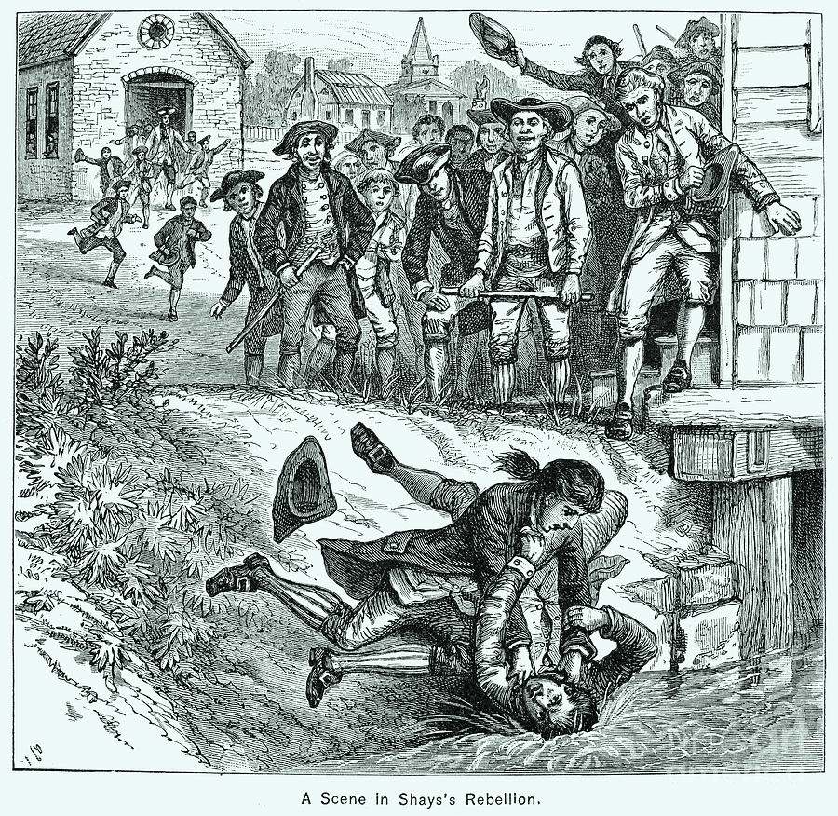
I can explain Shay's Rebellion and how it showed a weakness in the Articles of Confederation.
2000 Massachusetts farmers rebelled because they were being taxed after the Revolutionary War.
They rebelled by taking over the Mass. courthouse.
Mass. asked for help from the Confederation, but the Confederation did not have enough money to raise an army.
The states and Congress realized the current government was too weak to protect its own citizens.

Slide 7
I understand how these weaknesses led to the writing of the US Constitution…
These weaknesses led to the writing of the Constitution because it showed that the central government was too weak and the state governments had most of the power.

Slide 8
CHAMPs
C- Level 1
H- Raise your hand
A- Working on analyzing the features of the AOC and completing the chart
M- None without permission
P- Quietly working with only your partner on the activity.
S- Success
CARDS!!!
20 points
You can lose your cards by:
Talking over a level 1, off topic, or to another person besides your partner
Being out of your seat
Working on something other than the activity
Touching the cards/popping rubberbands

Slide 9
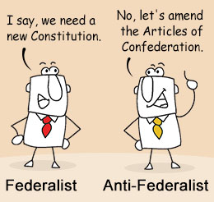
Explain the viewpoints of the Federalists and the Anti-federalists

Slide 10
I can define ratification:
The process of formally approving something
9 out of 13 states had to approve of the Constitution before it could be passed

Slide 11
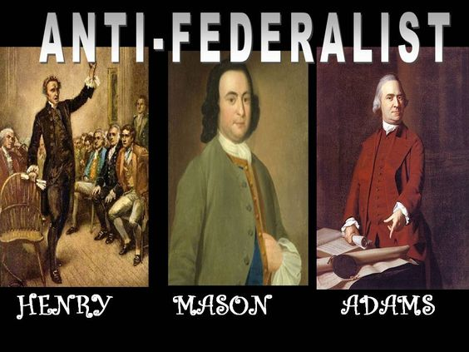
I can explain who the Anti-Federalists were:
Anti-Federalists are the people who opposed the ratification of the Constitution.
This means:
They didn’t approve of the Constitution.

Slide 12
I can explain what the Anti-Federalists papers were:
Anti-Federalists wrote essays and newspaper articles to spread their point of view against the ratification of the constitution.

Slide 13
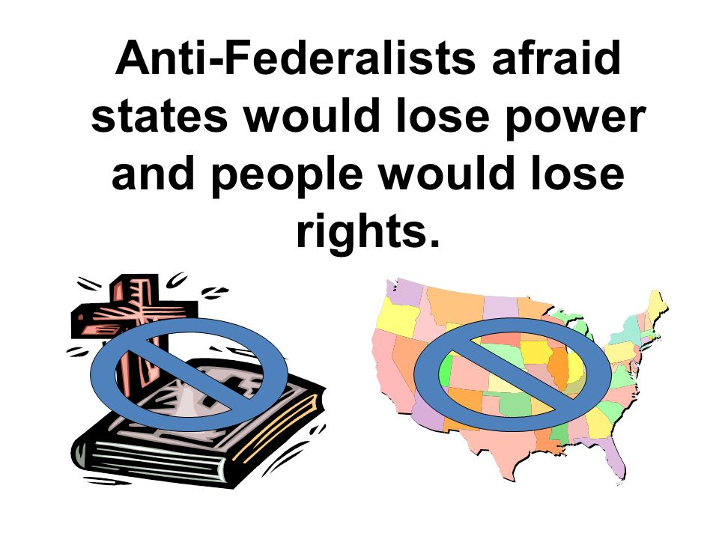
I can explain the viewpoints of the Anti-Federalists regarding the ratification of the U.S. Constitution.
The Constitution gave too much power to the national government and not enough to the states.
The legislative and executive branches were too powerful.
The Constitution lacked a specific list of rights to be protected for the people.

Slide 14
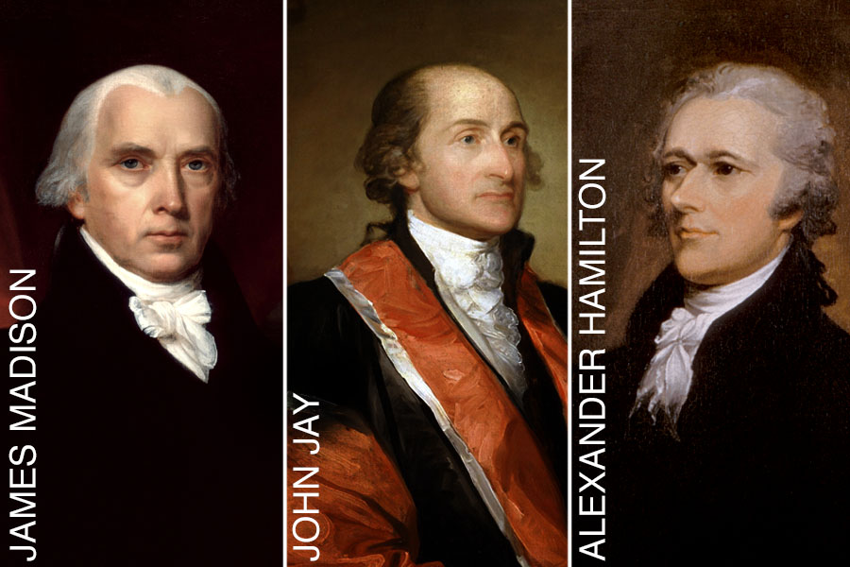
I can explain who the Federalists were.
Federalists were the people who supported the ratification of the Constitution. They wanted a strong central government that would share certain powers with the states.

Slide 15
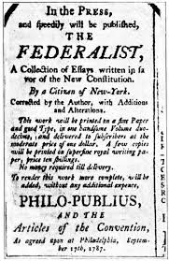
I can explain what the Federalists papers were.
The main arguments in favor of ratifying the Constitution were stated in a series of essays.

Slide 16
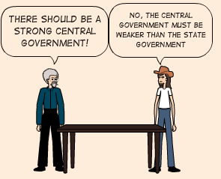
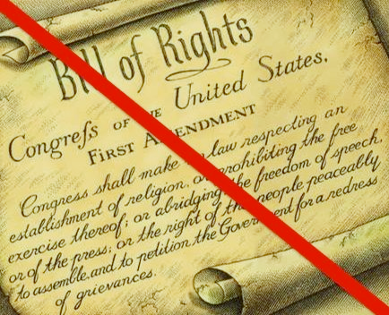
I can explain the viewpoints of the Federalists regarding the ratification of the U.S. Constitution.
The Constitution was necessary in order to protect the liberty and independence that was gained from the American Revolution.
They believed that the three branches of government separated the powers and protected the rights of the people.
They also believed that a listing of rights can be a dangerous thing.

Slide 17
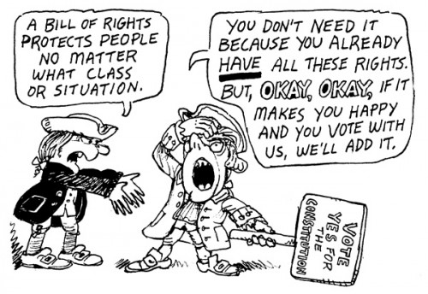
I can explain the Anti-Federalists’ reasons for wanting to include of a bill of rights in the U.S. Constitution.
They believed that a bill of rights was essential to protect the people from the federal government.
The Anti-Federalists did not want a powerful national government taking away their rights.

Slide 18
Federalists vs. anti-federalists reading

Slide 19
1. Compare the two systems of government created by the Articles and the Constitution.
Under the Articles, the central government lacked power while the states maintained most of the power under a confederal system. The Constitution created a federal system where the central government and the states shared power instead.

Slide 20
2. What does it mean to ratify something?
To ratify something means to formally approve of it.

Slide 21
3. What are the two groups that people were divided into after the Constitution was created?
The federalists and anti-federalists were the two groups created when the Constitution was written.

Slide 22
4. Explain the Anti-Federalist position on the Constitution.
The Anti-Federalists were opposed to the Constitution because they felt the federal government, including the legislative and executive branches had too much power. They were also concerned there was no list of rights.

Slide 23
5. Explain why a bill of rights was so important to Anti-Federalists.
The Bill of Rights was so important to the Anti-Federalists because they didn’t want a controlling, over powerful government to take the rights they fought for away.

Slide 24
6. How did the Anti-Federalists share their concerns?
The Anti-Federalists spread their opinions through the Anti-Federalist papers, which were a series of essays and articles.

Slide 25
7. Explain the Federalist viewpoint on the Constitution.
The Federalists were in support of the Constitution just the way it was. They didn’t feel like the government could take too much power because of separation of powers and checks and balances. They were afraid of a bill of rights and felt that a strong central government was needed to keep the country united.

Slide 26
8. Explain the Federalists’ opinion on the Bill of Rights.
The Federalists felt that listing specific rights could be a dangerous thing because what would happen to the rights that weren’t listed? Would our government be able to restrict or limit those rights?

Slide 27
9. What were the Federalist Papers?
Just like the Anti-Federalists, the Federalists wrote a series of essays and articles in order to promote their point of view on the Constitution.

Slide 28
10. Explain the compromise the Federalists and Anti- Federalists came to regarding the Constitution.
The Federalists agreed to add a bill of rights at the end of the Constitution so that the Anti-Federalists would agree to ratify it.

Slide 29
Federalists/Anti-Federalists Quote Analysis
Directions: With your partner, read each quote. Decide if the quote was said by a Federalist or an Anti-Federalist. Mark your text evidence and explain your answer. Use the dictionary under your desk to determine the meaning of unfamiliar words.

Slide 30
CHAMPs for Quote Analysis Activity
Cards:
C- Level 1
H- Raise your hand
A- Working with your partner on analyzing the quotes in order to determine who would have said it.
M- None without permission
P- Quietly working with only your partner on the quote analysis activity while remaining in your seat.
S-Success!
20 points/ Each card=2 points
You can lose your cards by:
Talking above a level 1
Talking to another group or off topic
Being out of your seat without permission
Working on another assignment
Touching the cards/popping rubber bands

