Slide 1
Powers of Congress

Slide 2
Enumerated Powers:
Powers that are specifically written out in the Constitution (Article I)
Also known as Expressed Powers
Example:
Congress has the written power to maintain an army and navy

Slide 3
Implied Powers:
Powers that are “suggested” (not specifically written) in the Constitution.
These help Congress to fulfill their expressed powers
Necessary and Proper (Elastic) Clause
Example:
Congress has the power to institute a draft
(Our military needs soldiers in order protect us)

Slide 4
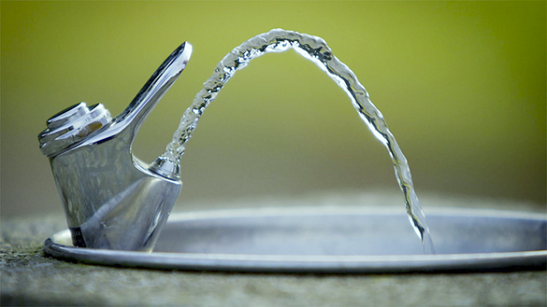
Implied Powers
Which was the expressed power in this example?
The power (permission) to get water
Which was the implied power?
The need to get up and go into the hallway
You can’t perform the expressed power without the implied

Slide 5
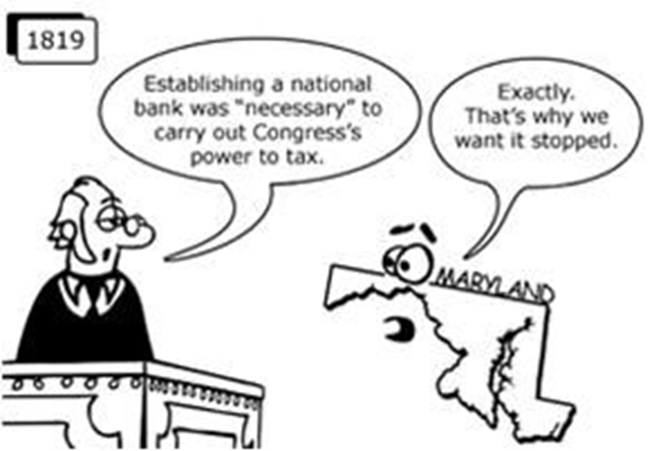
What was the implied power Congress used to tax?

Slide 6
Example of Implied Power | Expressed Power
Congress created a Marines and Airforce of the United States.
2. Congress has required all health related products that are shipped between states to have safety seals under their lids.
3. Congress created money for all fifty states.
4. Congress increased the price of the postage stamp to $0.49 cents.
5. Congress is able to limit the number of immigrants to the United States
6. Congress has the right to draft citizens into the armed forces.
7. Sonia Sotomayor was selected to the Supreme Court.
8. After the Japanese attacked Pearl Harbor, President Roosevelt asked Congress to go to war.
To raise and support an army and navy
Regulate foreign and interstate trade
Coin money
Create a post office and postal roads
Make Naturalization Laws
To raise and support an army and navy
To approve of presidential appointments
To declare war

Slide 7
House of Representatives
Representative
25
citizen
You have to live in the state you want to represent

Slide 8
Senate, Senator
30
9 years

Slide 9
Both houses make their own rules
67

Slide 10
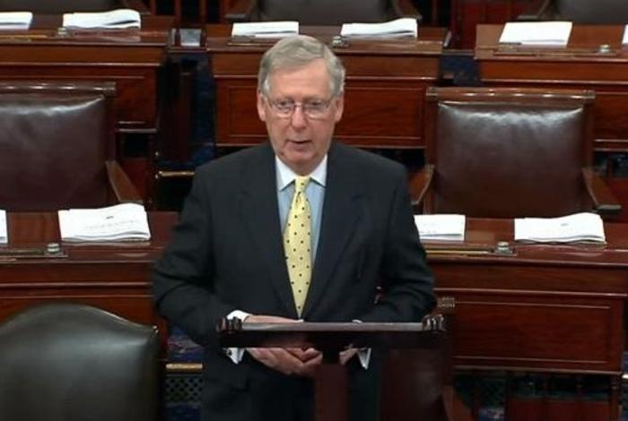
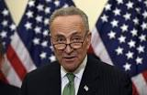
I can explain the following:
Majority leader - a Member of Congress elected by the majority party to serve as the chief spokesperson for that party and to manage and schedule the business of either house
Minority leader - a member of Congress elected by the minority party to serve as the chief spokesperson for the party and to support the majority party in managing and scheduling the business of either house

Slide 11
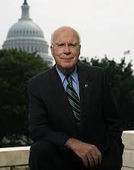
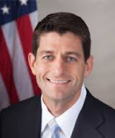
President pro tempore of the Senate - the person who presides over the Senate when the Vice President is not present
Speaker of the House - the leader of the U.S. House of Representatives and majority party, very powerful, 3rd in line to be president
Patrick Leahy
Paul Ryan

Slide 12
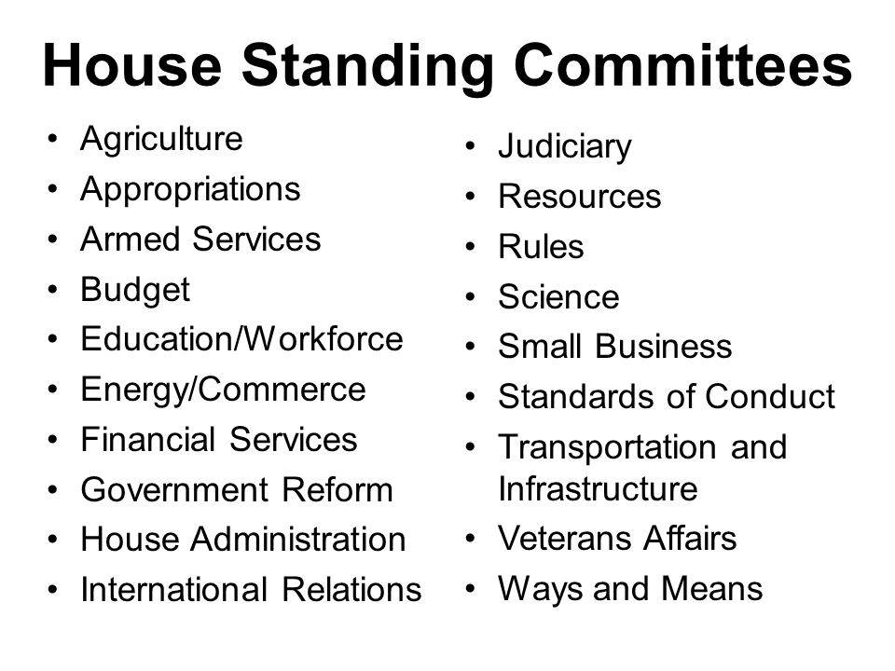
Standing - Permanent committees which cover specific areas of government work (agriculture, Education, Homeland security)
Select - Temporary committee that addresses a specific issue; once that committee’s business is complete, the committee closes
Joint - Committee from both houses to reach a compromise on a certain issue

Slide 13
How a bill becomes a law

Slide 14
The Bill Begins
The bill starts as someone’s idea. That person writes a letter to his Representative in the U.S. House of Representatives (or Senate). The Representative researches the idea and writes the bill (rough draft of a law).

Slide 15
Step 1: The Proposal
The Representative is excited about the bill and decides to sponsor it. He talks with other Representatives about the bill in hopes of getting their support for it.

Slide 16
Step 2: The Introduction
The Representative will introduce the bill by placing it in a special box called the hopper. The bill is assigned a special number, starting with H.R.
The bill is read to all the Representatives and the Speaker of the House (Paul Ryan) sends the bill to one of the House standing committees.

Slide 17
Step 3: The Report
Each committee is made up of Representatives who are experts on topics like agriculture, education, or international relations.
The committee members discuss the bill, make changes, and then vote to accept or reject the changes. If they like it, it gets sent to the whole House for a floor debate. If not, it stops there.

Slide 18
Step 4: The Floor Debate
The Representatives discuss the bill and explain why they agree or disagree with it. Then, the bill is read section by section and the Representatives suggest more changes to it. Now the bill is ready to be voted on.

Slide 19
Step 5: The Vote
Representatives vote on the bill electronically by clicking yes, no, or present.
If a majority of the Representatives click yes, then the bill passes in the U.S. House of Representatives.

Slide 20
Step 6: The Delivery
The bill is sent to the U.S. Senate where it goes through many of the steps it went through in the House. The bill is discussed in a Senate committee and then the Senate votes on the bill by voice. Those who support the bill say “yea” (yes) and those who oppose it say “nay” (no). If a majority of the Senate approves it, it is ready to go to the President.

Slide 21
Step 7: To the President!
When the bill reaches the President, he has 3 choices:
He can sign and pass the bill
He can refuse to sign, or veto, the bill
He can do nothing and pocket veto the bill

Slide 22
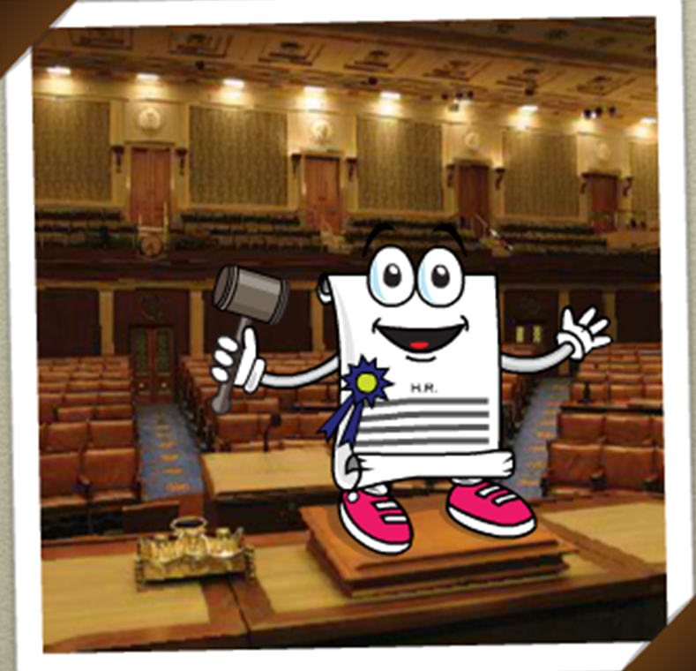
Yay! He’s now a law!
Oh no, he was vetoed! Is this as far as bill can go?

Slide 23
*Congress can override a veto if there are enough votes (2/3 of Congress) to do so.
The president can also ignore the bill. If a bill is ignored while Congress is in session, it automatically becomes a law after ten days. If Congress is not in session, it doesn't. (pocket veto)

Slide 24
1. The Proposal
A representative writes a bill and gets support from others in the House.
6. The Delivery
The bill arrives at the Senate, where it goes through the same debate, changes are made, then another vote is held before it can move on.
2.The Introduction
The bill is assigned a number and is read aloud to the other Representatives. Then it is sent to a committee for a close review.
5. The Vote
If changes are made, the bill is read again, and the whole House is called to vote on the bill. They can vote yes, no, or present (if they don’t want to vote on that particular bill).
7. To The President!
If both chambers of Congress approve, the bill lands on the president’s desk. If it is signed, it becomes a law. If it is vetoed, it doesn’t.*
3. The Report
If the committee likes it, it will be sent to the whole House for debate.
4. The Floor Debate
All of the representatives get a chance to read the bill and debate whether it should be supported or opposed. The bill is read again and changes are suggested.

Slide 25
A. Members represent an entire state
B. Bills about taxes and money must start here
C. Approves presidential appointments
D. Members represent citizens
E. Serve two-year terms
F. Passes bills to the president to become laws
G. There are 100 members of this chamber
H. Can override a presidential veto with a 2/3 vote of support
I. Must be at least 25 to serve in this chamber
J. Led by the vice president of the U.S.
K. Leader is called the “speaker”
House
B.
E
Both
I
Senate
D
A
K
F
H
C
G
J

Slide 26
Item One:
Extend the school year by 8 days.
Item two:
Lengthen the school day by making it start one hour earlier.

