Slide 1
Legislative Branch

Slide 2
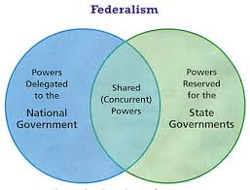
I can define the following words:
Federalism - a system of government in which power is divided and shared between national, state, and local government
Concurrent powers - powers shared by the Federal, state, and/or local government
Example: making laws, enforcing laws, collecting taxes
Enumerated powers - the powers specifically listed and given to the Federal government or banned from being exercised by the states under the U.S. Constitution.
Synonyms: Delegated and Expressed
Example: Declaring war, Coining money

Slide 3
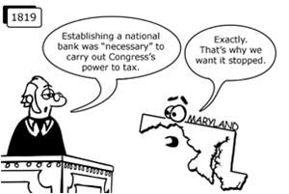
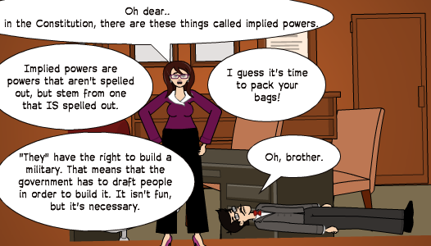
Reserved powers - powers that are NOT granted to the national government (are reserved to the states)
Example: regulating education
Necessary and Proper Clause: Allows Congress to stretch its powers to meet new needs
Synonym: Elastic Clause
Implied Powers: Powers that are NOT written down but are implied based on the powers that have already been listed. Found in the Necessary and Proper Clause
Ex: creating the draft to fulfill the expressed power of creating and maintaining an army and navy

Slide 4
Supremacy clause:
The clause that states that the U.S. Constitution is the supreme law of the land, and that Federal laws are supreme over state laws, Article VI (6)
I can explain the Main function of the Legislative Branch:
To make laws

Slide 5
I can explain the structure of the Legislative Branch:

Slide 6
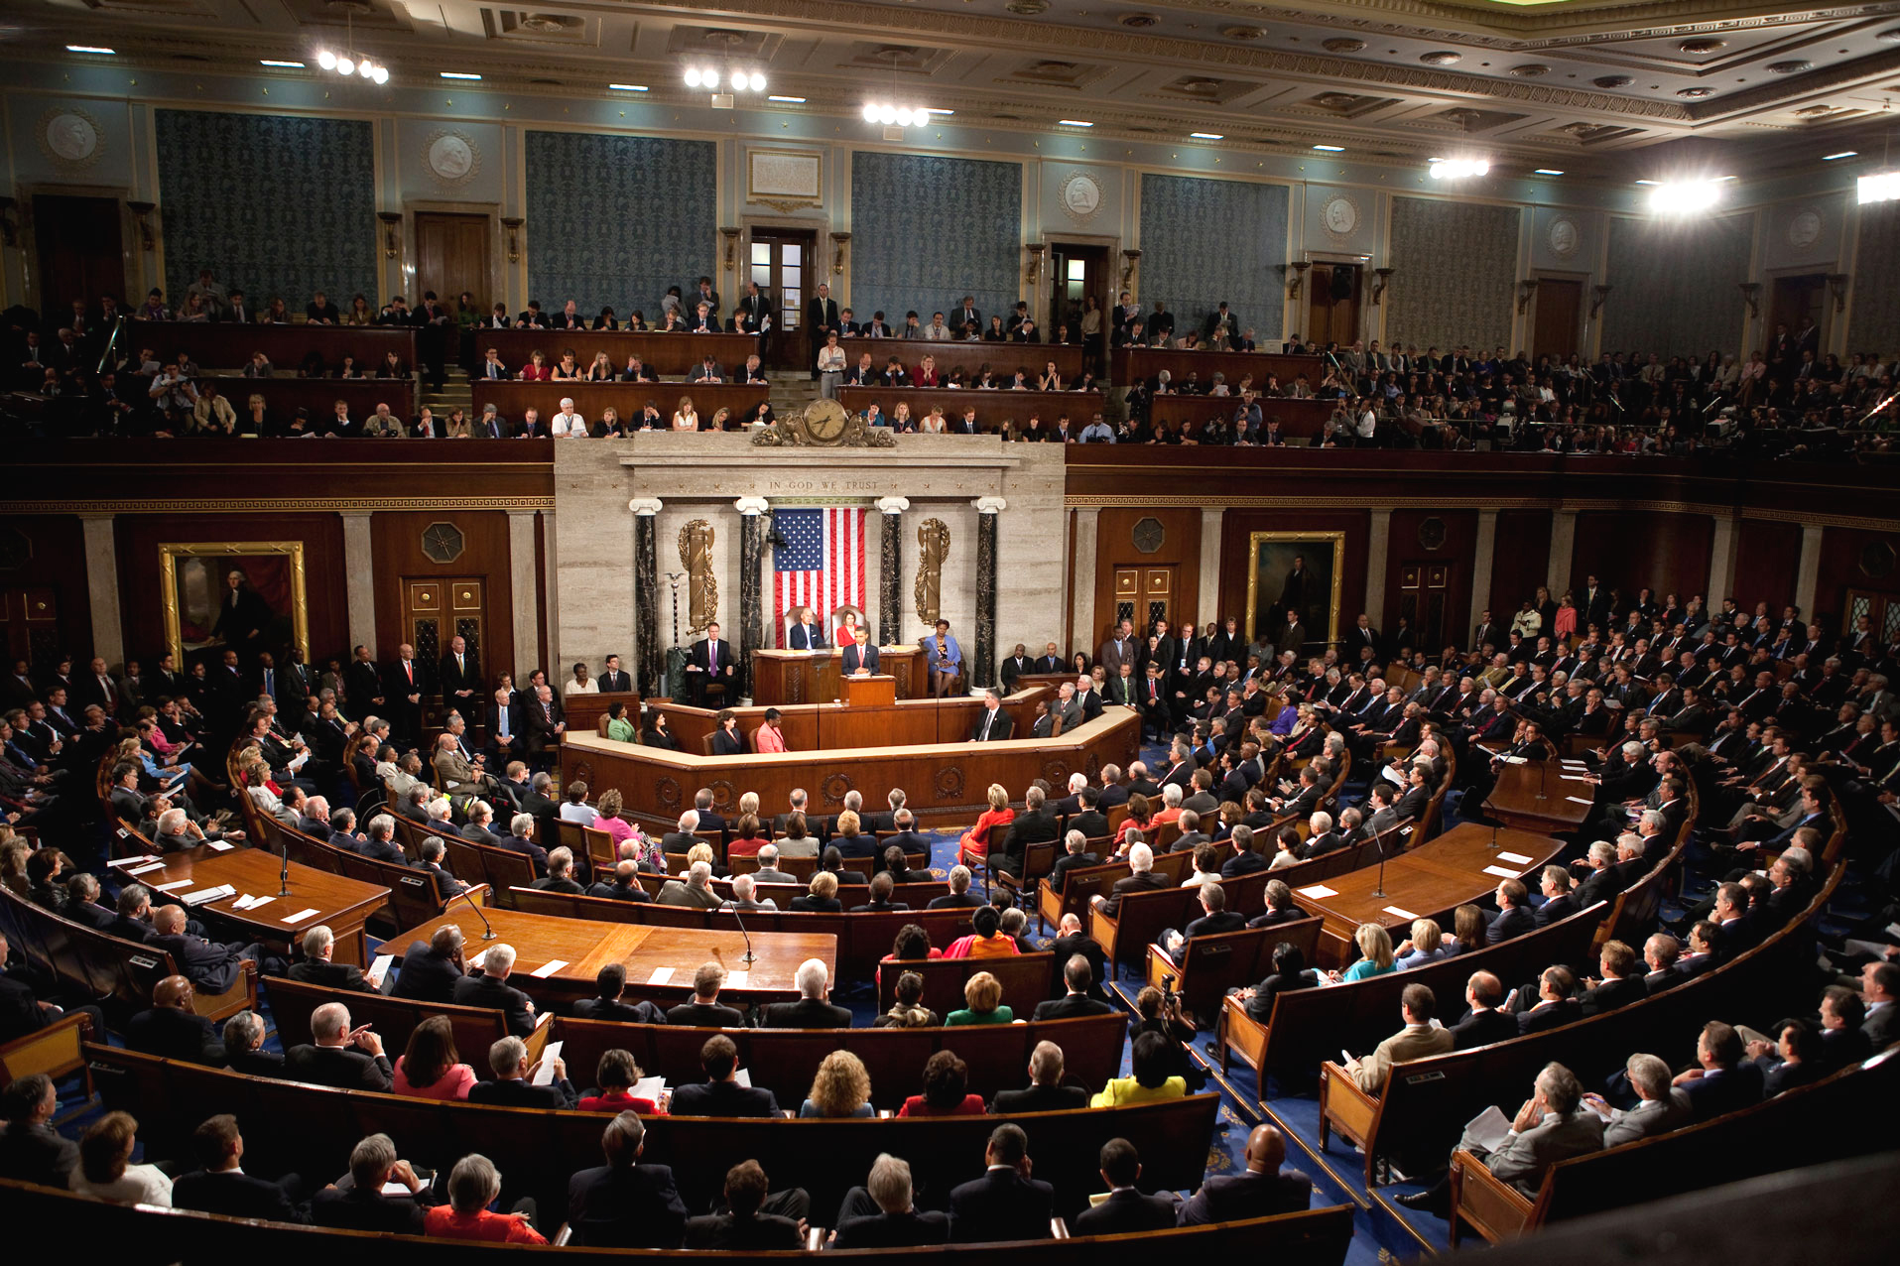
Bicameral: made up of two chambers; the House of Representatives and the Senate
House of Representatives: #s are based on population and currently has 435 members.
Senate: The senate has two representatives from each state; 100 total.

Slide 7
I can explain the requirements to become a Representative and a Senator:

Slide 8
Chamber: | Age: | Citizenship: | Residence: | Term:
Repres.: | 25 | Citizen for 7 years | Must live in the state they represent | 2 years
Senator: | 30 | Citizen for 9 years | Must live in the state they represent | 6 years
Ted Yoho 3rd District
Bill Nelson
Marco Rubio

Slide 9
I can identify the main powers of the Legislative Branch:

Slide 10
Money:
Power to tax
has the power to coin money
Borrow money
regulate foreign and interstate commerce and trade

Slide 11
Military
Create and maintain an army and navy
To declare war

Slide 12
Other
Determine naturalization laws
Create the post office
Secure patents

Slide 13
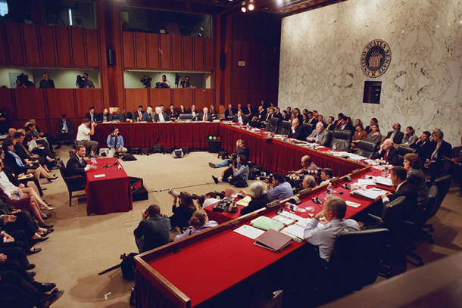
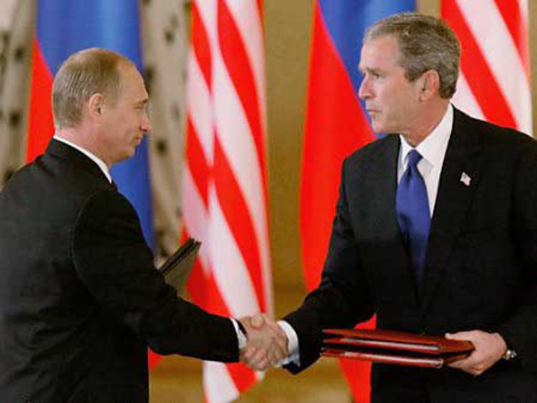
Checks and Balances/Non-Legislative Powers
Impeachment of government officials
Confirms presidential appointments (Senate)
Ratifying presidential treaties (Senate)

Slide 14
Questions:

Slide 15
Now, answer the questions in the first column of your notes.
How do the House and Senate Differ?
They differ in size and how each state is represented.
How do the requirements to be a senator or representative differ?
To be a Senator, you must be at least 30, while you only need to be 25 to be a Representative. You must be a citizen for at least 7 years if you want to be a Representative, but you must be a citizen for at least 9 if you want to be a Senator .
Which powers are important to Congress?
Why does the senate need to approve the presidential appointments?
The Senate approves presidential nominations as a way to check the power of the President. This way, the President can’t just appoint whomever he wants, the person must be qualified.

Slide 16
To lay (make) and collect taxes
To regulate commerce (trade) with foreign nations, and among the states
To coin money
To secure patents for authors and inventors
To raise and support armies and to provide and maintain a navy
Holds impeachment hearings
To borrow money
To approve of treaties
To establish post offices and post roads
To declare war
To Establish naturalization rules
Approves of Presidential appointments (ambassadors, Supreme Court)
To lay (make) and collect taxes
To regulate commerce (trade) with foreign nations, and among the states
To coin money
To borrow money
To raise and support armies and to provide and maintain a navy
To declare war
Holds impeachment hearings
Approves treaties
Approves of Presidential appointments (ambassadors, Supreme Court)
To secure patents for authors and inventors
To establish post offices and post roads
To establish naturalization rules

Slide 17
What is Congress?
Circle the branch of government that makes the laws.
Put a box around the two chambers of Congress. Underline what it means to make laws.
The United States Congress is the legislative, or lawmaking, branch of our federal government. Congress is bicameral, which means it is made up of two chambers: the Senate and the House of Representatives. Each chamber includes elected officials from all fifty states. They meet in Washington, D.C. to legislate, or make laws, for the entire country. Congress was created by the Constitution, and that document describes how this branch of government works.

Slide 19
CHAMPs: Venn Diagram Activity *5 min
With your partner, you will work on the Venn Diagram on the bottom of your reading. Decide which part of the diagram each statement belongs.
C- Conversation Level 1
H- Raise your hand
A- Use your reading/notes to complete the Venn Diagram with your partner.
M- None without permission
P- Working quietly with only your partner in order to complete the Venn Diagram.
S- Success!

Slide 20
House
Senate
B
E
BOTH
I
D
F
A
H
A. Members represent an entire state
B. Bills about taxes and money must start here
C. Approves presidential appointments
D. Members represent citizens
E. Serve two-year terms
F. Passes bills onto the president to become laws
G. There are 100 members of this chamber
H. Can override a presidential veto with a 2/3 vote of support
I. Have to be at least 25 to serve in this chamber
C
G

Slide 21
Qualifications for Congress Scenarios:
Rhianna is 23 years old and has been a singer her whole life. She just decided to run for the Senate in California, where she lives. Is she eligible? Why or why not?
No, Rhianna can’t be a Senator because she is too young. She has to be at least 30 years old.
James Walker has lived in Illinois his whole life. He is 28 years old. He wants to be a Representative for his home state. Is he eligible? Why or why not?
Yes, James is eligible to be a Representative because he meets the age, citizenship, and residency requirements.
Victoria came to New Orleans from South Africa and took the Oath of Allegiance 11 years ago. She wants to run for the Senate in Louisiana. She is 38 years old. Is she eligible? Why or why not?
Yes, Victoria has been a citizen for at least 9 years and she meets the age and residency requirements.
Though Juan’s family is from Cuba, he was born in New York and has always lived there. He is 28 years old and wants to participate in government. Can he run for the Senate in New York? Can he run for the House?
Juan can’t run for the Senate, but he can run for the House because he meets the age, residency, and citizenship requirements.

