Slide 1
Judicial Branch in a Flash

Slide 2
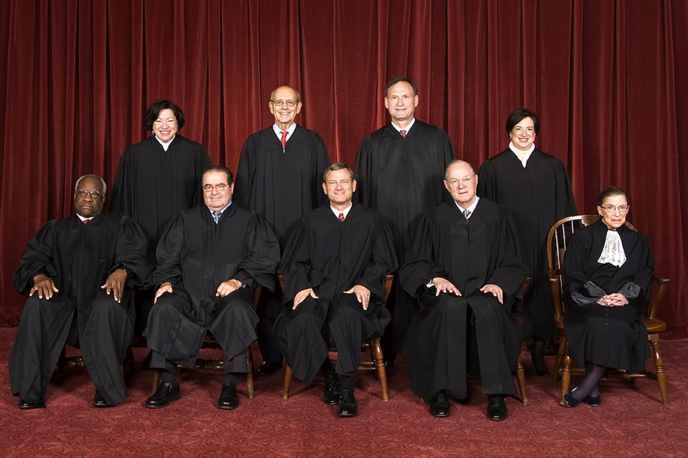
What court does the U.S. Constitution set up?
Supreme Court

Slide 3
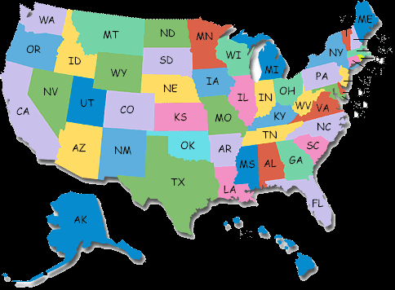
2. What issues do the Federal and State Court Systems deal with?
Federal
State
Disputes about laws that deal with the whole country
Disputes about state laws

Slide 4
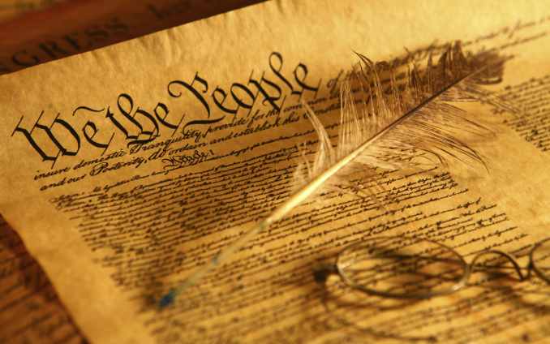
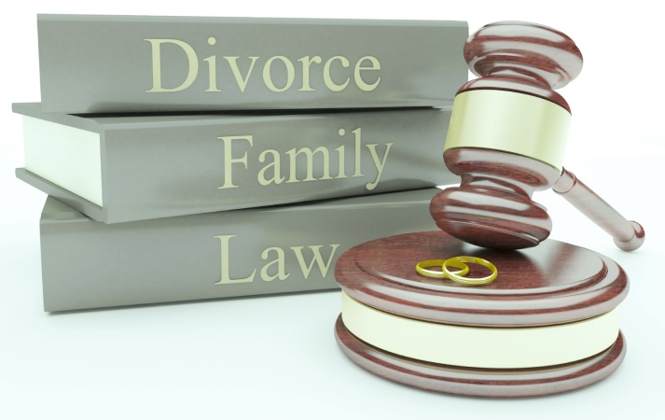
What kind of cases do the Federal and State Court Systems deal with?
Federal:
State:
Federal laws, U.S. Constitution, disputes between citizens of different states
State laws, State Constitution, family matters, accidents, crimes, traffic violations

Slide 5
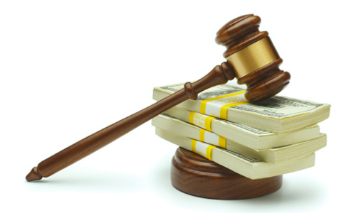
4. Which type of case would the following examples be?
A person has been arrested for stealing a car.
Criminal
A person has been arrested for murder.
Criminal
An employee is suing his former employer for not paying him overtime.
Civil

Slide 6
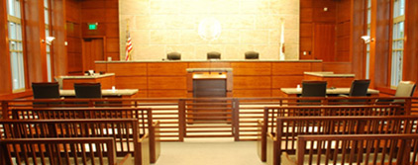
5. Which court is the first to hear a case?
Trial Court
6. What is this court called in the Federal System?
District Court

Slide 7
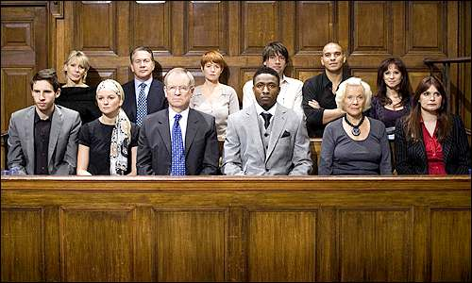
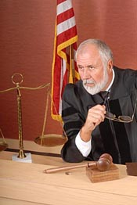
Who gives the verdict (decision) in a…..
Jury Trial?
Bench Trial?
Jury-group of 12 citizens
Judge

Slide 8
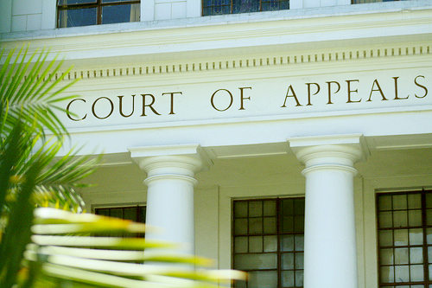
8. If there’s been an error in the trial court, where does the case go?
Appeal the case (ask the appellate court to review the case)

Slide 10
Original Jurisdiction: Means this court has the power to hear the case first Appellate Jurisdiction: Means this court hears a case after an appeal.
9. Label the levels of the courts:
Supreme Court
Appellate Jurisdiction
Appellate Court
Appellate Jurisdiction
Original Jurisdiction
Trial Court

Slide 11
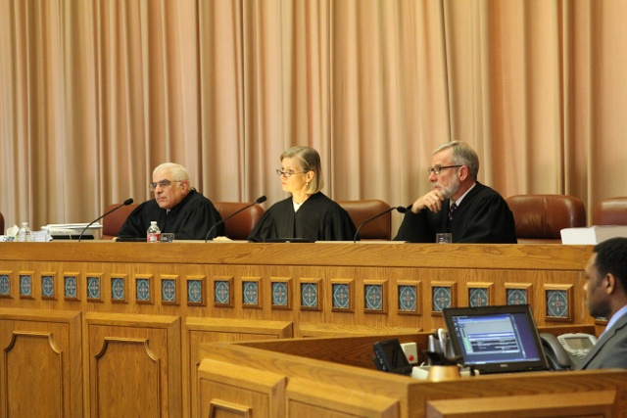
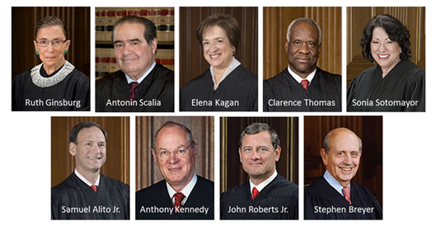
10. At each level of the courts, who decides the case?
Supreme Court:
Appellate Court:
Trial Court:
Nine Justices
Panel of three Judges
One judge

Slide 12
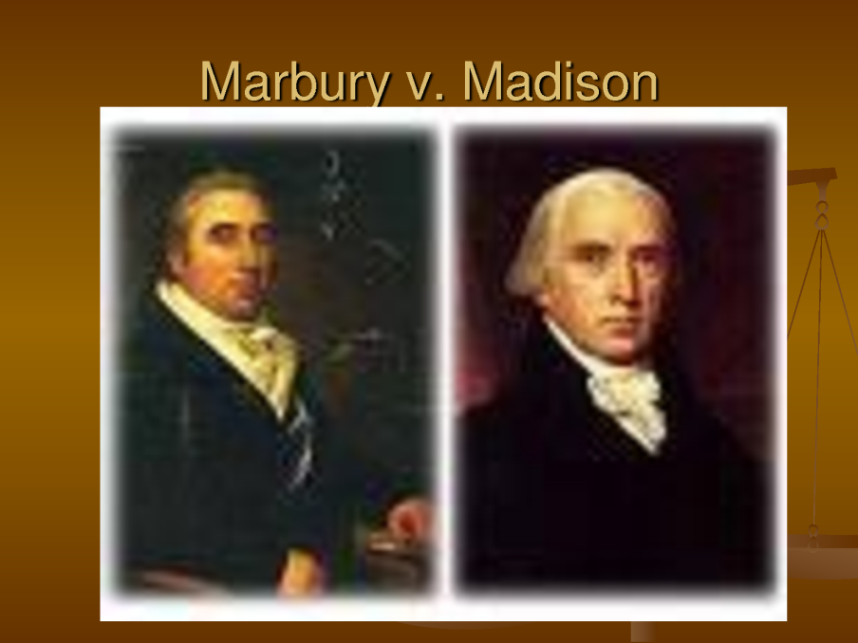
11. What principle explains the idea that the Supreme Court has the final say over the constitutionality of laws?
Judicial Review

Slide 13
Comparing our Dual Court System
You and a partner will work together to answer the questions on the back of your Court Systems Diagram.
You will have 20 min. to complete this.
C-Level 1
H-Ask 3 before me, then raise your hand
A-Working quietly with your partner on answering the questions related to the diagram
M-None without permission
P-Working with only your partner on only this task
S-Success!

Slide 14
1. What are the two systems of courts in the United States?
Federal and State Court Systems

Slide 15
2. What is the difference between the types of cases heard in Federal and State court systems?
Federal Court Systems hear cases that have to do with the entire U.S. and the U.S. Constitution.
State Court Systems hear cases about state/county laws.

Slide 16
3. Where do cases start on both federal and state levels?
They start at the District/Trial courts.

Slide 17
4. Who hears cases at the District and County Level?
District: Judge/Jury
County: Judge

Slide 18
Federal:
U.S. Appellate Courts:
Panel of judges
U.S. Supreme Court:
9 justices
State:
Florida Circuit Courts:
Judge and jury
Florida Appellate Court:
Panel of 3 judges
Florida Supreme Court
7 justices
5. Who hears the case on the appellate level?

Slide 19
6. Who hears cases at the Supreme Court level? How many are there in each system?
Justices.
Federal Supreme Court:
9 justices, and the
Florida Supreme Court
7 justices.

Slide 20
7. Why are there an odd number of justices in the supreme courts?
In order to avoid ties.

Slide 21
8. Where would a case originating in Orange Park be heard?
Misdemeanor -heard at the County Courts (local level)
Felony- heard at the Circuit Courts level

Slide 22
9. Which courts deal with case appeals?
State System:
FL Circuit Courts (sometimes)
FL Appellate Court
FL Supreme Court
Federal System:
U.S. Appellate Court
U.S. Supreme Court

Slide 23
10. What court is the last chance for a case to be heard before the decision cannot be appealed again?
U.S. Supreme Court

