Slide 1
Judicial branch notes

Slide 2
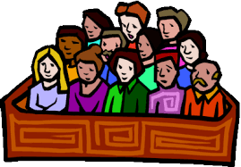
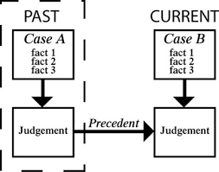
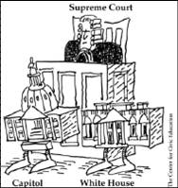
Define the following:
writ of certiorari: a court order that allows the supreme court to choose which cases it wants to hear
jury: group of twelve that hears a case and issues a verdict. Must have unanimous decision to determine guilt.
precedent: a ruling in a previous case that is used as a basis for a ruling in a similar case or decision
judicial review: the power of the Supreme court to declare a law unconstitutional

Slide 3
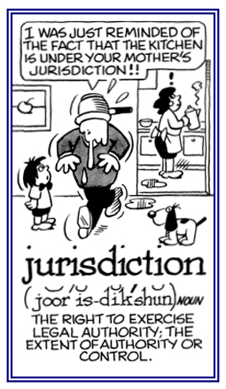
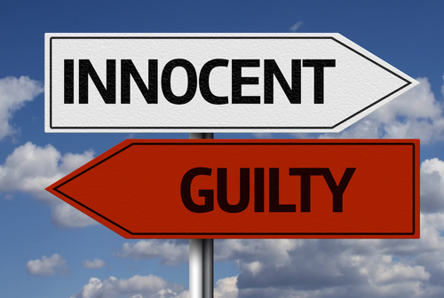
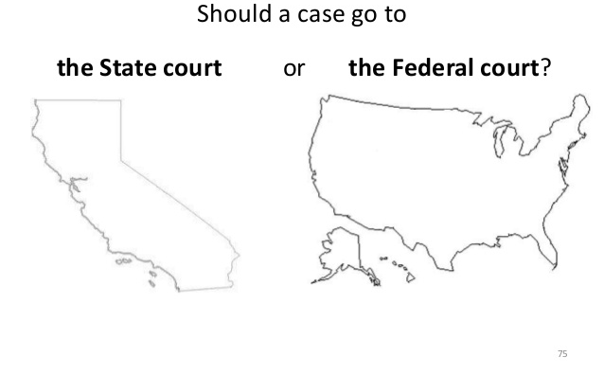
jurisdiction: power of the courts to hear a case
Original jurisdiction: the power of the courts to hear a case first
appellate jurisdiction: the power of a court to hear a case after an appeal
appeal: a request for a higher court to review your case
verdict: a decision in a court case
dual court system: a system made up of federal and state court systems
Write these in the margins!

Slide 4
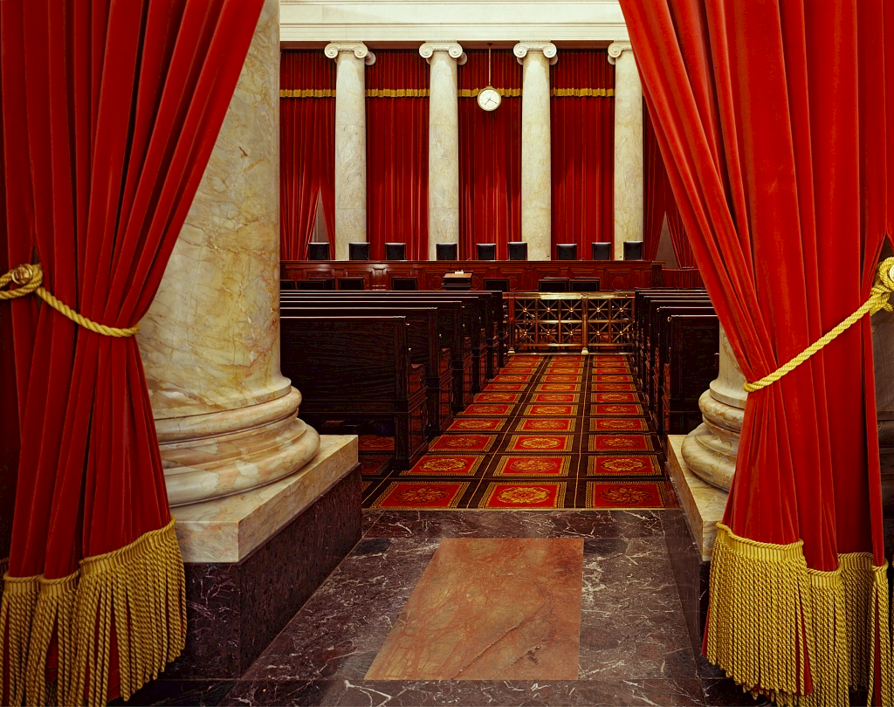
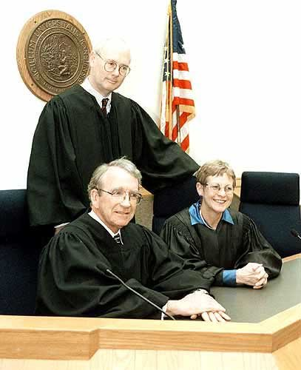
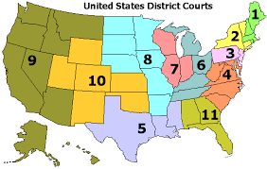
I can explain each level of the Federal/State Court Systems
Supreme Court
Level: 3 highest level (final decision)
Type of jurisdiction: original (rare cases) /appellate JUDICIAL REVIEW
Who hears the case: panel of 9 Justices
Appeals/Circuit Courts
Level: 2 Middle level
Type of jurisdiction: appellate jurisdiction reviews cases for error
Who hears the case: panel of 3 judges
District/Trial Courts
Level: 1 lowest
Type of jurisdiction: original jurisdiction
Who hears the case: judge and jury

Slide 5
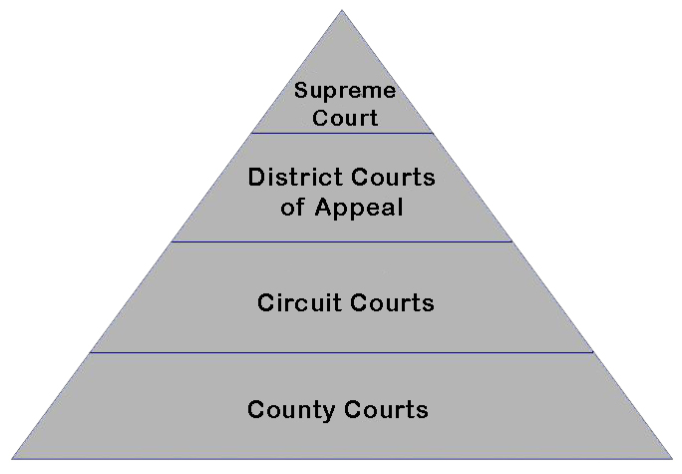
I can identify the extra court level for the state system:
The local or county courts
Original Jurisdiction
I can compare the appellate and trial courts:
Appellate court: reviews a lower court’s decision to look for an error
Trial court: the first court to hear a civil or criminal case. A judge and a jury hear evidence and decide a verdict

Slide 6
The main job of the Supreme Court is to….
Interpret the law

Slide 7
I can identify how amendments 5, 6, 7, & 8 are related to the court system:
5th: due process, no self-incrimination, no double jeopardy, right to a grand jury
6th: right to a lawyer, public and speedy trial, know accusations, confront witnesses, a fair(impartial) jury
7th: right to a jury during a civil trial
8th: no cruel and unusual punishments or excessive bail

Slide 8
I can explain why this is a Landmark case (case that has legal significance)
Marbury v Madison
Established judicial review for the U.S. Supreme Court
Gideon v. Wainwright
Provides everyone with a lawyer according to the 6th amendment
In re Gault
Established due process for juveniles
Miranda v. Arizona
Protects your right to no self-incrimination according to the 5th amendment and established the procedure of Miranda Warning

Slide 9
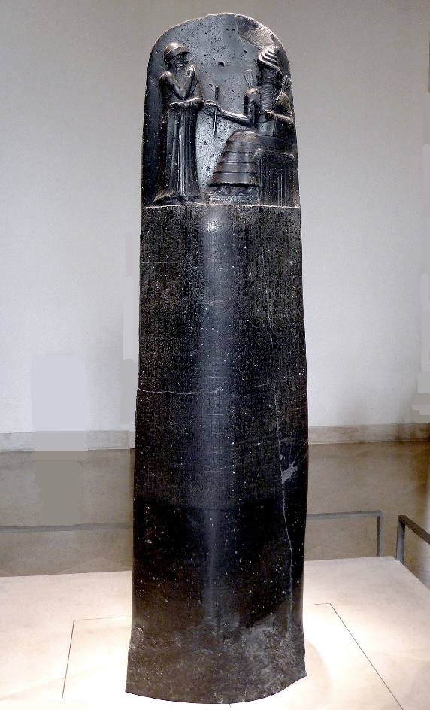
I can understand the importance of the following document.
Code of Hammurabi
First written set of laws
Created a law system with punishments related to marriage, slaves, adoption, business practices but depended on social status
“An eye for an eye”

Slide 10
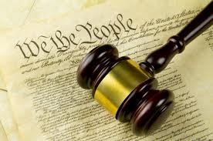
I can identify the following sources of law
Constitutional Law: laws based on the constitution
Constitutional Law cases decide the limits of the government’s power and the rights of the individual

Slide 11
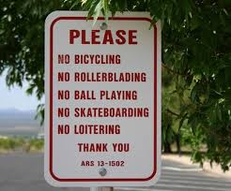
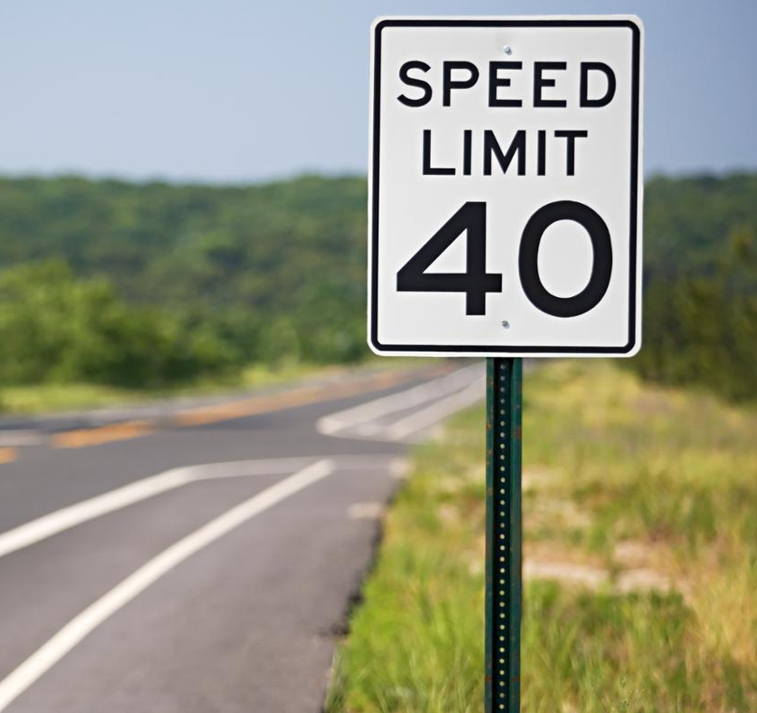
Statutory Law
Statutory Law: Laws created by congress and state legislatures
Regulate our behavior in many ways
Speed limits, minimum wage

Slide 12
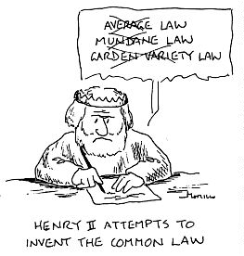
Common/Case Law
Common/Case Law: laws based on traditions and court case precedents
Plessy v. Ferguson set up a precedent that allowed for segregation to continue

Slide 13
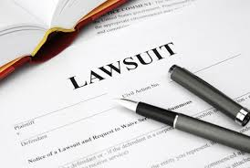
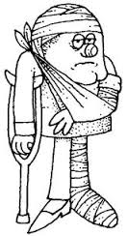
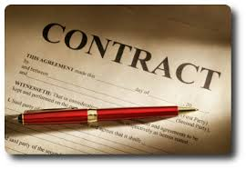
I can identify the following types of law
Civil Law: settle disputes between people usually about money

Slide 14
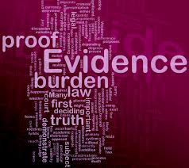
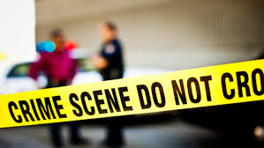
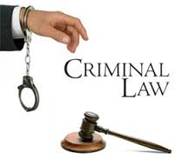
Criminal Law
Criminal Law: breaking the law by committing a crime
Aim to protect public safety
Misdemeanor or Felony

Slide 15
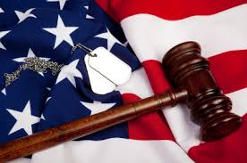
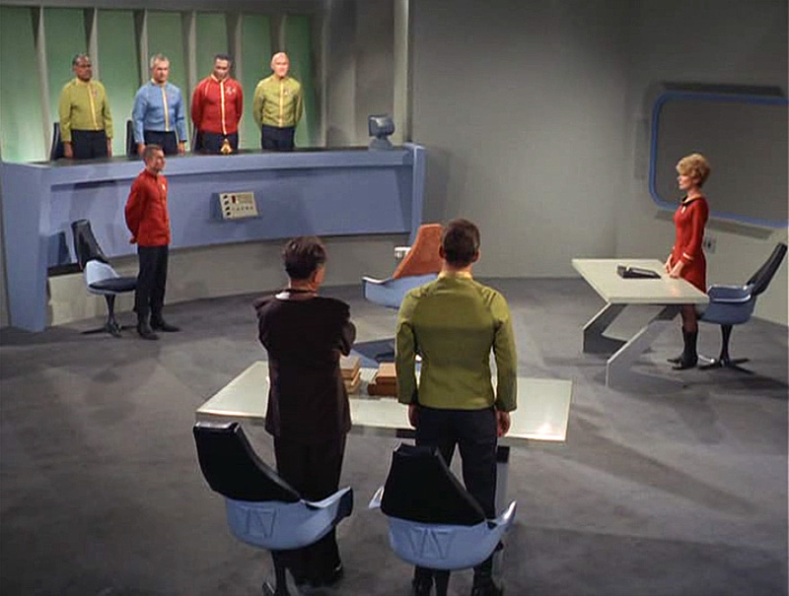
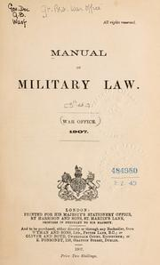
Military Law
Military Law: laws that apply to people in the military only (ex. AWOL)
Uniform Code of Military Conduct
Deals with disrespect towards superior officers, leaving the military without permission (AWOL), failing to obey an order
Court Martial: Court made up of officers who hear military cases

Slide 16
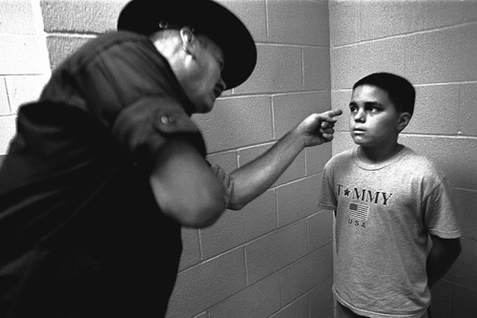
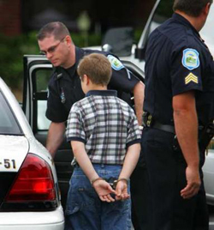
Juvenile Law
Juvenile Law: Laws that apply to anyone under the age 18
Deals with cases of people 18 and under
Adoption/Foster care
Curfew
School Attendance
More flexible than the adult justice system

Slide 17
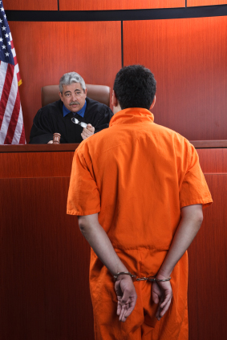
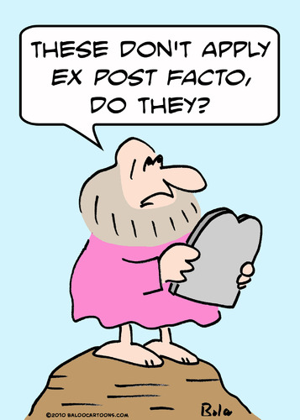
Add these to the bottom of your notes or in the margins
Define Writ of Habeas Corpus:
A court order that requires police to bring a prisoner to court to explain his charges
Define Ex post facto Law:
A law that would allow a person to be punished for an action that was not against the law when it was committed

Slide 19
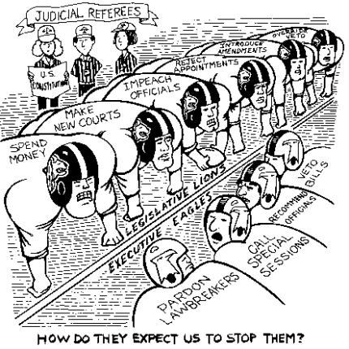
What Words does the artist use?
What Action does the artist include?
What Visuals/symbols does the artist include?
What Emotions do you feel after analyzing the cartoon?
So what? What is the purpose or argument of the cartoon?
Do you agree or disagree with the message?

Slide 20
Read the scenarios below and decide which type of law is being described. Provide text evidence to explain how you know.
1. You use a file sharing website to get free digital copies of copyrighted songs and videos. The music company and the band sue you for their losses.
2. You are accused of using your elderly neighbor’s password to transfer money online, from their bank account to your online payment account.

Slide 21
What If? Select the correct type of law based on the scenario.
When a soldier failed to return to base after going on leave, he was charged and brought to trial for being AWOL (Absent Without Official Leave).
a. Military Law
b. Juvenile Law
c. Civil Law
d. Criminal Law
Julie was pulled over by the police at 2:00am and was charged with breaking the curfew law in her town. She was fined and released back to her parents.
a. Military Law
b. Juvenile Law
c. Civil Law
d. Criminal Law

Slide 22
The Smith family has decided to adopt their foster child, Anna. They work with their state adoption agency to complete all of the necessary paperwork.
a. Military Law
b. Juvenile Law
c. Civil Law
d. Criminal Law
A married couple decides to get a divorce. They disagree over who gets what. A judge hears both sides and makes a decision about how their property should be divided.
a. Military Law
b. Juvenile Law
c. Civil Law
d. Criminal Law

Slide 23
A man was caught on tape robbing a gas station. He was arrested, brought to trial, and found guilty of burglary. He was sentenced to 10 years in prison and a fine.
a. Military Law
b. Juvenile Law
c. Civil Law
D. Criminal Law
Karen ordered an iPod off the internet and paid with her credit card, but she never received the order. The seller is refusing to refund her money, so she takes the matter to court.
a. Military Law
b. Juvenile Law
c. Civil Law
d. Criminal Law

Slide 24
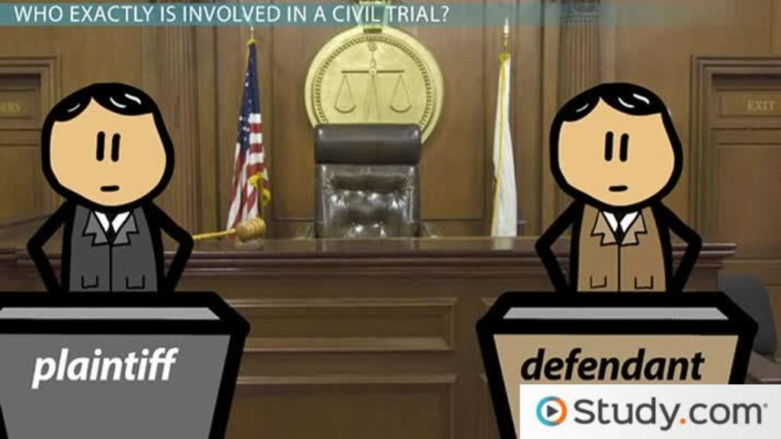
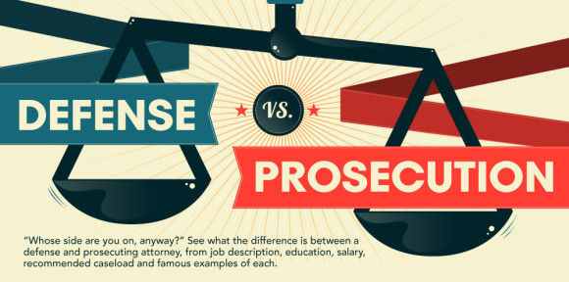
I can define the following terms
Plaintiff:
The person who files a lawsuit
Defendant:
The person who is being sued or accused of a crime
Prosecution:
The government in its role as the party who starts the legal proceedings against someone charged with a crime and is charged with proving that persons guilt
Misdemeanor:
Minor crime which a person can be fined a small amount or spend up to one year in jail
Felony:
More serious crime such as murder, kidnapping, robbery, or assault

Slide 25
I can identify the steps of the criminal trial process

Slide 26
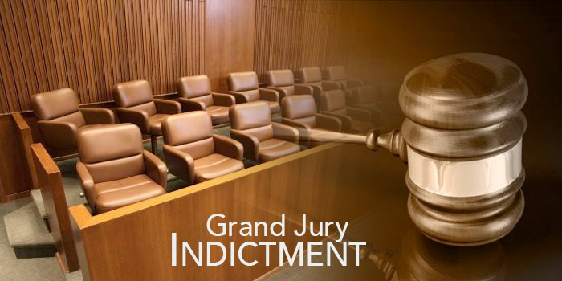
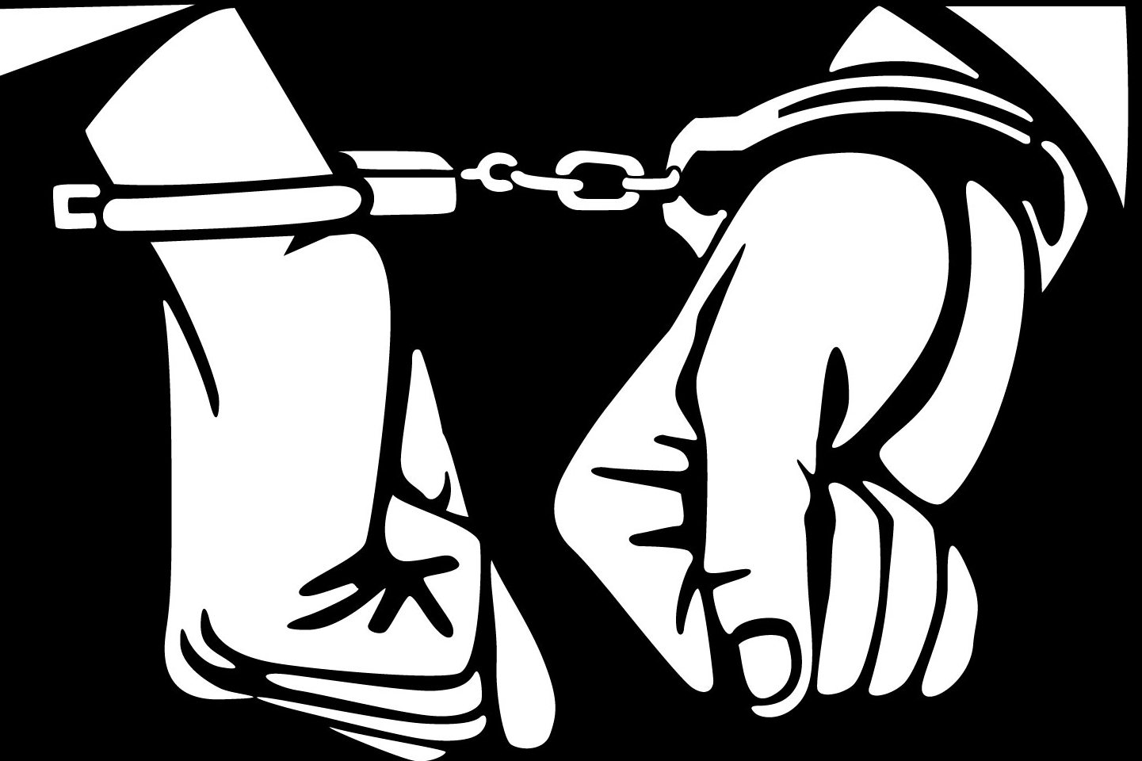
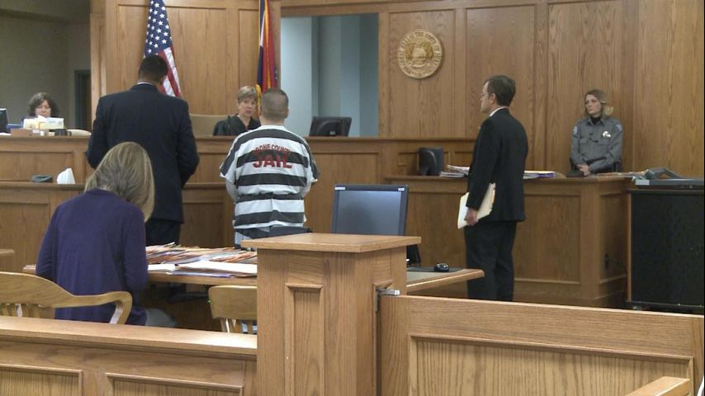
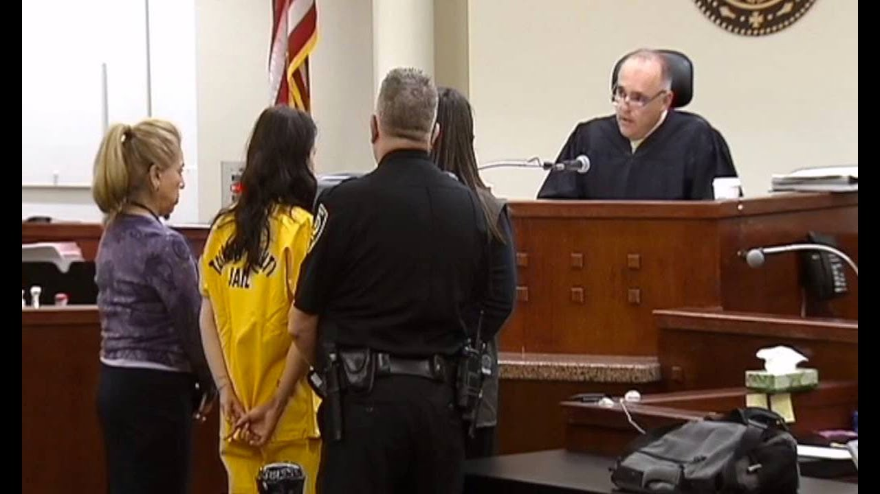
Pre-Trial
Arrest:
Police arrest and book a suspect
Preliminary Hearing:
Suspect appears before judge for explanation of charges. Bail is set.
Indictment:
Grand jury (or judge) hears evidence and formally charges the suspect with a crime
Arraignment:
Defendant enters a plea of guilty or innocent. If plea is innocent the trial date is set. If plea is guilty a plea bargain is accepted.

Slide 27
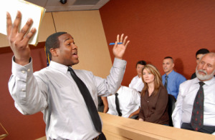
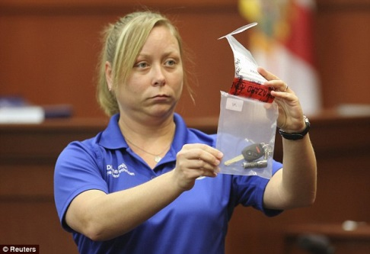
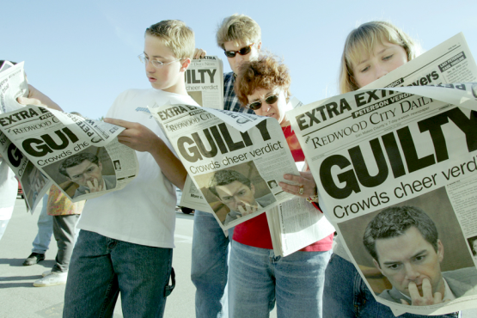
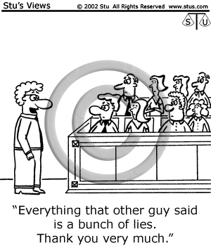
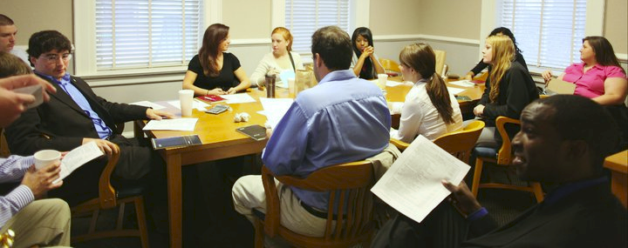
Trial
Opening Statements:
Prosecution and Defense outline their cases
Presentation of Evidence:
Prosecution presents its evidence first then it is the defenses turn. During this time witness can be called and examined.
Closing Statements:
Prosecution and Defense summarize their cases
Jury Deliberation:
Jury meets in secret to discuss the case. Jury must unanimously agree beyond a reasonable doubt that the defendant is guilty
Verdict & Sentencing:
If defendant is found not guilty they are acquitted or goes free guilty the judge sentences them with a punishment ranging from probation, fines, community service, or imprisonment.

Slide 28
Johnny was arrested for stealing a car. Put the following steps of his trial in order:
Johnny’s defense lawyer presents evidence to try and prove his client is innocent.
The prosecutor and Johnny’s defense attorney make their closing statements.
The Jury reads the verdict (decision) to the court.
The prosecutor and defense attorney make their opening statements to the court.
The jury goes to a room to deliberate (discuss the evidence) before they make a decision.
The prosecutor (attorney for the government) presents evidence to try and prove that Johnny is guilty.
4, 6, 1, 2, 5, 3

Slide 29
Detective #1
Reads each article
Finds and underlines evidence in the text to determine which type of law is being discussed
Provides the information to the Task Manager/Recorder in a timely and efficient manner
Task Manager/Recorder
suggests solutions to team problems.
helps members clarify points.
makes sure that every voice is heard.
says, "Let's hear from_____next."
says, "That's okay, but let's get back to our task.
Collects and records information from the detectives to complete the organizer
Detective #2
Reads each article
Finds and circles evidence in the text to determine which court system each case would be held in (Federal, State, Military)
Provides the information to the Task Manager/Recorder in a timely and efficient manner

Slide 30
Johnny gets arrested for stealing a car.
A writ of Habeaus Corpus is issued and Johnny gets taken to a judge who explains why he’s been arrested.
A grand jury decides there is enough evidence to formally charge Johnny with grand theft auto.
Johnny goes back in front of the judge and enters a plea of innocent. His trial date is set.

