Slide 1
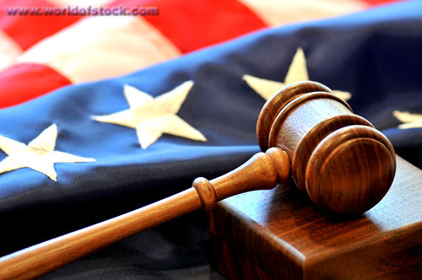
Judicial Branch
Judicial Branch clip

Slide 2
True or False
1. The Supreme Court is a trial court.
(F)
2. There is only one judge in a trial court.
(T)
3. The Supreme Court can strike down an unconstitutional law.
(T)
4. When you first begin a trial, you will be in an appellate court.
(F)
5. A jury decides the case in a bench trial.
(F)

Slide 3
6. The Supreme Court must take every case that gets appealed to it.
(F)
7. If you break a state law, your case will probably be in a state court system.
(T)
8. The Supreme Court’s power to decide if something is constitutional is called judicial review.
(T)
9. It would be easy to prove a case without evidence.
(F)
10. If the Court of Appeals remands a case, that means the court says the verdict was right.
(F)

Slide 4
11. The federal court system was created by Congress.
(T)
12. State court systems were created by the Constitution of the United States.
(F)
13. When you ask a higher court to review your case, you are making an appeal.
(T)
14. When the Court of Appeals affirms a case, it sends the case back to the trial court.
(F)
15. The Supreme Court gets the last word about what the Constitution really says.
(T)

Slide 5
Pick Column A or B
Question | A | B
When someone is accused of a crime, the type of case is | civil | criminal
If you appeal a case, you are going to | appellate court | trial court
The court that gets to decide what is constitutional | Supreme Court | Court of Appeals
If the appellate court thinks a decision was wrong, it will | affirm the decision | reverse the decision
If a group of people gives the verdict after a trial, that trial was a | jury trial | bench trial
A word that means “relating to the rights of citizens” | criminal | civil

Slide 6
Question | A | B
The Supreme Court has | three justices | nine justices
If an appellate court sends a case back to the trial court, it | has affirmed the case | remanded the case
If you go to the Court of Appeals, you will see | three judges | one judge
The decision in a case is called the | evidence | verdict
If you break a law of the United States, your case will probably be in | federal court | state court
At trial, lawyers try to prove their case using | An appeal | evidence
State courts were created by | the US Constitution | state constitutions

Slide 7
The only court the Constitution creates is
Supreme Court
The two court systems in the United States are
Federal and State
Two kinds of legal cases are
Criminal and civil
The job of the Court of Appeals is
To see if the trial court made a mistake

Slide 8
It’s difficult to take a case to the Supreme Court because
They choose which cases to hear and they don’t hear very many.
If you lose a case in the trial court, you can
Appeal to a higher court
If an appellate court affirms a case, it means
The verdict stays the same

Slide 9
8. If a law is unconstitutional, the Supreme Court can
Strike it down
9. Evidence is used for
Proving that one person’s side of the story is really what happened
10. A trial with no jury is called a
Bench trial

Slide 10
B. Making Comparisons. Decide whether each description fits trial courts only, appellate courts only, or both, and write the letter of the description in the correct part of the diagram. The first one is done for you.
Trial Court
Appellate Court
Hears Civil cases
Might have a jury trial
Does not hear cases for the first time
Hears criminal cases
Reviews a verdict to look for mistakes
Usually has three-judge panels
Hears cases for the first time
Works with laws
B
C
G
F
E
A
D
H

Slide 11
Order in the Court! Number each set of events to put the three events in the correct order.
2
The Court of Appeals remands the case
A new trial begins
The first verdict is appealed
Trial is held in the District Court
The Supreme Court agrees to hear the case
An appeal is made to the Court of Appeals
Evidence is presented to the jury
The members of the jury are chosen
The jury returns a verdict
The Supreme Court strikes down the law
The Supreme Court hears a case about the law
Congress passes a law
3
1
1
3
2
2
1
3
3
2
1

