Slide 1
International Organizations
Listen to your group members present their organization. Complete the chart as each group member shares what they’ve learned about each organization.

Slide 2
Review:
What are organizations?
Groups of people, businesses, or governments that work together to solve an issue.
What are international organizations?
Groups of governments or people from different countries working together to solve an issue that crosses country borders.

Slide 3
What are Intergovernmental organizations?
Organizations that are formed between governments. They are based on formal agreements between three or more countries that have come together for a specific purpose.
What are Nongovernmental organizations?
Groups that work to solve problems around the world and are free to work towards their own goals without government interference.

Slide 4
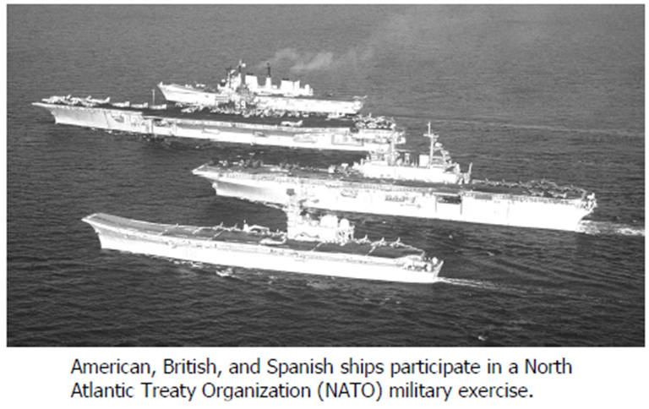
1. Why are intergovernmental organizations formed?
Intergovernmental organizations are formed by three or more countries that have come together for a specific purpose, like fighting hunger around the world.

Slide 5
2. What makes nongovernmental organizations different than intergovernmental organizations?
NGO’s are not connected to any government and are free to work towards their own goals without any government involvement.
Goal is to end human rights abuses around the world
Goal is to protect wildlife and their habitats

Slide 6
What International Organizations Do
International organizations have often been responsible for providing help to nations in need.
They also keep the peace in countries that are having violent uprisings or civil war.
In addition to using troops or volunteers to maintain peace, international organizations also work to provide better education and medical care to people in war-torn areas.

Slide 7
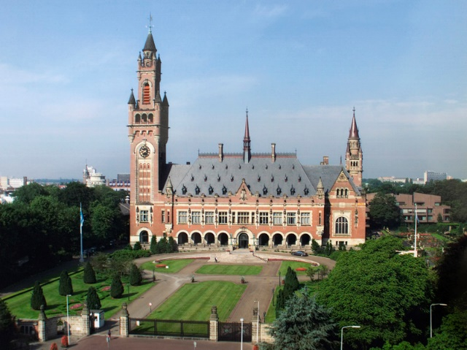
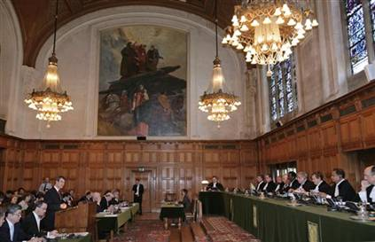
World Court
Created in 1945 (a part of the UN)
Handles cases where two countries are in conflict

Slide 8
World Trade Organization (WTO)
Located in Geneva, Switzerland
Created in 1995
160 countries are members
An organization that supervises trading throughout the world.
Overseeing trade agreements
Forum for trade negotiations
Handling trade disputes

Slide 9
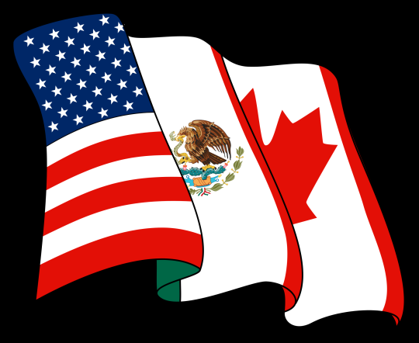
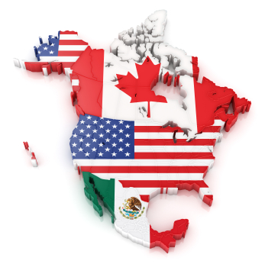
NAFTA (North American Free Trade Agreement)
Created in 1994
Countries involved: Canada, the United States, and Mexico
Created one of the world’s largest free trade zones and set the rules of trade and investment between Canada, the United States, and Mexico.

Slide 10
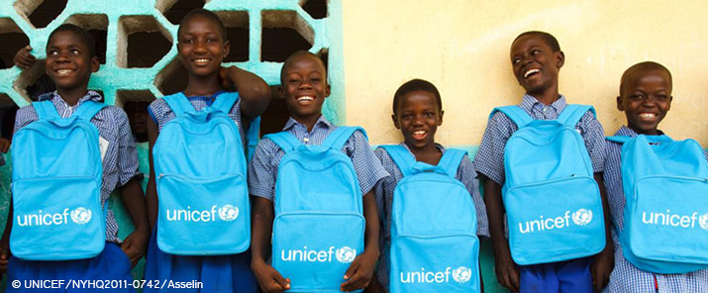
UNICEF (United Nations Children’s Fund)
An organization that works to help children around the world by promoting and offering:
Child survival (vaccines)
Development/education(easier access to school)
Protection (child abuse/labor/marriage)
Humanitarian aid
UNICEF

Slide 11
The United Nations (UN)
Year Founded: 1945
Current Number of countries Involved: 193
Reason the UN exists:
Keep the peace
create friendly relationships among countries

Slide 12
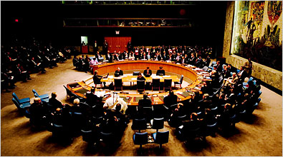
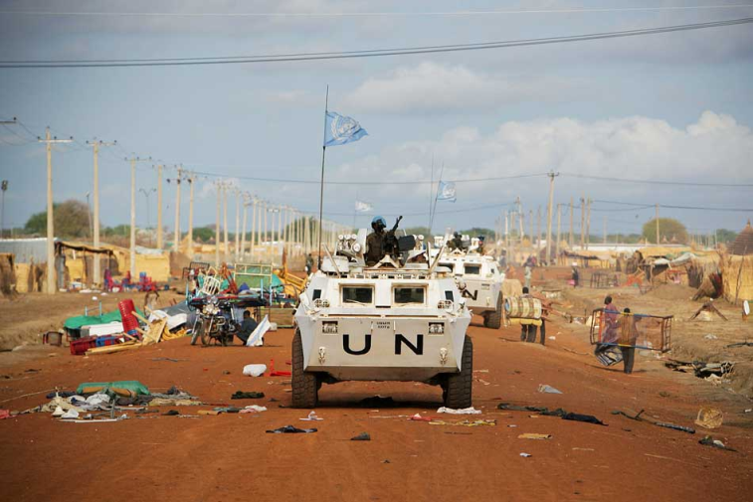
Main roles of the UN:
Peacekeeping
Bring stability and peace to troubled areas of the world
Improve the quality of life for the world’s poor
Example of what the UN does:
providing lunches to schools so families can keep their kids in school
UN peacekeepers (troops) protect aid workers and citizens from attacks in Congo.

Slide 13
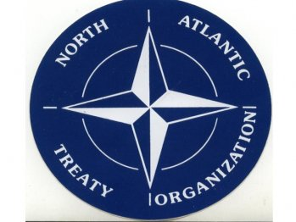
The North Atlantic Treaty Organization (NATO)
Year Founded: 1949
Current Number of countries Involved: _28_
Reason NATO exists:
Group of countries that will protect each other in case of attack

Slide 14
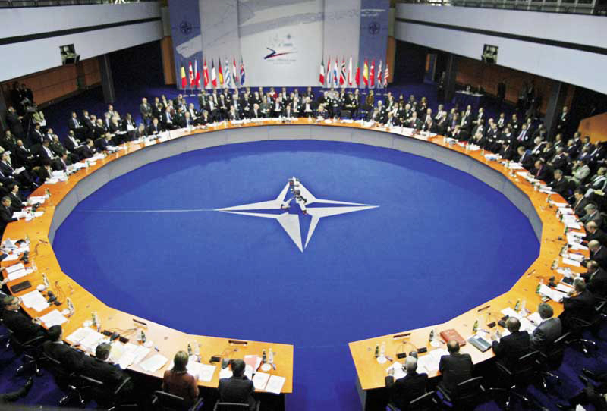
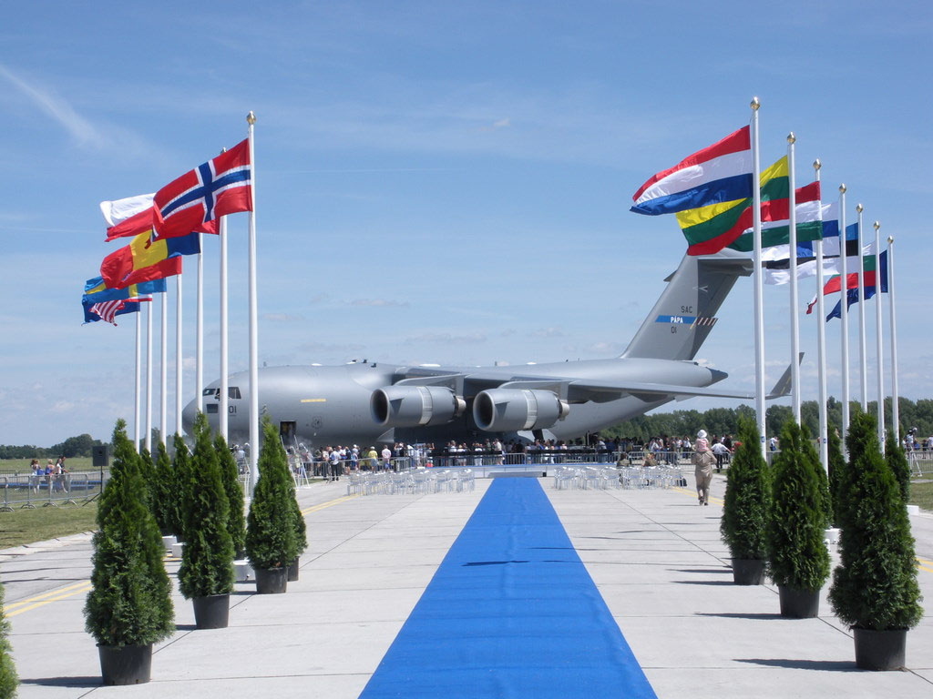
Main roles of NATO:
Help keep peace and security around the world
Help countries after a natural disaster
Example of what NATO does:
After a flood in Pakistan, NATO delivered supplies like generators, food, and blankets from its member countries
NATO troops in Afghanistan to help country maintain control

Slide 15
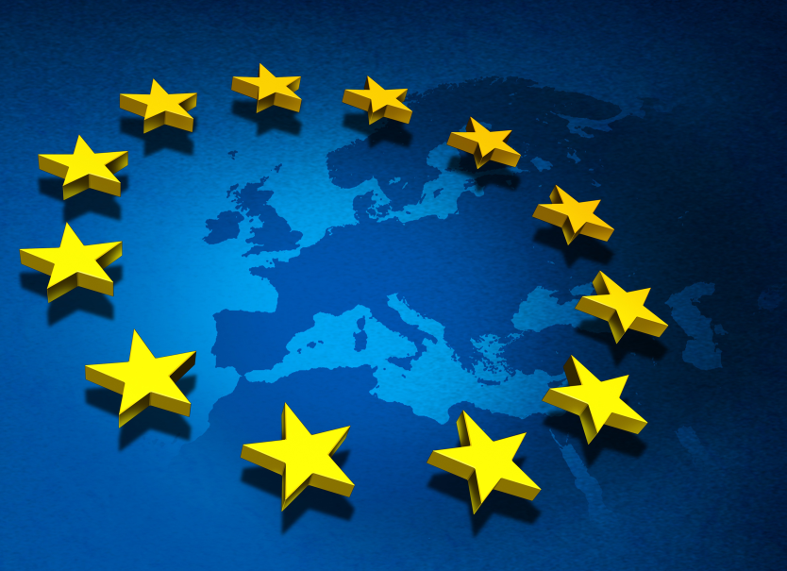
The European Union (EU)
Year Founded: __1951__
Current Number of countries Involved: _27_
Reason the EU exists:
Help European countries avoid conflict by making them dependent on each other

Slide 16
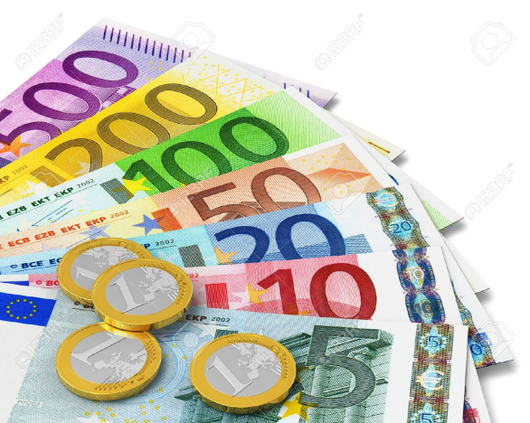
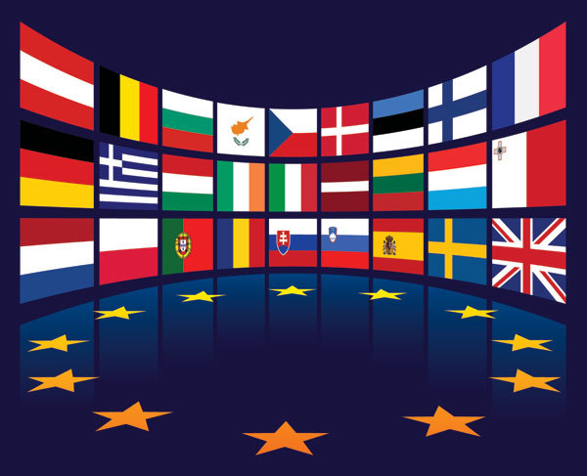
Main roles of the EU:
Create a single economy using the Euro
Act as a single voice in the world for its members
Give aid to countries around the world
Example of what the EU does:
Distributes food to people in the poorest countries in Africa
Negotiate peace between two countries

Slide 17
The World Bank
Year Founded: __1944__
Current Number of countries Involved: _187
Reason the World Bank exists:
Help poor and middle-income countries get money to make improvements to reduce poverty

Slide 18
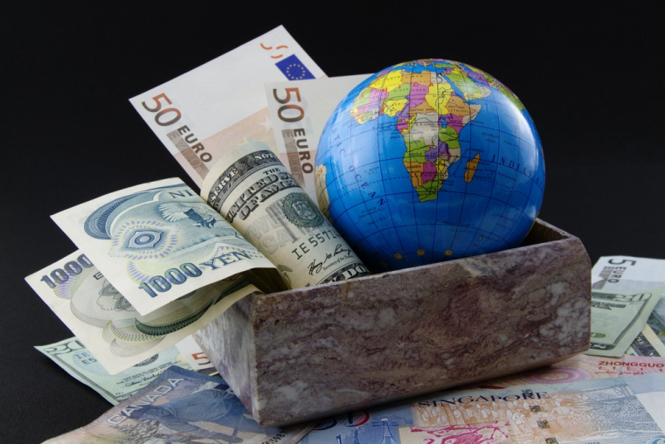
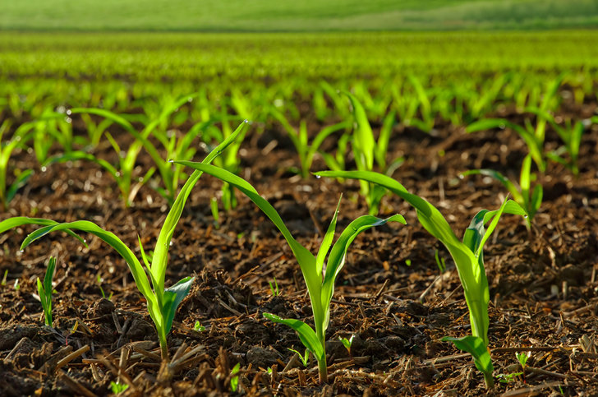
Main roles of the World Bank:
Improve living conditions in middle-income countries.
Improve conditions in the poorest countries.
Example of what the World Bank does:
Helped Ethiopia buy fertilizer to have a good growing season so that they could sell the crops at a cheaper rate.

Slide 19
The World Heath Organization (WHO)
Year Founded: __1948__
Current Number of countries Involved: _193
Reason the WHO exists:
Works to improve health around the entire world

Slide 20
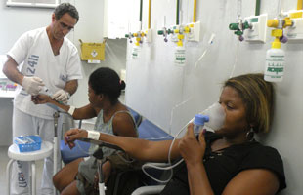
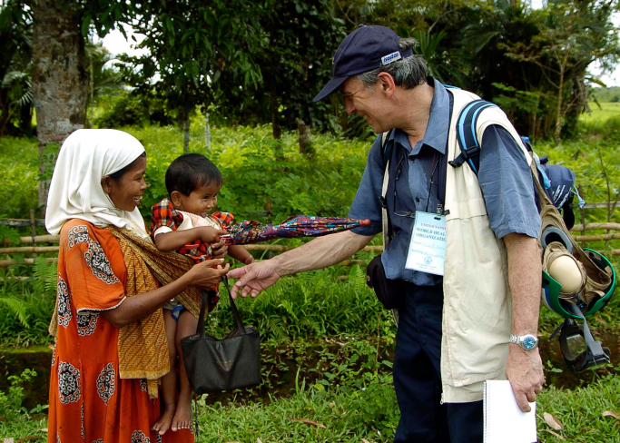
Main roles of the WHO:
Gather health data
Keep people healthy
Respond to crises
Example of what the WHO does:
Prevents diseases caused by mosquitos by conducting research
A part of UN

Slide 21
The Red Cross and Red Crescent
Year Founded: __1863__
Current Number of Countries Involved: _186
Reason the Red Cross/Red Crescent exists:
Help people around the world

Slide 22
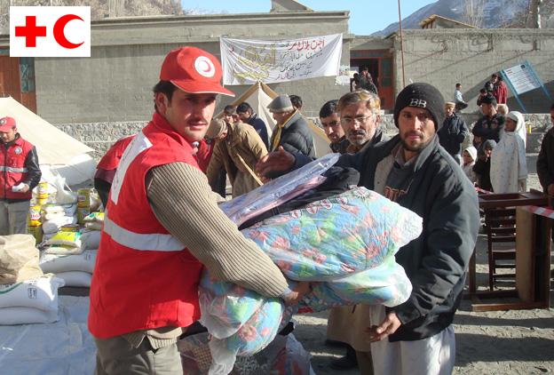
Main roles of the Red Cross/Red Crescent:
Respond to disasters
Run programs in local communities
Visiting prisoners of war
Example of what the Red Cross/Red Crescent does:
Visits prisoners of war and makes sure prisoners are healthy

Slide 23
Reflection Questions
What is one activity almost all the organizations you learned about are involved in doing?
They help poor people and countries in the world.
Why do you think countries might think this is an important thing to do?
What are two ways that we as citizens can help these organizations solve the issues in the world?
Volunteering
Donating

Slide 24
C- Level 1
H-Ask three before me, raise hand
A-Working on your review guide for your test (only on this assignment)
M-Only with permission
P-Working at a level one and working only on your study guide

