Slide 1
Forms and systems of government

Slide 2
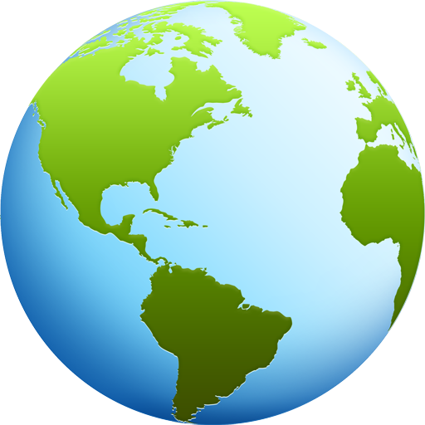
Every country in the world has their own type of government.
Each country’s government is unique and varies widely across the globe.
Each country’s government has been shaped by the traditional beliefs of its people and by their history.

Slide 3
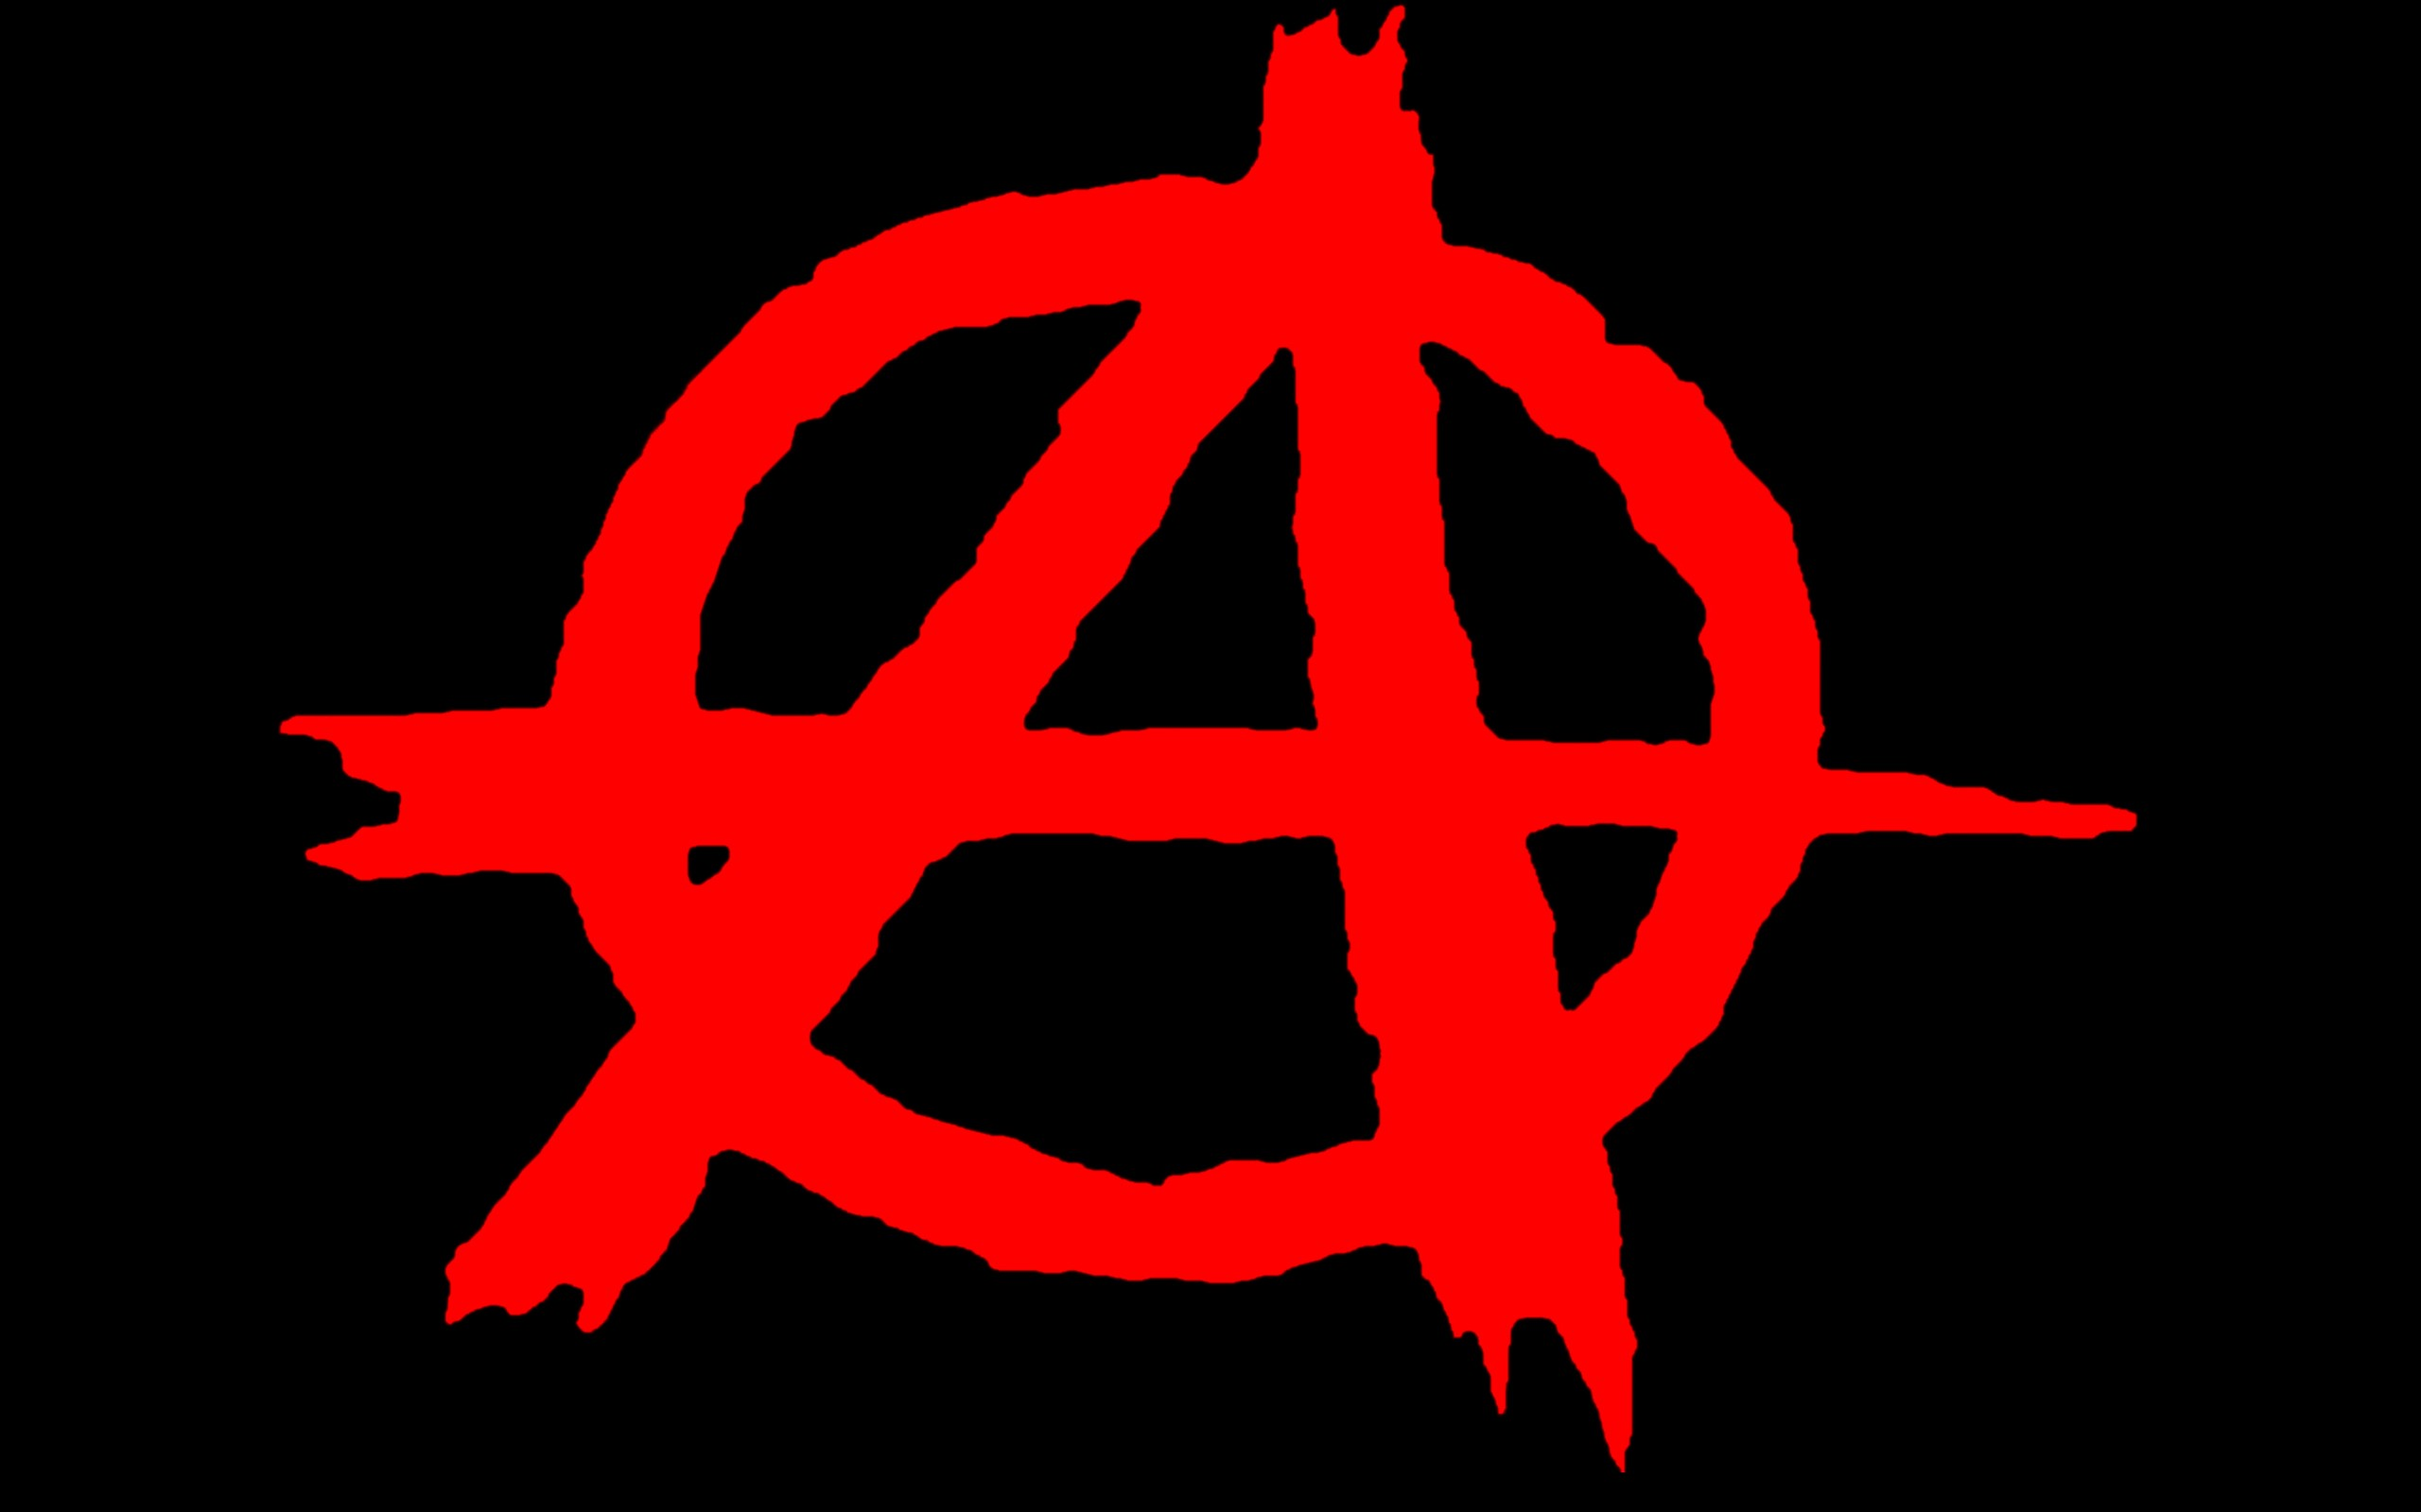
Anarchy
There is NO government- no one is in charge
This is what society was like before government
Think-Pair-Share:
What do you think life would have been like with no government?

Slide 4
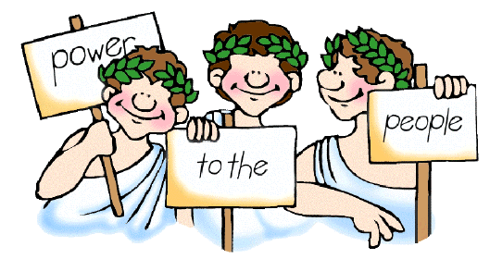
Democracy
Means ‘Rule of the People’- the government is accountable to the people
There are two kinds:
Direct
Representative Democracy/Republic

Slide 5
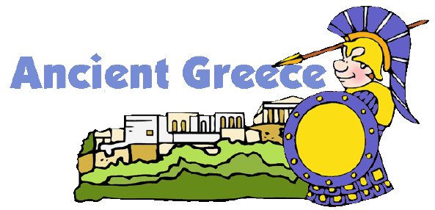
Direct democracy
Everyone plays a role in the day-to-day running of the government and everyone votes directly on all laws
Example:
Ancient Athens, Greece

Slide 6
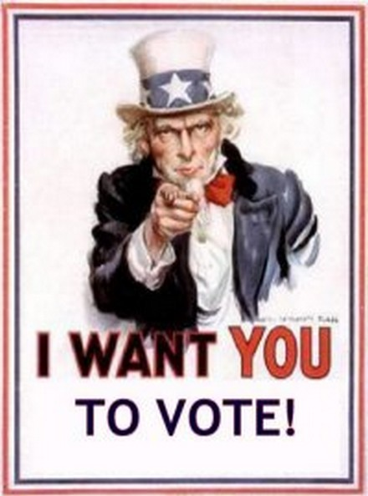
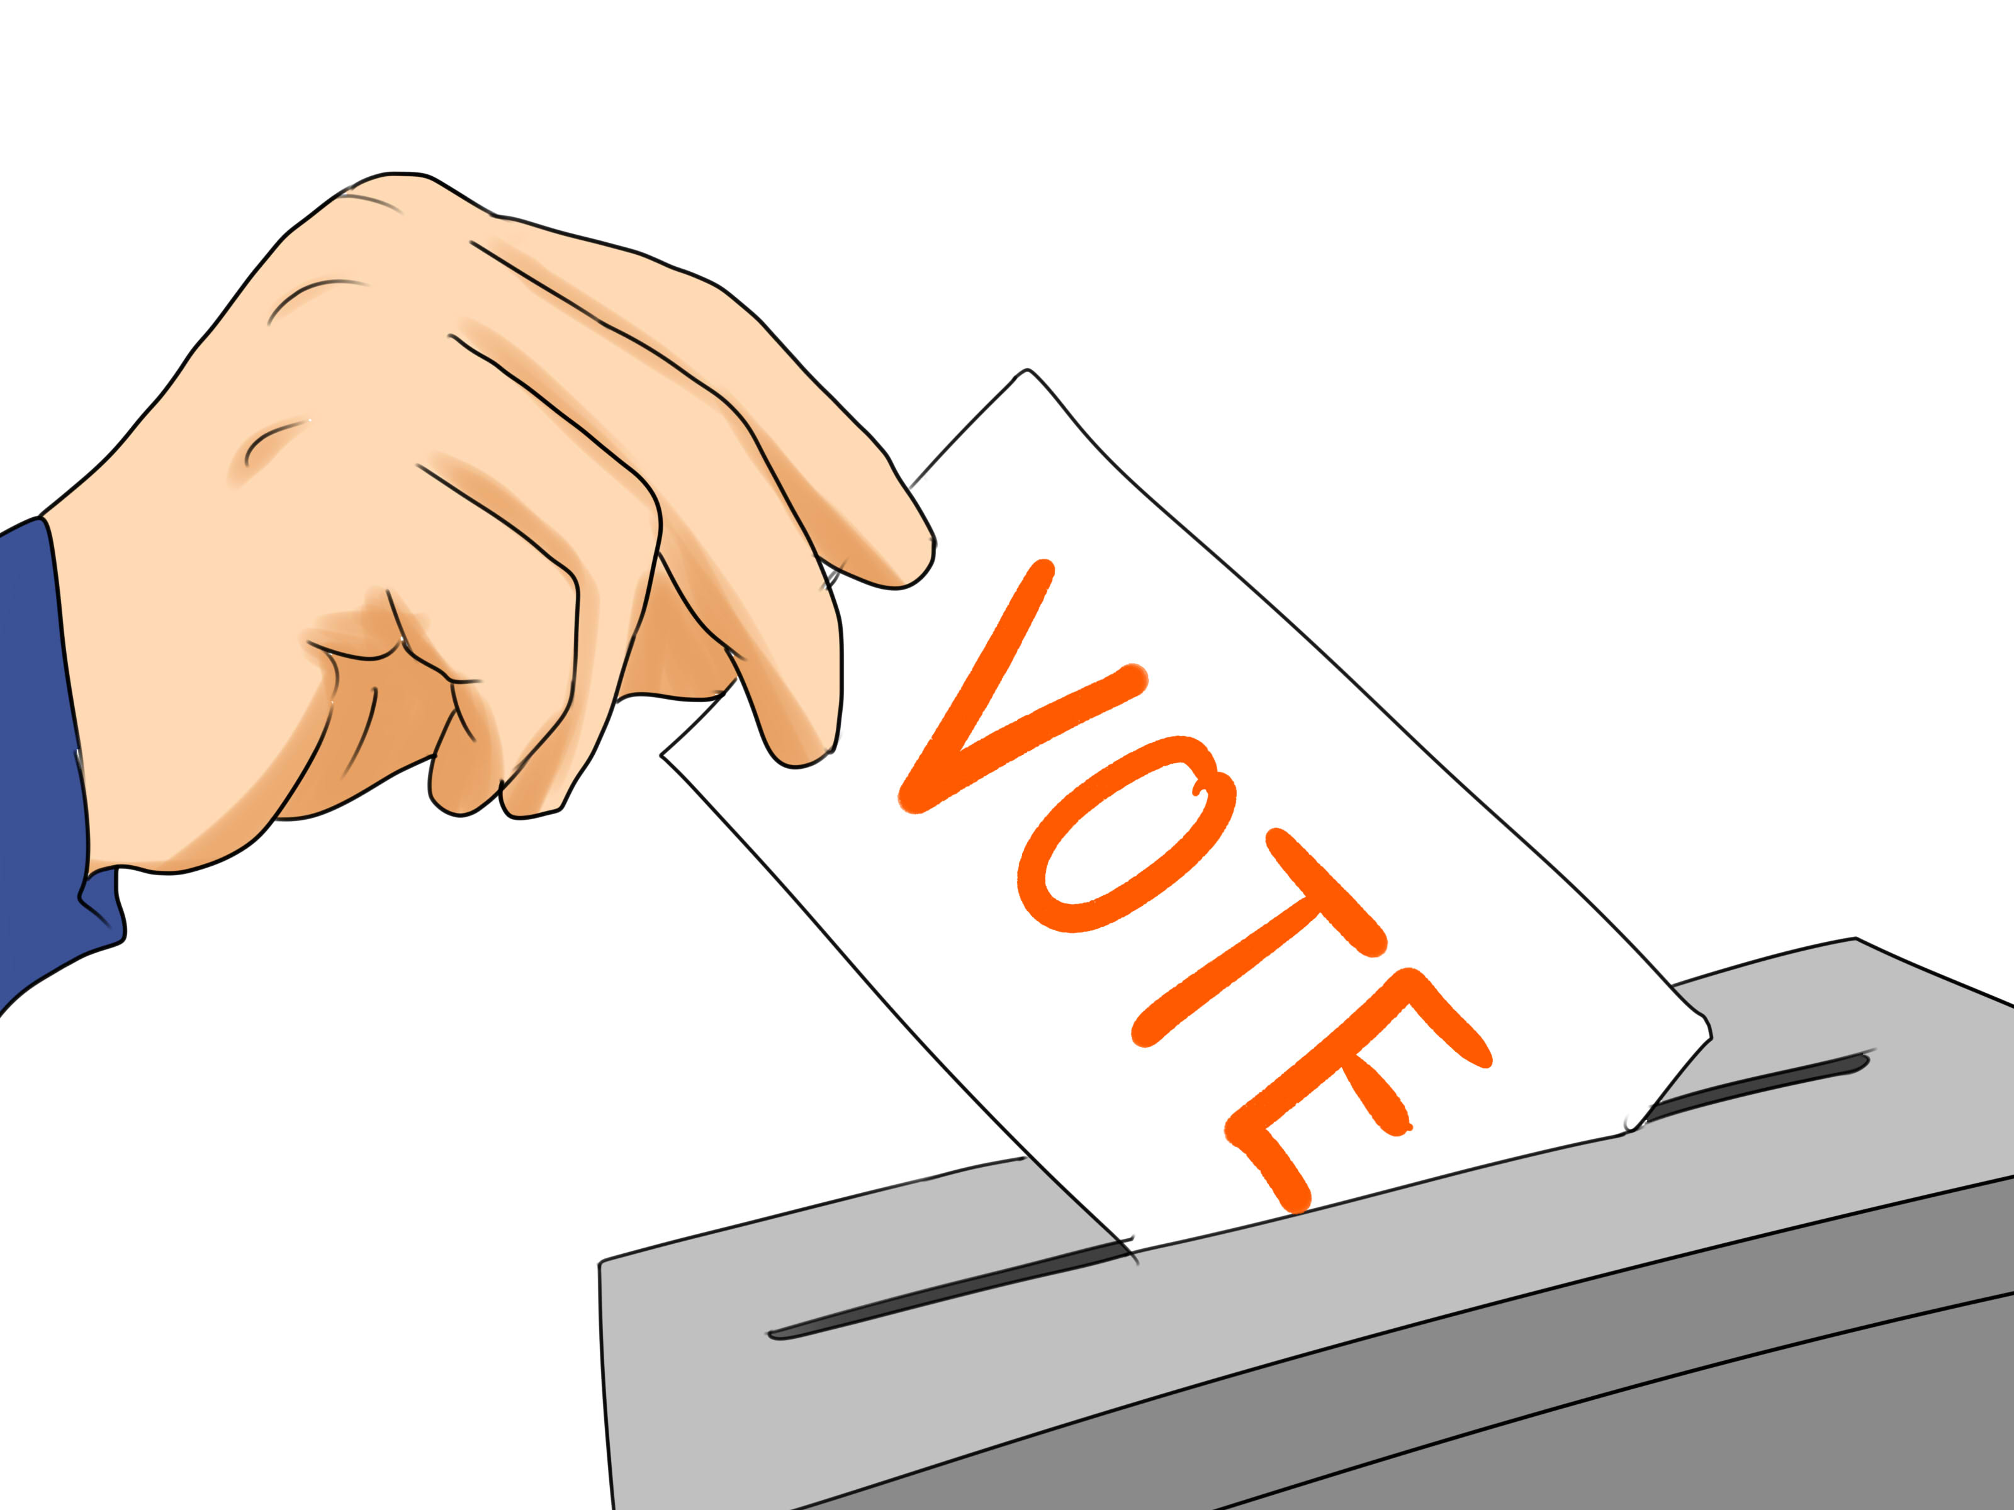
Representative Democracy (Republic)
Citizens elect representatives to vote on our behalf
Example:
The United States

Slide 7
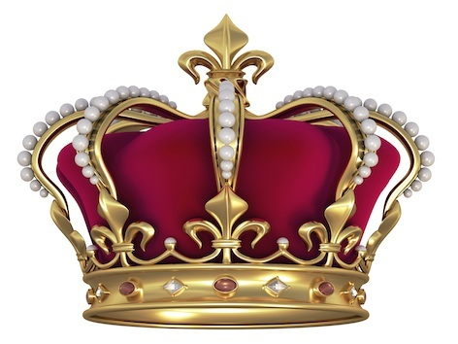
Monarchy
King or Queen has the power which is passed down by blood (inherited power)
Two kinds:
Absolute
Constitutional

Slide 8
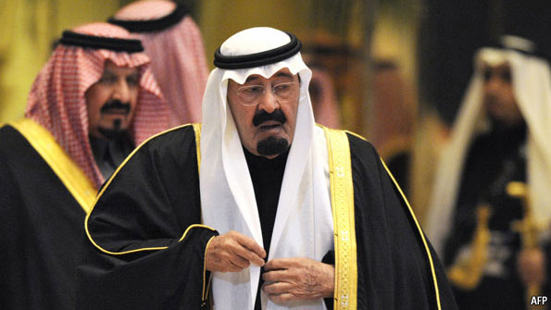
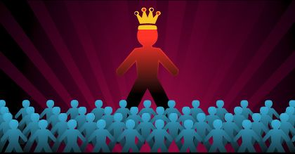
Absolute monarchy
King or Queen has absolute (complete) power
Example:
Saudi Arabia

Slide 9
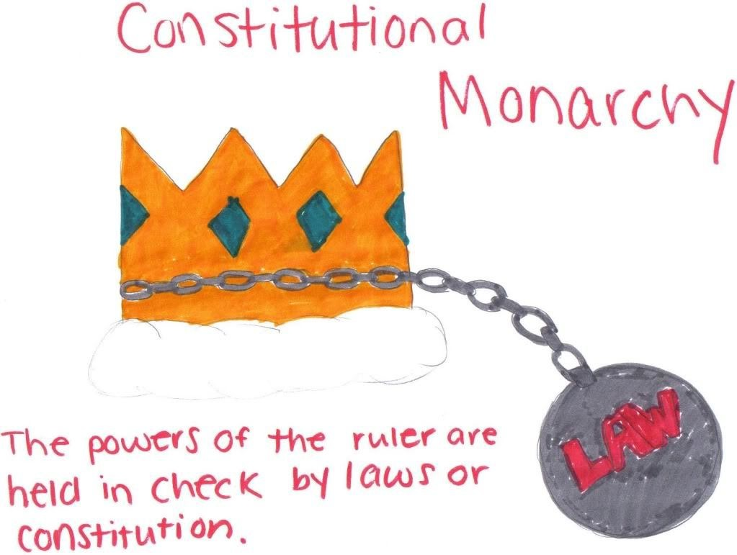
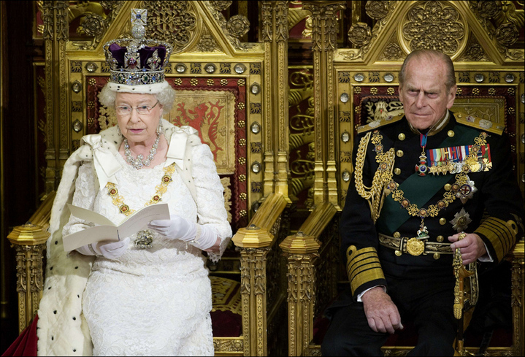
Constitutional monarchy
King or Queen’s power is limited by a Constitution
Example:
England

Slide 10
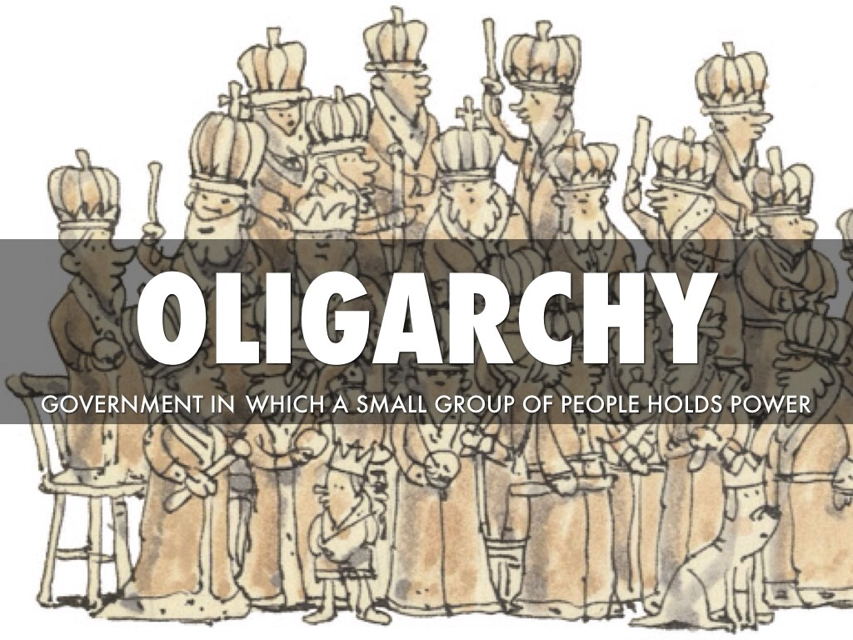
oligarchy
Rule by a small group, just a few, such as the wealthy class
Example:
South Africa (at one point only the white South Africans could vote or play a role in government)

Slide 11
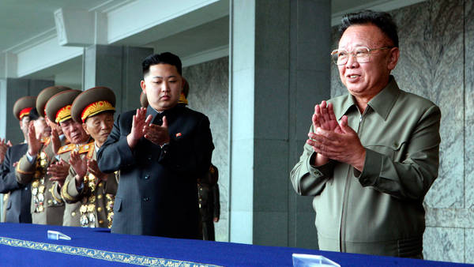
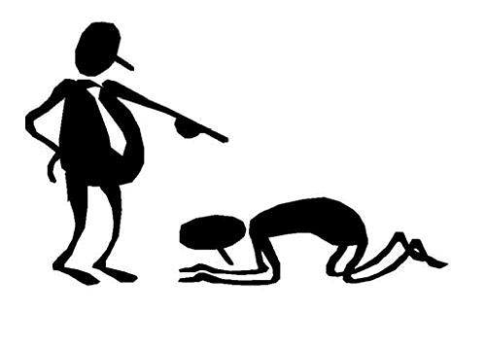
Autocracy
One ruler who has complete power (AKA Dictatorship)
Power is usually taken by force
Example:
North Korea

Slide 12
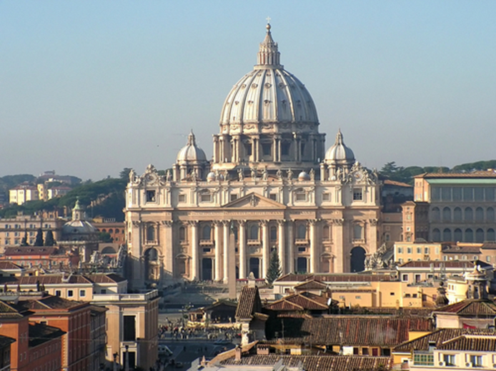
Theocracy
The government uses religious laws to rule the people
Example:
Iran
Vatican City

Slide 13
C- Level 1
H- Ask 3 before me
A- Working quietly with your partner to decide which form of government is being described.
M- None without permission
P- Quietly working with your partner on the assigned task only, staying focused
S-Success

Slide 14
Example: | Form of Government:
Some Native American tribes organize themselves by having all male adult members of the tribe vote to make changes to the laws.
In the 20th century, royalty have generally become symbols of national unity, while real power is usually held by elected officials who follow a constitution.
In England in 1215, a small group of wealthy, powerful men forced the king to share power with them.
Most of the leaders who started World War I were the few remaining absolute monarchs of Europe. In World War II, many who started the war were dictators, such as those in Germany, Japan, and Italy.
In early European history, government power was held by kings and queens who ruled with unlimited powers.
Direct Democracy/Oligarchy
Constitutional Monarchy
Oligarchy
Autocracy
Absolute Monarchy

Slide 15
Systems of Government

Slide 16
Parliamentary system
Parliament is the lawmaking body of a government that elects the prime minister (the leader) of the country
Example:
England

Slide 17
Federal
Power is shared with the central (national) government and the states
Example:
United States

Slide 18
Confederal
The power is given to the states and there is little or no central power

Slide 19
Unitary
Strong central government, power is not shared with any other level of government
Example:
North Korea

Slide 20
Example: | System of Government:
In New Zealand, the government is led by the legislature (lawmaking body) and the Prime Minister. The Prime Minister is the leader of the political party that has a majority of seats in the legislature.
2. Argentina’s federal government has an elected President, National Congress, and Supreme Court. Argentina has provinces, or states, that have their own constitutions and legislative, executive, and judicial powers. The central government shares powers with those provinces.
3. The European Union is a partnership among 27 countries in Europe. Everything that happens among those countries comes from treaties (formal agreements) agreed to by the members.
4. Japan has a strong central government. The legislative branch in Japan is called The Diet. The executive branch is led by the Prime Minister and lower ministers. The 47 provinces, or states, of Japan rely on the central government for money and support and have no power whatsoever.
Parliament
Federal
Confederal
Unitary

Slide 21
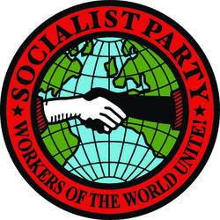
Socialism
Economic system where a country has power over all goods that are produced and provides everything for their people.
Most property and resources are owned and controlled by the government
Example:
Denmark
Canada

Slide 22
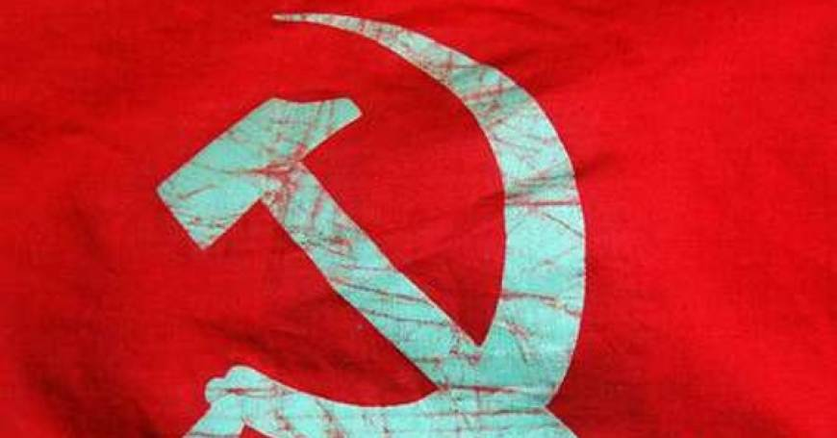
Communism
All property is owned by the community as a whole
All people work and there are no social classes- everyone is considered equal
Example:
Cuba
Soviet Union

