Slide 1
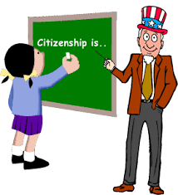
Citizenship…
Civics is the study of the rights and duties that citizens have. Civics is important because citizens need to know what rights are guaranteed to them and what is expected of them. One place to begin the study of civics is by looking at how someone becomes a citizen of the United States.

Slide 2
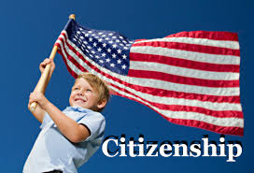
What is a citizen?
Citizen:
A legal member of a country and/or a state who has the full rights and responsibilities of that country

Slide 3
How do we know who is considered to be a U.S. citizen?
14th Amendment :
A change to the U. S. Constitution which:
defines citizenship
grants citizenship to former slaves

Slide 4
14th Amendment: What does it really say?
Section 1.
All persons born or naturalized in the United States, and subject to the jurisdiction thereof, are citizens of the United States and of the state wherein they reside. No state shall make or enforce any law which shall abridge the privileges or immunities of citizens of the United States; nor shall any state deprive any person of life, liberty, or property, without due process of law; nor deny to any person within its jurisdiction the equal protection of the laws.
Kids Law Version:
The 14th Amendment is a very important amendment that defines what it means to be a U.S. citizen and protects certain rights of the people. It gives individuals born in the United States – but especially at that time, African Americans – the right to citizenship. Before the 14th amendment, African Americans could not become citizens, which limited the rights of those who were able to escape slavery and become free. This clause allows all people born in the United States to be U.S. citizens. Once you have American citizenship, it cannot be taken from you by Congress or anyone else, unless you lie to the government during the process to get U.S. citizenship. Otherwise, everyone who becomes an American citizen stays an American citizen, unless they give it up themselves.

Slide 5
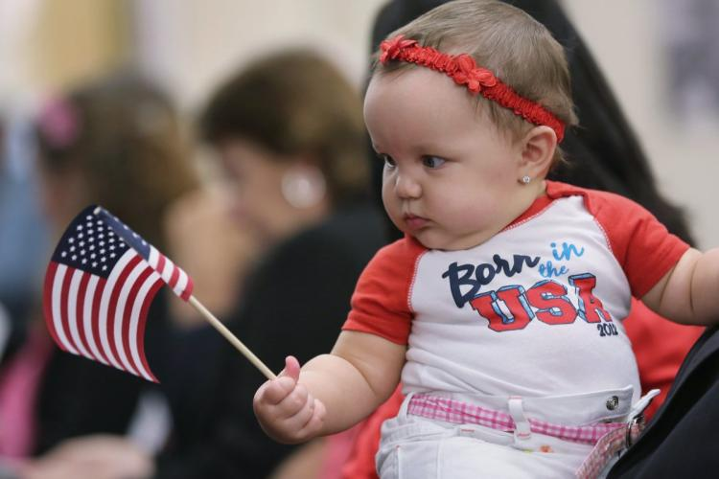
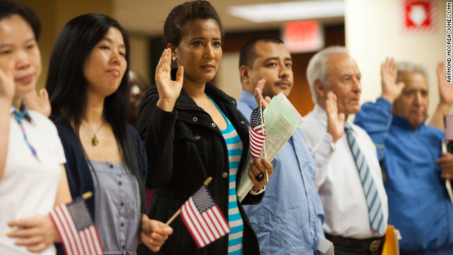
There are two ways to be a U.S. citizen:
To be BORN a U.S. citizen
To be NATURALIZED
OR

Slide 6
Natural Born Citizenship

Slide 7
How do you know if you were born a U.S. citizen?
You were born a U.S. citizen if you meet one of the following two requirements:
Law of Soil:
Law of Blood:
You were born…
In any of the 50 U.S. states,
On a U.S. military base overseas
In a U.S. territory (a country that is owned by or controlled by the U.S.)
You are a citizen by Soil
You were born…
overseas but at least one of your parents is a U.S. citizen
You are a citizen by blood (heredity)

Slide 8
Naturalized Citizen

Slide 9
Let’s say you don’t meet the Natural Born Citizenship requirements, is all hope lost for becoming a citizen?
No!!!
Immigrants (people who leave their home country to live in another permanently) can become naturalized citizens.
Resident: Someone who lives in a place for a minimum period of time.
In order to become a citizen, immigrants have to meet certain requirements through a process called naturalization.

Slide 10
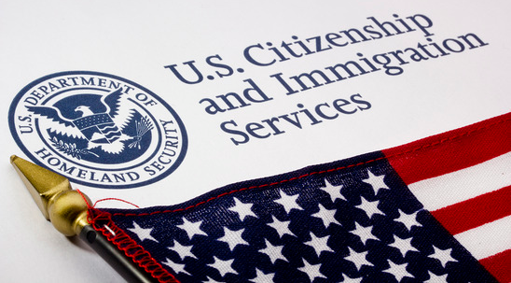
Naturalization Process:
Immigrants must:
Be at least 18 years old
Be a resident of the U.S. for at least 5 years
Be of good moral character
Be able to read and speak basic English
Pass an interview and a test on U.S. History and Government

Slide 11
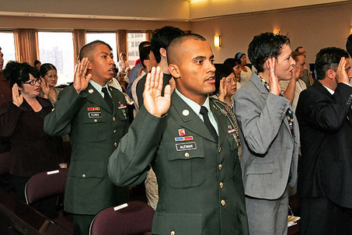
One last step…
Once an immigrant has met the other requirements, all that is left is for them to swear an oath of allegiance to the United States.
This is the most important step because it requires them to pledge their loyalty to only the United States.
http://www.whitehouse.gov/photos-and-video/video/2012/07/04/president-obama-speaks-naturalization-ceremony

Slide 12
Decide whether each person is already a citizen, eligible for naturalization, or must wait to apply.

Slide 16
CHAMPs for Naturalization Scenarios
C- Level 2
H- Raise your hand for me
A- You and your partner will work on analyzing the naturalization scenarios.
M- There will be no movement without permission
P- You are working at a level 1 with only your partner. You are only working on the naturalization scenarios.
S- Success!

Slide 17
Ways to keep your cards
Working and focusing on the task assigned only
Working cooperatively with only your partner
Working at a conversation level 2- I shouldn’t hear you across the room
Using your time wisely
Staying in your seat
Keeping hands off of the cards/not losing cards
You will start out with 20 participation points and 10 cards.
Each card is worth 2 points.
You lose 2 points for each card that is taken away.
If I take away the 10, you will have 18 points
If I take away the 9, you will have 16 points
If I take away the 8, you will have 14 points

Slide 18
Carlo has lived most of his life in Italy, but now he wants to become a U.S. citizen. He came to the United States three years ago, has been a legal resident ever since and has never been in trouble with the law, either in the United States or in Italy. He enjoys owning his own home and living in a wealthy neighborhood. Carlo is 25 years old, speaks English very well and has recently taken a class at local community college on U.S. history for new citizens.
1. Can Carlo become a citizen?
No, Carlo can’t become a citizen.
2. What advice can you give him?
Carlo needs to wait 2 more years before he can apply to become a citizen.
3. What qualifications does he already have for citizenship?
Carlo meets the age and good character requirements. He can also speak English and is learning about U.S. History.

Slide 19
Jin Ling has been a legal resident of San Francisco, California, for 20 years. All of her children and grandchildren are United States citizens. She is very loyal to the United States, has never been in trouble with the law and can speak English very well, even though she still speaks her native language, Mandarin. She has attended classes on U.S. history and received high grades. Sometimes she even surprises her grandchildren with her knowledge.
1. Can Jin Ling become a citizen?
Yes, Jin Ling can become a citizen.
2. What advice can you give her?
Jin Ling needs to apply for citizenship.
3. What qualifications does she already have for citizenship?
Jin Ling has been a legal resident for 20 years and is very loyal to the country and of good moral character. She also speaks English and is well versed in U.S. History.

Slide 20
Omar was a citizen of Afghanistan for most of his life. He came to the United States because he admires our country’s democratic principles. He moved to the United States and became a legal resident when he was 50 years old. He is now 60 years old. He speaks perfect English, knows and understands U.S. history, and is a law-abiding person. He has started his own grocery business. He believes he is qualified to become a citizen and has applied for an appointment with a judge.
1. Can Omar become a U.S. citizen?
Yes, Omar can become a citizen.
2. What advice can you give him?
Omar needs to apply for citizenship and to keep studying.
3. What qualifications does he already have for citizenship?
Omar has lived in the U.S. legally for 10 years. He speaks perfect English and knows and understands U.S. History. He also is of good moral character.

Slide 21
Mary is 17 years old and has lived with her parents as a legal resident for the past five years. Although she was born in Australia, she loves the United States and the wonderful lifestyle she and her family have worked so hard to achieve. She reads and speaks perfect English and has done well on all of her U.S. history courses in high school. She has worked at a local shoe store for the past year and has received several raises.
1. Can Mary become a U.S. citizen?
No, Mary can’t become a citizen.
2. What advice can you give her?
Mary needs to wait until she is 18 to apply for citizenship.
3. What qualifications does she already have for citizenship?
Mary has lived here for 5 years and speaks perfect English. She also understands U.S. History. She is of good character.

Slide 22
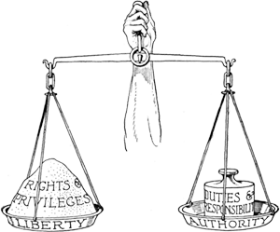
Duties/Obligations and Responsibilities for Citizens

Slide 23
Okay, so you’re a citizen… now what?

Slide 24
U.S. citizens have many more rights than many citizens of other countries; like the right to vote, but we also have certain responsibilities and obligations to fulfill…

Slide 25
A responsibility is something that we should do to help further the common good.
The common good (public good) is something that benefits the whole community, instead of what’s best for me, it’s what’s best for society…
Even though voting is considered a right, voting is also considered a responsibility. How does voting benefit the common good?
Obligations (also known as duties) are things we are required to do, and if we don’t, there are consequences- like jail time or fines.

Slide 26
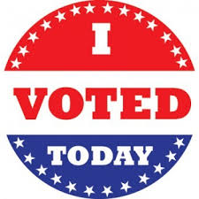
Responsibilities of Citizens
Voting and holding office
Community Service
Be informed/Understand what is going on in the country
Respect the opinions, beliefs, and way of life of others

Slide 27
Obligations of citizens:
Registering for the Selective Service (draft): All men 18-25 must sign up to defend our nation if called upon.
Paying Taxes: Taxes pay for large programs that benefit everyone (roads, schools and law enforcement)
Jury Duty: You must serve on a jury if called upon in order to protect your fellow citizens’ right to be tried by their peers.
Obeying Laws: Laws must be followed by everyone in order to maintain a safe and orderly community.

Slide 28
What are the consequences for not fulfilling a responsibility (like community service?)
Your community doesn’t benefit.
What are the consequences for not fulfilling a duty (like paying taxes?)
Both you and your community suffer because you can face a fine or go to jail, and your community doesn’t get to have programs and services like schools or law enforcement.

Slide 29
Exit Ticket:
On the bottom of your notes page, answer the following in complete sentences:
Imagine a world without citizen responsibilities, what would the world look like, how would people act?

Slide 30
Exit Ticket:
Do you think that the U.S. expects too much or too little of its citizens? Should certain responsibilities such as voting or military service be required of all citizens?

