Slide 1
Think-Pair-Share:
Where does the government get its instructions?
How do Congress, the President, and the Supreme Court know what to do?

Slide 2
Anatomy of the constitution

Slide 3
I can describe the following parts of the Constitution:

Slide 4
Article I:
Created the Legislative Branch (Congress)
Congress is bicameral:
Divided into two parts-
Senate and House of Representatives
Describes Congress’s powers
Ex: make laws, declare war, print money
Describes checks on other branches
Describes qualifications to serve in Congress

Slide 5
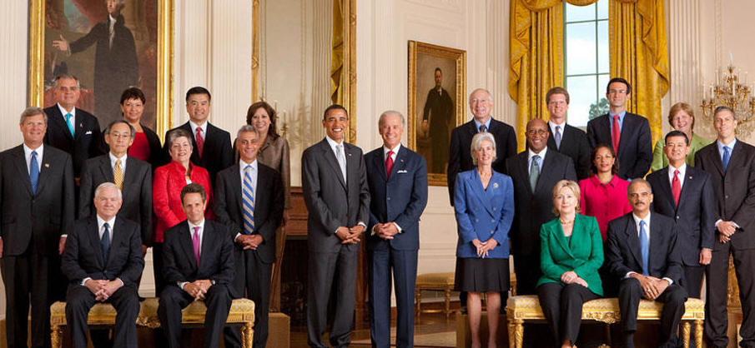
Article II:
Created the Executive Branch
President, Vice President, Cabinet (presidential advisors), and Departments
Describes the President’s powers
Ex: executes (carries out) laws, make treaties, appoint government officials to positions
Describes checks on other branches
Describes qualifications to be President

Slide 6
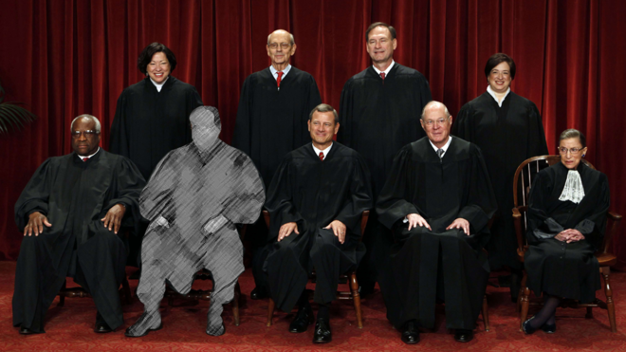
Article III:
Created the Judicial Branch
9 Justices (judges) of the Supreme Court, and Federal Courts
Describes the Court’s powers
Ex: to interpret the laws to determine if they violate the constitution or not
Describes checks on other branches
Explains that Federal judges and Supreme Court Justices are appointed to their position

Slide 7
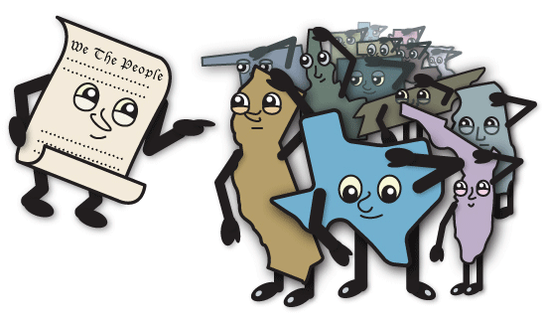
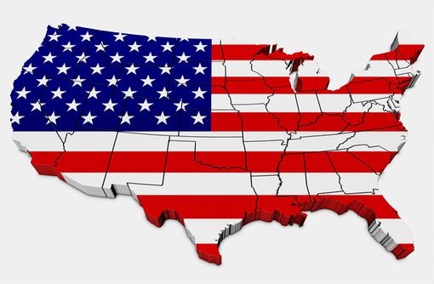
Article IV:
States’ Powers
States have the power to create and enforce their own laws (as long as it doesn’t contradict the Constitution)
All states must have a representative government

Slide 8
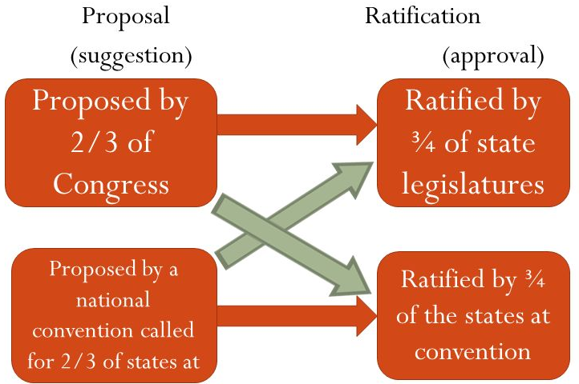
Article V:
Describes how to amend the Constitution
Amendments are changes to the Constitution (there are 27)

Slide 9
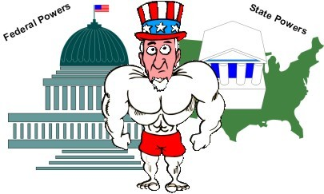
Article VI:
Supremacy Clause:
The Constitution is the highest law in the land, meaning state laws can’t disagree with federal laws (federalism)

Slide 10
Article VII:
Ratification:
To ratify means to pass- 9 out of 13 states had to approve of the Constitution before it could be ratified.

Slide 11
I can define the principles of Separation of Powers and Checks and Balances

Slide 12
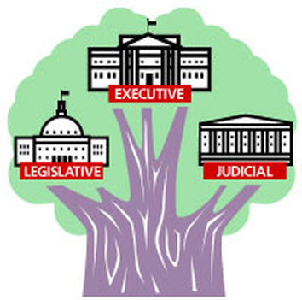
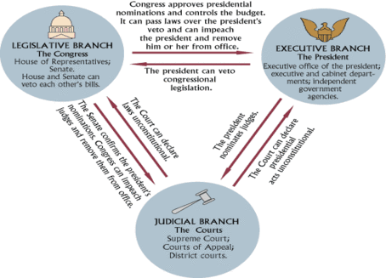
Separation of Powers:
The structure of the government that sets up three branches with their own distinct powers and responsibilities.
Checks and Balances:
A principle of the government that allows each branch of government to limit the power of the other branches.

Slide 13
I can identify how each branch checks the powers of the others

Slide 14
Legislative Branch (Makes the Law)
Can check the Power of the Executive Branch (President) by:
Overriding a presidential veto on a bill (2/3’s vote)
Impeaching or removing the president
Approving/Not Approving treaties (Senate Only)
Approving/Not Approving Presidential Appointments (Senate Only)
Can check the power of the Judicial Branch by:
Approving/Not Approving of appointments to the Court
Impeaching or removing justices

Slide 15
Executive Branch (Enforces the Law)
Can check the power of the Legislative Branch (Congress) by:
Proposing new laws (Executive Order/Actions)
Vetoing/rejecting bills
Can check the power of the Judicial Branch (Supreme Court) by:
Appointing Justices

Slide 16
Judicial Branch (Interprets the Law)
Can check the power of the Legislative Branch by:
Declaring laws unconstitutional
Can check the power of the Executive Branch by:
Declaring executive actions unconstitutional

Slide 17
Add on a sheet of paper and attach to your notes:
Enumerated/Delegated/Expressed Powers: Specifically listed/written in the Constitution
Congress has the power to declare war (Article I, Section 8)
The President has the power to make treaties (Article II, Section 2.
Implied Powers: Powers that aren’t written in the Constitution but are necessary in order to perform other functions of government.
Military draft is needed to create and maintain a military
Creating an income tax is needed in order to collect taxes

Slide 18
Who’s Got the Power? Chart
You will be working with your partner in order to complete the chart by identifying which branch of government possesses each of the powers listed.
You will need to find where the power is listed in the “Excerpts of Articles I, II, and II of the Constitution”, highlight the power in the reading and mark the number from the activity sheet on the reading.
You will then need to write on the activity sheet the Article and Section from the Constitution where you found evidence to justify your answer.

Slide 19
C- Level 1
H- Raise your hand
A- Working with only your partner to identify who the powers listed belong to.
M- None without permission
P- Quietly working on this assignment only
S- Success
Cards:
20 points, each card = 2pts
You can lose cards by:
Being above a level 1
Talking off topic or to another group
Being out of your seat without permission
Touching the cards/popping rubber bands
Working on another assignment

